Slide 1
Quality Improvement Community of Learning
August 21, 2023
3:00-4:00 pm ET

Slide 2
Welcome!
Thank you for joining the call! We will get started shortly.
You may be muted upon entry to the call
You DO have the ability to unmute yourself
We encourage participants to remain muted in an effort to reduce background noise
This presentation will be recorded

Slide 3
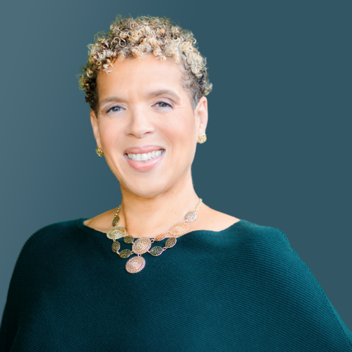


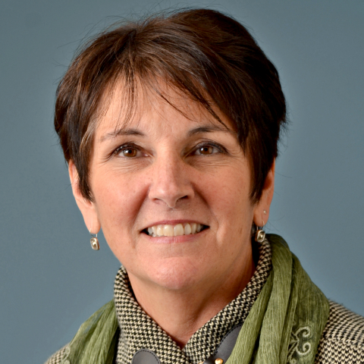
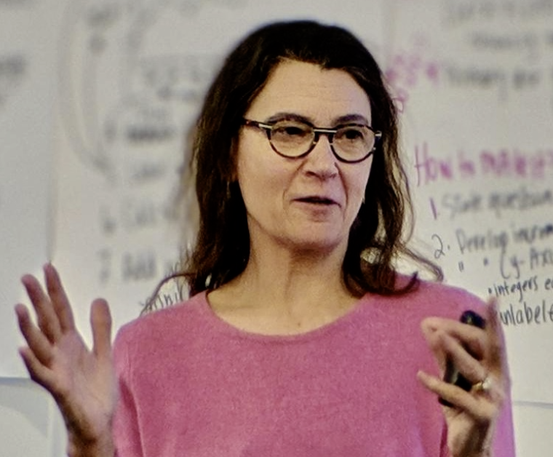
The NICHQ Team
Stacey C. Penny, MSW, MPH
Senior Project Director
Callie Rowland, MPH
Project Manager
Rinka Murakami, MPH
Analyst, Applied Research & Evaluation
Sue Butts-Dion
Improvement Advisor
Jane Taylor, EdD
Improvement Advisor
The faculty have nothing to disclose.
Notes:
Stacy

Slide 4
Objectives of the QI Workshop Series
Introduce you to quality improvement basics for those new to quality improvement (QI) and offer you an opportunity to practice improvement skills and receive feedback and engage deeper with office hours. We are supporting your learning in
Laying a foundation for learning and improving
Developing improvement capability for your PQC, and other state or hospital-based teams
Applying QI principles to your existing projects
JAT
Notes:
The Quality Improvement Community of Learning (QI CoL) is a learning series to develop foundational knowledge and skills for professionals engaged with PQCs and other state-or hospital-based QI teams who are new to QI. The 2023 QI CoL will run twice (beginning in January and May) and will provide participants with the opportunity to apply QI principles to their existing projects, such as The Model for Improvement, Plan Do Study Act (PDSA) cycles, using data for improvement, spreading improvement, and sustainability.

Slide 5
So far . . .
We have covered:
Quality improvement—what it is
Setting aims
Testing changes using PDSA cycles
Using data for learning and improvement
Run charts and run chart rules
And we have:
Provided office hours assistance
Targeted coaching and feedback upon request

Slide 6
QI Community of Learning Overview
Session Title | Date and Time
Quality Improvement: What and Why? Foundations of Improvement | Thursday, May 25th 2023 3:00 – 4:00 PM ET
Activating the How Using PDSA Cycles to Learn and Improve | Monday, June 12th 2023 3:00 – 4:00 PM ET
Measurement for Improvement Collecting, Displaying, and Analyzing Data for Learning and Improvement | Monday, July 10th 3:00 – 4:00 PM ET
Holding the Gains and Spread Sustaining Improvement and Cohort Learning | Monday, August 21st 3:00 – 4:00 PM ET
Be sure to add all webinars to your calendar if you have not already done so!

Slide 7
Today’s Agenda
Welcome
Implementation
Holding and Sustaining the Gains
Spreading Changes that work

Slide 8
Discussion Questions
As we move through the workshop today consider:
How will you coach your team(s) to move from testing small to implementation?
What are key activities needed for implementation?
What are the key activities needed for spread?
How do the key activities differ?

Slide 9
Preworkshop Poll
The difference between implementation and spread is a question of scale. True or false?
If a team cannot hold their gains they should:
a. start measuring
b. reconvene the team to regain their results
c. wait to see if things improve
The most important components of spread are:
a. selecting the first spread recipients
b. packaging the changes that worked
c. supporting spread recipients with technical assistance
d. getting feedback from the spread sites
e. leadership support
f. none of the above
g. all of the above.

Slide 10
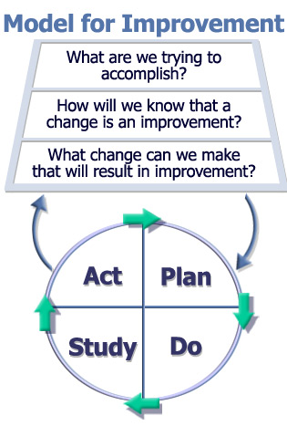
Model for Improvement
Source: Langley, et al, The Improvement Guide, 2009
SBD

Slide 11

The Sequence for Improvement and Spread
Make part of routine operations
Spreading a change to other systems
Test under a variety of conditions
Implementing a change; Holding Gains
Theory and Prediction
Testing a change
Act
Plan
Developing a change
Study
Do
IHI.org Impact Community
Notes:
Not always so linear inside an entire project

Slide 12
Different stages require different activities
Testing
Trying and adapting a change.
Learning what works in your system.
Start on a small scale and expand to wider range of conditions, as knowledge grows.
Change is not permanent
Failure very useful here, even expected
Fewer people impacted than during implementation
Implementing
Making this change a part of the routine day-to-day operation of the system in your pilot population.
Don’t expect failure here
More people impacted than during testing
Increased resistance compared to testing
Generally, requires more time than testing

Slide 13
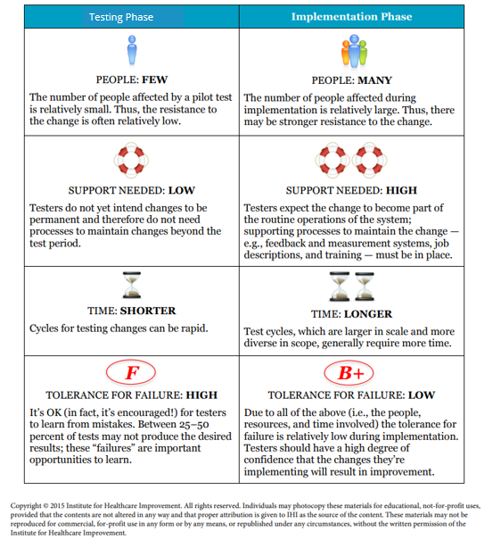

Slide 14
Implementation Considerations
Buy-in
Policies and documentation
Hiring procedures and requirements
Staff education/training
Job descriptions, evaluation, compensation
Information flow
Equipment, supplies purchasing
Ongoing measurement

Slide 15
Our Baseline

Slide 16
We hit our target . . .

Slide 17
We are improving!
Percent

Slide 18
Holding our Gains!

Slide 19

Worksheet: Considerations for Sustainability
Attribute | Notes on Questions
Measurement What would we continue to measure? What would we stop measuring? What is our plan if we see a negative signal (aka special cause variation)?
Ownership Who will own the new standard work? Are they engaged and onboard with our improvement work?
Communication and Training How will we communicate about this work? Who will be the messengers? How will we support individuals in the “new right way”? What type of training will we use?
Hardwiring the Change & Build the Infrastructure How will we make it hard to do the wrong thing and easy to do the right thing? How will we standardize? Can we reduce reliance on human memory? What about documentation. Do we have all the resources needed?
Assessment of Workload Are our changes increasing the overall workload to the system? If so, how can we decrease the workload? If not, how will we communicate about what is changing and not changing?
Source: Institute for Healthcare Improvement
Notes:
Worksheet to achieve and maintain change. Show the slide that shows the progression of measurement.

Slide 20
The Sequence for Improvement and Spread
Make part of routine operations
Spreading a change to other systems
Test under a variety of conditions
Implementing a change; Holding Gains
Theory and Prediction
Testing a change
Act
Plan
Developing a change
Study
Do
IHI.org Impact Community
Notes:
Not always so linear inside an entire project

Slide 21
Scale up and Spread
Scale up
Overcoming system and infrastructure issues that arise during both implementation and spread to secure results at the system level
Spread
Taking a new system or intervention and replicating it at other locations

Slide 22
IHI Breakthrough Series (6–18 Months)
IHI’s BTS is a
spread model!
Participants (10–100 Teams)
Select Topic (Develop Mission)
Prework
Dissemination Publications, Congress, etc.
P
P
P
Develop
Framework
& Changes
A
D
A
D
A
D
Expert Meeting
S
S
S
LS 1
LS 2
LS 3
Holding the Gains
Planning Group
AP1
AP2
AP3*
LS = Learning Session
AP = Action Period
Supports
Email Phone Conferences Visits
Extranet Assessments
Sponsors Team Reports (Monthly)
*Continue reporting data as needed to document success
Notes:
4
4
4
This is our model--engine.We aren’t sure how many times you will see this---but it will be a lot!!
At the BTS College we will go thru it in more detail…in fact…its our roadmap thru the 3 days..but today let’s do an overview of the model.
Topic selection is our start point….ripe topic..one important to work on..and we know how to get improvement
Expert meeting—get together subject matter experts to harvest key changes that we know work…get some initial ideas on appropriate breakthrough goals and on possible measures for the Collaborative teams to use
Developing the framework means getting the charter, goals, measures and package fo changes ready to be used by the teams
At the 3 learning sessions subject matter experts share the changes in depth and help teams plan how to test/adapt them at their orgs. At LS 2 and 3 more time is spent on the teams sharing/teaching and less on the faculty
AP—where the action is…full of testing changes, adapting…implementing
At the end of the collaborative some collaboratives hold a Congress…nationally..or for the sponsoring orgs…others commit to publish
HTG…6 months post end of collaborative teams report results again and update their work
Support system…ongoing
Topic Selection: IHI leaders identify a particular area or issue in health care that is ripe for improvement:
existing knowledge is sound but not widely used, better results have been demonstrated in realworld
settings, and current defect rates affect many patients somewhat, or at least a few patients
profoundly.
Faculty Recruitment: IHI identifies 5 to 15 experts in the relevant disciplines, including international
subject matter experts as well as application experts, individual clinicians who have demonstrated
breakthrough performance in their own practice. One expert is asked to chair the Collaborative and
is responsible for establishing the vision of a new system of care, providing faculty leadership, and
teaching and coaching the participating teams. Typically, chairs devote one or two days per week for
the duration of the Collaborative. The chair and the expert faculty assist IHI in creating the specific
content for the Collaborative, including appropriate aims, measurement strategies, and a list of
© 2003 Institute for Healthcare Improvement
LS1 LS2 LS3
Summative
Congresses and
Publications AP1 AP2 AP3
Supports:
Email • Visits • Phone Conferences • Monthly Team Reports • Assessments
A
D
P
S
A
D
P
S
A
D
P
S
Enroll
Participants
Prework
Develop
Framework
and Changes
Select Topic
Recruit Faculty
LS1: Learning Session
AP: Action Period
P-D-S-A: Plan-Do-Study-Act
Institute for Healthcare Improvement Cambridge, Massachusetts 6
evidence-based changes. An Improvement Advisor teaches and coaches teams on improvement
methods and how to apply them in local settings.
Enrollment of Participating Organizations and Teams: Organizations elect to join a Collaborative
through an application process, appointing multidisciplinary teams within the organization
charged to learn from the Collaborative process, conduct small-scale tests of change, and help
successful changes become standard practices. Senior leaders from participating organizations are
expected to guide, support, and encourage the improvement teams, and to bear responsibility for
the sustainability of the teams’ effective changes. To help teams prepare for the start of the
Collaborative, IHI conducts prework conference calls to clarify the Collaborative processes, roles,
and expectations of organization leaders and team members. IHI traditionally accepts all applicants
who agree to commit to these expectations.
Learning Sessions: Traditional Learning Sessions are face-to-face meetings, usually three of which
are conducted during a typical Collaborative, bringing together multidisciplinary teams from each
organization and the expert faculty to exchange ideas. At the first Learning Session, expert faculty
present a vision for ideal care in the topic area and specific changes, called a Change Package, that
when applied locally will improve significantly the system’s performance. Teams learn from an
Improvement Advisor the Model for Improvement (described below) that enables teams to test these
powerful change ideas locally, and then reflect, learn, and refine these tests. At the second and third
Learning Sessions, team members learn even more from one another as they report on successes,
barriers, and lessons learned in general sessions, workshops, storyboard presentations, and informal
dialogue and exchange. Formal academic knowledge is bolstered by the practical voices of peers who
can say, “I had the same problem; let me tell you how I solved it.”
Action Periods: During Action Periods between the Learning Sessions, teams test and implement
changes in their local settings—and collect data to measure the impact of the changes. They submit
monthly progress reports for the entire Collaborative to review, and are supported by conference
calls, peer site visits, and Web-based discussions that enable them to share information and learn
from national experts and other health care organizations. The aim is to build collaboration and
support the organizations as they try out new ideas, even at a distance.
The Model for Improvement: To apply changes in their local settings, Collaborative participants
learn an approach for organizing and carrying out their improvement work, called the Model
for Improvement (Figure 3). This model, developed by Associates in Process Improvement
(The Improvement Guide, Jossey-Bass, 1996), identifies four key elements of successful process
improvement: specific and measurable aims, measures of improvement that are tracked over
time, key changes that will result in the desired improvement, and a series of testing “cycles”
during which teams learn how to apply key change ideas to their own organizations.
© 2003 Institute for Healthcare Improvement
7 The Breakthrough Series: IHI’s Collaborative Model for Achieving Breakthrough Improvement
The Model for Improvement requires Collaborative teams to ask
three questions:
1. What are we trying to accomplish? (Aim) Here, participants
determine which specific outcomes they are trying to change
through their work.
2. How will we know that a change is an improvement?
(Measures) Here, team members identify appropriate measures
to track their success.
3. What changes can we make that will result in improvement?
(Changes) Here, teams identify key changes that they will
actually test.
Key changes are then implemented in a cyclical fashion: teams
thoroughly plan to test the change, taking into account cultural
and organizational characteristics; they do the work to make
the change in their standard procedures, tracking their progress
using quantitative measures; they closely study the results of
their work for insight on how to do better; and they act to
make the successful changes permanent or to adjust the
changes that need more work. This process continues serially
over time and refinement is added with each cycle; these are
known as “Plan-Do-Study-Act” (PDSA) cycles of learning
(Figure 4).
© 2003 Institute for Healthcare Improvement
A
D
P
S
A
D
P
S
S
P
A
D
D
A
S
P
Hunches,
theories,
and ideas
Changes that
result in
improvement
What are we trying
to accomplish?
How will we know that a
change is improvement?
What changes can we
make that will result
in improvement?
Do
Act
Study
Plan
Figure 3. Model for Improvement
Figure 4. Multiple PDSA Cycles
Institute for Healthcare Improvement Cambridge, Massachusetts 8
Summative Congresses and Publications: Once the Collaborative is complete, the work is documented
and teams present their results and lessons learned to individuals from non-participating organizations
at national and international conferences and meetings.
Measurement and Evaluation: Collaboratives involve regular measurement and assessment. All teams
are required to maintain run charts tracking their system measures over time and key faculty members
review each team’s monthly report to assess the overall progress of the Collaborative.

Slide 23
The IHI Breakthrough Series Collaborative
An improvement method that relies on spread and adaptation of existing knowledge to multiple settings to accomplish a common aim.
S
Notes:
So what do mean by BTS Style Collaborative? It is an improvement method…..
Spread: method to adapt and spread
So, we have existing knowledge on the subject..we know what works
We want to adapt it and get it to work in multiple settings…so this is not a single team….
Is multiple teams working on common topic with common aim

Slide 24
Everett Rogers Adopter Categorization:
Innovators
Early Adopters
Early Majority
Late Majority
Laggards (Traditionalists)
2%
13%
35%
35%
15%

Slide 25
IHI Framework for Spread
IHI.org
Leadership
-Topic is a key strategic initiative
-Goals and incentives/policies aligned
-Executive sponsor assigned
-Day-to-day managers identified
-Aim developed
Measurement and Feedback
Set-up
-Adopter audiences
-Successful sites -Key partners -Infrastructure supports to enable adoption
-Initial spread strategy (leverage system structure)
Social System
-Early adopters -Key messengers
-Communities -Technical support
-Transition issues
Better Ideas
-Develop the case
-Describe the ideas
Knowledge Management
Communication (awareness & technical)

Slide 26
Test your Knowledge!
Notes:
Post test poll

Slide 27
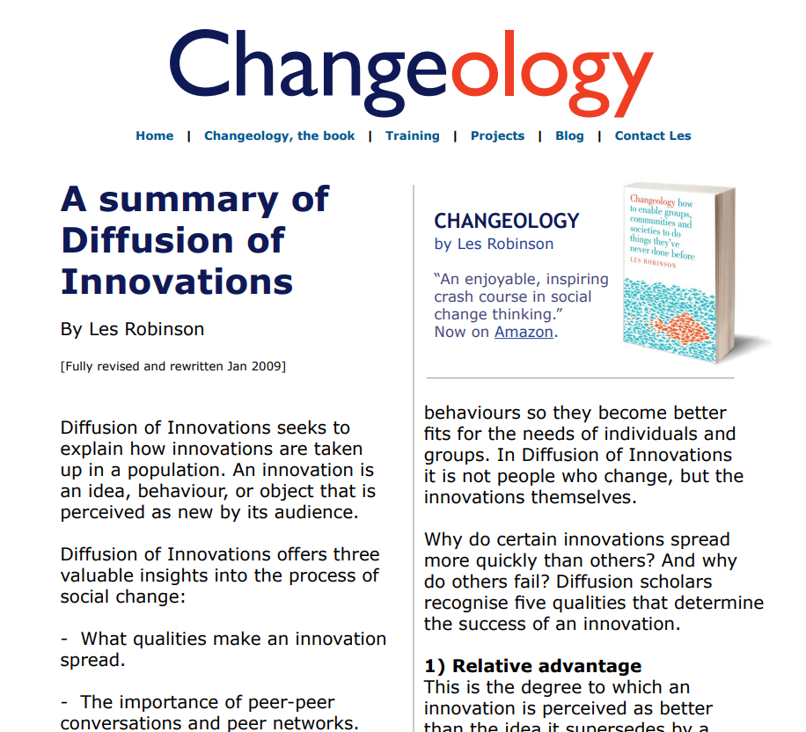
Summary_Diffusion_Theory.pdf (enablingchange.com.au)

Slide 28
Thank you!
We are improvers at heart.
We want to hear and learn from your experiences during these sessions.
Please take a moment to complete the brief evaluation before signing off!
Add QR Code

Slide 29

Good luck on your improvement journey!
Photo by Alexas_Fotos on Unsplash

Slide 30
Resources
NICHQ QI 101
NICHQ QI 102
How to Improve, IHI Website How to Improve | IHI - Institute for Healthcare Improvement
Dr. Robert Lloyd's "A Family of Measures" on youtube@ https://www.youtube.com/watch?v=uow7mzrFif4
Dr. Lloyd's "Applying Four Rules to Understand a Run Chart" on youtube @ https://www.youtube.com/watch?v=8e38RCU8-uA
Summary of Diffusion of Innovations Summary_Diffusion_Theory.pdf (enablingchange.com.au)

