Slide 1




July 9th, 2025
3:00-4:15pm ET
AIM Obstetric Readiness Summer Learning Sprint:
Planning and Assessment for Obstetric Emergency Readiness:
Moving Information to Action

Slide 2



Do not edit
How to change the design
Join at slido.com
#2420415
The Slido app must be installed on every computer you’re presenting from

Slide 3

The Alliance for Innovation on Maternal Health is a quality improvement initiative to support best practices that make birth safer, improve maternal health outcomes, and save lives.
You can find more information at saferbirth.org.

Slide 4

Disclaimer and Disclosures
This activity is facilitated by the Alliance for Innovation on Maternal Health which is funded through a cooperative agreement between ACOG and the Health Resource and Services Administration Maternal Child Health Bureau (HRSA MCHB).
Disclaimer: Any mention of commercial products, goods or services displayed or discussed during this CE activity should not be interpreted to imply endorsement by NPWH or ACOG.
Disclosure: The planners of this activity report no conflicts of interest. This activity has not received any commercial support.
This program is supported by a cooperative agreement with the Health Resources and Services Administration (HRSA) of the U.S. Department of Health and Human Services (HHS) under grant number UC4MC49476. This information or content and conclusions are those of the author and should not be construed as the official position or policy of, nor should any endorsements be inferred by HRSA, HHS or the U.S. Government.

Slide 5



Before we get started
This
Webinar
will be recorded
Resources should be used at your discretion
Resources discussed are not vetted or endorsed by AIM or ACOG and are provided for your convenience
If you need help during the call, please chat an AIM staff member

Slide 6
Continuing Education Credits
AIM is excited to offer continuing education credit to attendees of this live session.
To receive your certificate
Attend at least 60 minutes of live activity
Complete evaluation following activity
Certificates will be sent via email in 1-2 weeks
This activity is approved by the Continuing Education Approval Program of the National Association of Nurse Practitioners in Women’s Health for 1 continuing education contact hours, including 0 hours of pharmacology content. NPWH Activity Number 25-12-02
The Continuing Education Approval Program of the National Association of Nurse Practitioners in Women’s Health, is accredited as a provider of continuing by the California State Board of Nursing, Provider Number CEP 13411
Notes:
Information on how to get CE – share the program in the chat at this time

Slide 7
Session Description
In this webinar, participants will receive practical information on how to use data and assessment to inform and improve obstetric emergency readiness efforts. Feasible strategies for the use of data to support obstetric emergency readiness will be shared, as well as data collection resources for use of the AIM Obstetric Emergency Readiness Resource Kit.
Learning Objectives
At the end of this webinar, participants will be able to:
Contextualize the use of data for obstetric emergency readiness and its value for targeting improvement efforts
Describe best practices for conducting a landscape analysis to inform obstetric emergency readiness efforts
Identify measurement strategies for data-informed use of the AIM Obstetric Emergency Readiness Resource Kit

Slide 8

Up Next!
Session #3:
Pre-Hospital Care: Collaboration with Emergency Medical Services (EMS) in OB Readiness
Session #4:
Sharing Best Practices in Obstetric Simulations for the Emergency Department
July 23rd, 2025
3:00-4:15pm ET
August 6, 2025
3:00-4:15pm ET
Speakers: Nick Nudell, PhD(c), MS, MPhil, NRP, Anne Margaret Perry, BSN, RN, CLNC, Jamie Robinson, DNP, RN
Jennifer Mitzman, MD, and Gina Grabowski, MSN, RN, CHSE

Slide 9

Do not edit
How to change the design
What best describes your role?
The Slido app must be installed on every computer you’re presenting from

Slide 10



Today’s Presenters
Sarah Truitt
MD
Izzy Taylor
MS, CPHQ
David Laflamme
PhD
Meg Sheahan
MSN, CNM, MPH

Slide 11

Obstetric Emergency
Readiness: State of Alaska
Sarah Truitt, MD, FACOG
AKPQC Steering Committee Member

Slide 12
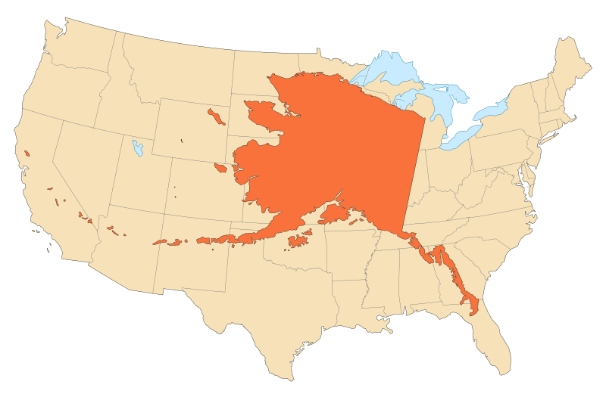
Geography: Is Alaska a big state?

Slide 13


What is unique about Alaska?
Texas = 265,581 sq mi
Alaska = 570,380 sq mi
Alaska has more ocean coastline than all of the other U.S. states combined.
Alaska is the only state whose capital city is accessible only via ship or air.
There are 229 federally recognized Alaska Native Tribes in Alaska.
AND… we have Denali, active volcanoes, whales, salmon, earthquakes and extremes of weather.

Slide 14


Alaska Birth Data
2019-2023
From the Alaska Department of Health, Division of Public Health, Section of Women's, Children's and Family Health

Slide 15
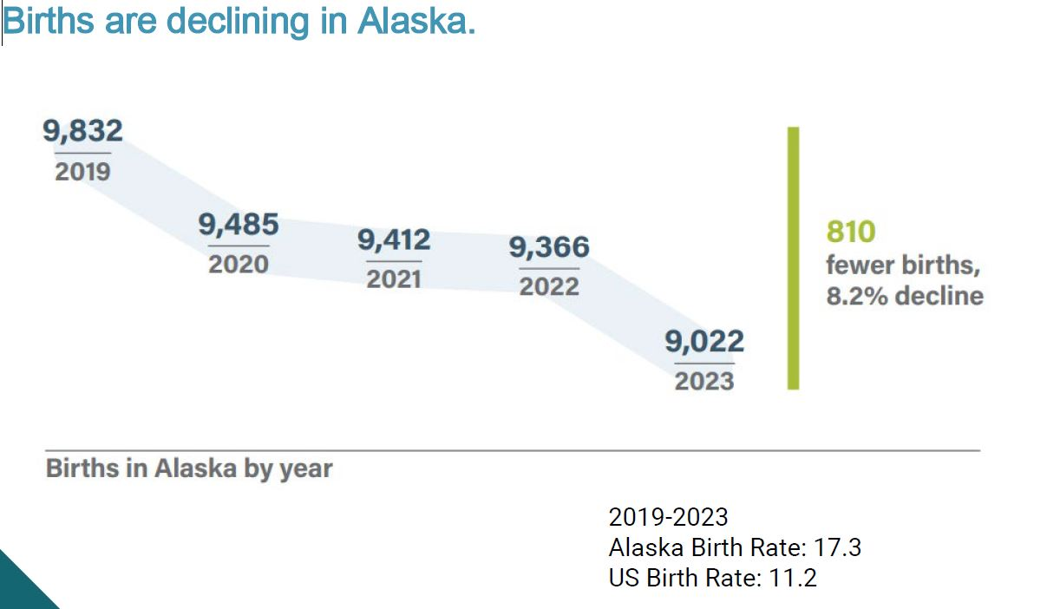
Alaska State Births
Alaska State data 2019-2023
Alaska had 29 birthing facilities: 19 hospitals, averaging 10 or more births annually
The average number of births at these facilities ranged from 12 to 2,257 per year
On average, there were 235 annual births outside of hospitals or birthing facilities (both planned and unplanned), and 67 births at small in-state facilities (fewer than 10 births annually)
SESSION TITLE
SESSION TITLE

Slide 16
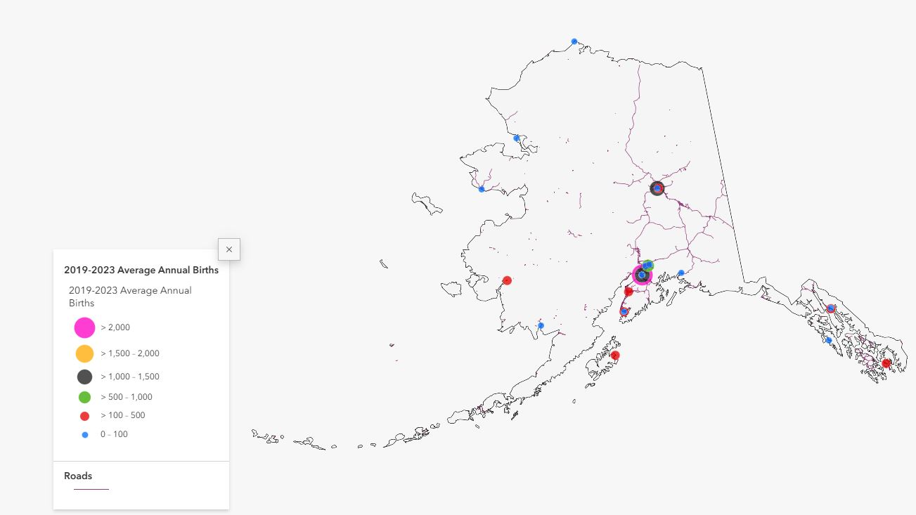
Births in Alaska Facilities

Slide 17
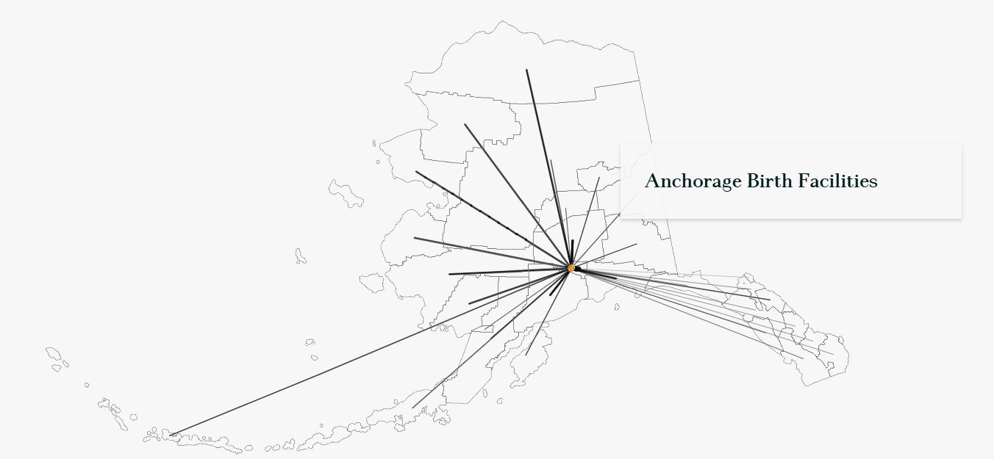
Travel to Birth Facilities
This map illustrates the vast distances traveled from residence boroughs to birth facilities in Anchorage. Lines are drawn from the center of the borough reported as the mother's residence to the facility where they gave birth.

Slide 18
Distances Across Alaska
Fairbanks to Anchorage is 386 road miles about 1.5 hour flight
Nome to Anchorage is 530 miles or about a 2 hour flight
Utquiagvik to Anchorage is about 726 miles or a 3 hour flight
From King Cove to Anchorage is 647 miles or a 3 hour flight
From Bethel to Anchorage is 399 miles or a 2 hour flight
These distances do not include the travel time from villages across Alaska to Anchorage

Slide 19
Regional Approach

Slide 20
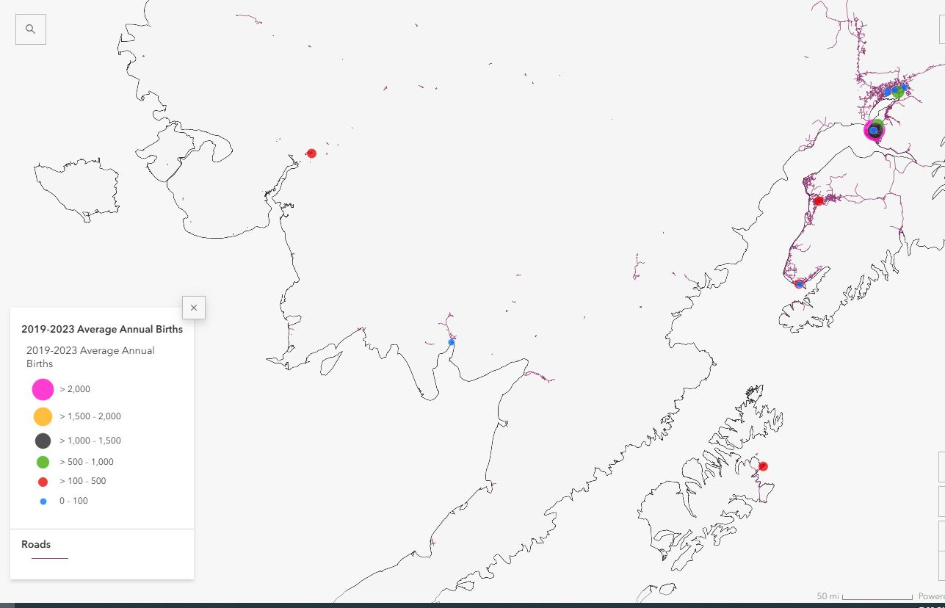
Geographic Region Example
Southwest
The Southwest Region has the second fewest annual births statewide with an annual average of 388 (4.1% of total) births. The facility in the region with the most births is Yukon-Kuskokwim Delta Hospital.

Slide 21
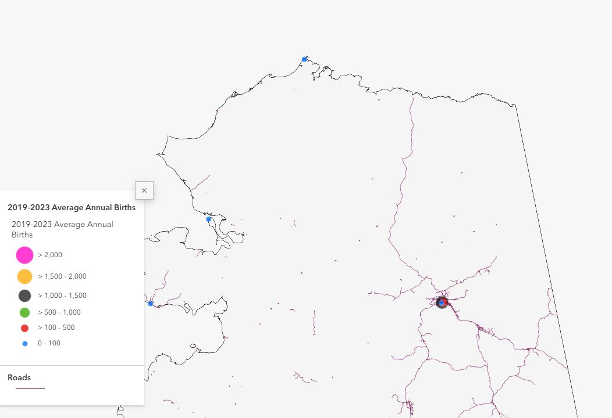
Geographic Region Example
Northern
The Northern Region has the fewest annual births statewide with an annual average of 139 (1.5% of total) births. The facility in the region with the most births is Norton Sound Regional Hospital.

Slide 22
Topics of Interest in Alaska
Maintaining OB services and OB trained providers at rural hospitals
Tribal and Military Health Systems
Medicaid for maternity care
Community Births are common
Maternity care workforce
AK Perinatal Quality Collaborative
Maternal Child Death Review Process & Recommendations
National Measures of Maternity Care in Alaska

Slide 23
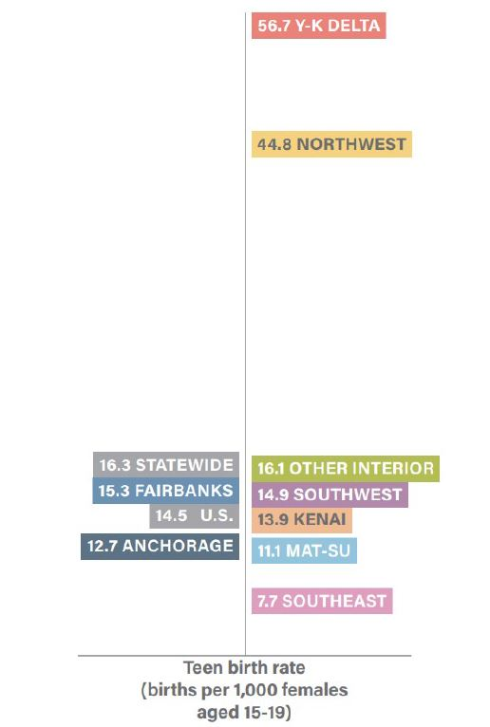
Teen Births are higher in AK than the US
Vary by Region
Cultural
Socioeconomic
Access to health care

Slide 24
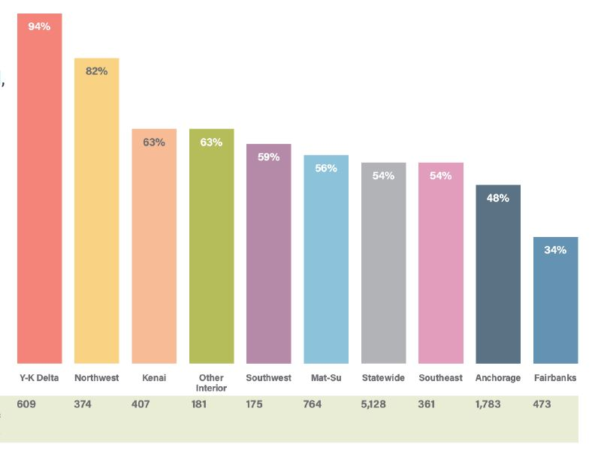
Medicaid Births
54% of births in Alaska According to AHHA
Medicaid can drive care models in Alaska
Delays in Medicaid eligibility determination and the travel authorization process can postpone prenatal care

Slide 25
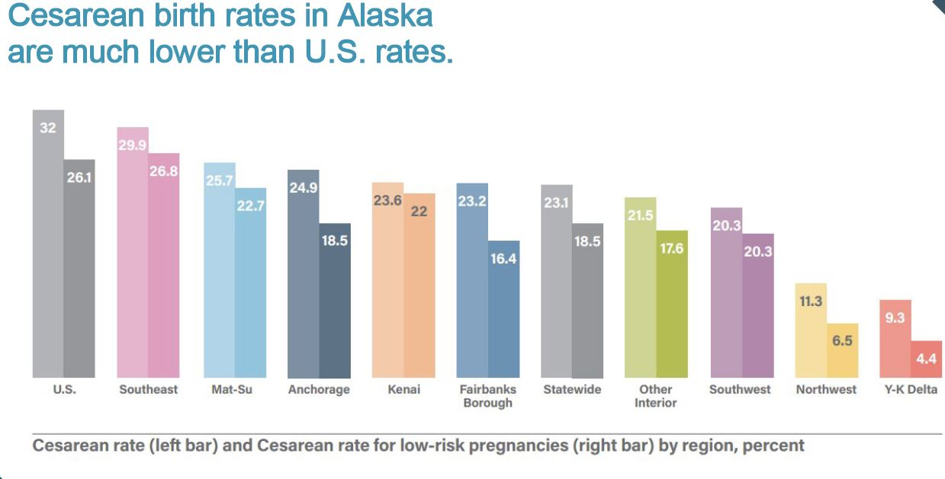
Cesarean Birth Rate Lower in Alaska

Slide 26
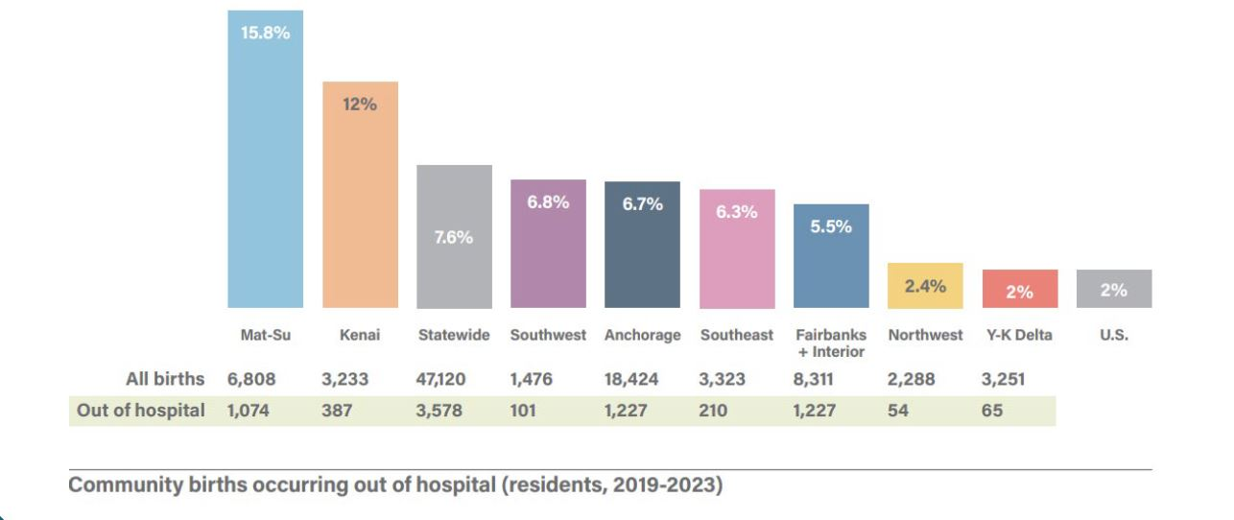
Out of hospital Community Birth Rates high in Alaska

Slide 27
Maternity Services Access
Over the past 20 years, 5 hospitals have discontinued providing birth services
8 of 13 rural critical access hospitals provide labor and delivery services
3 birthing hospitals have volumes averaging less than 30 births per year and require support to maintain access to care

Slide 28
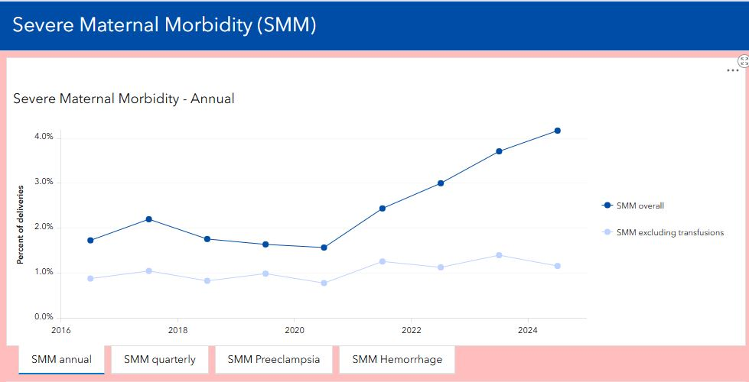
Severe Maternal Morbidity in Alaska

Slide 29
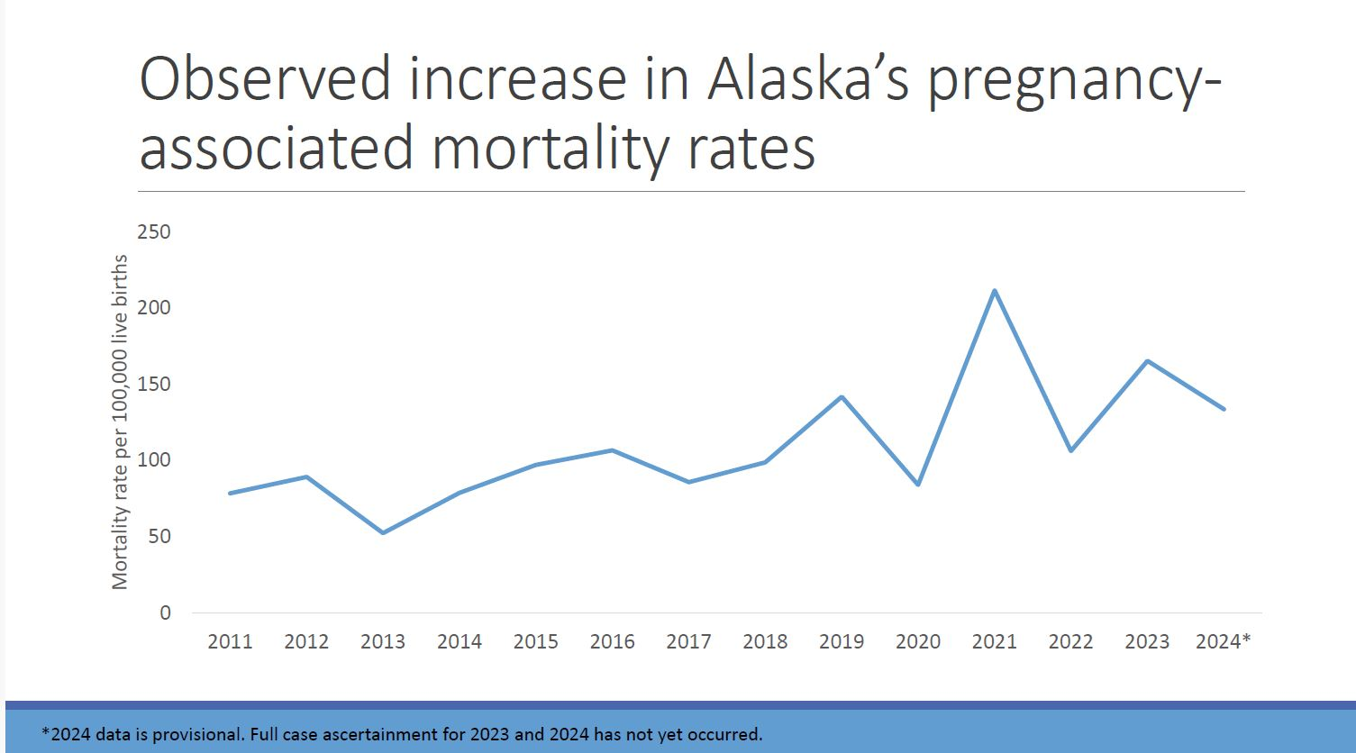
AK State MCDR Committee

Slide 30
Alaska OB Readiness Strengths
AKPQC state-wide initiatives so far: HTN, Substance use in pregnancy , PPH
Alaska Maternal Child Death Review Committee (legislated since 1989!)
We bring ALSO/BLSO training to any facility across the state (Kodiak, Norton Sound, Kotzebue, Dillingham, Sitka etc…)
Strong collaboration between different healthcare providers, including obstetricians, maternal fetal specialists, primary care physicians, midwives, nurses and doulas, makes care possible across Alaska.
State-wide tribal Health system provides comprehensive and culturally responsive maternity care
Robust system of trained rural health aides
Rural provider rotations at Anchorage Hospitals
Strong regional perinatal transport system w/obstetric and neonatal trained flight teams available
Local family medicine residency trains physicians for rural practice with OB care

Slide 31
Other Ideas for Alaska OB Readiness
  More Simulation support
  Expand Fetal Monitoring Education
  Increase telemedicine support
  Field clinic optimization with educational topics for field sites
QA support
Collect data
Compare unique populations
Structure multidisciplinary reviews of severe MM&M events with smaller sites
Structure and standardize an adequate QA process
Encourage just culture, safety culture and Improve debriefing, communication

Slide 32

Thank you
Sarah Truitt, MD, FACOG
struitt@southcentralfoundation.com

Slide 33

References
https://storymaps.arcgis.com/stories/e31fb19b882141039baf9cbc444451d3
https://akpqc-alaska-dhss.hub.arcgis.com/
Alaska Health Care and Hospital Association (AHHA):
Maternity Care in Alaska Landscape Report

Slide 34

Obstetric Emergency Readiness Resource Kit
Measurement Strategy

Slide 35
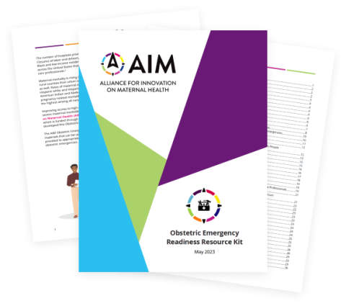

Obstetric Emergency Readiness Resource Kit (OBERRK)
Contains best practices, resources, and planning materials for non-OB settings
Supports readiness efforts for obstetric emergencies
For use by teams in healthcare settings where obstetric services are not typically provided

Slide 36
Resource Kits vs Patient Safety Bundles
Resource Kits
Broad structures and processes to promote safety in obstetric care alongside patient safety bundle implementation
Implemented across a variety of care settings
Patient Safety Bundles
List elements specific to a clinical condition or time period of care
Implemented in perinatal care settings
Currently no associated data collection plans – until now!
Data collection plans to inform quality improvement

Slide 37
Why a Measurement Strategy
Supports quality improvement* and implementation of best practices from the OBERRK
Not intended for research or formal evaluation
Used to drive change
  At the hospital level – Informs Plan-Do-Study-Act cycles
  At the state level – Informs strategic planning, engagement, and support given to hospitals
Highly requested by teams on the ground
  *See McQuillan RF, Silver SA, Harel Z, Weizman A, Thomas A, Bell C, et al. How to Measure and Interpret Quality Improvement Data. Clin J Am Soc Nephrol. 2016;11(5):908-914. doi: 10.2215/CJN.11511015

Slide 38
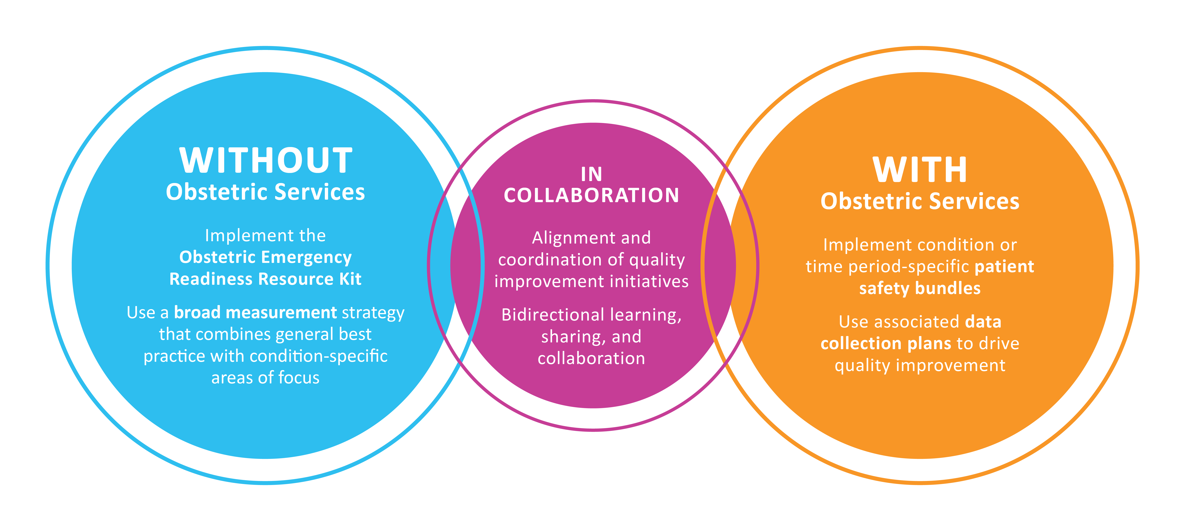
How the OBERRK and Patient Safety Bundles Work Together

Slide 39
Measurement Development Process
OBERRK Reviewed
Cross-Referenced With Standards*
Measures Identified
Expert Review
Finalization
*as possible

Slide 40
Diving In: Measurement Statement
Intended to support implementation of the AIM Obstetric Emergency Readiness Kit
Provides foundational outcome, process, and structure measures
Can be used in multiple ways:
  Individually by hospitals and health systems to support internal quality improvement work
  As part of a local, state, or national collaborative

Slide 41
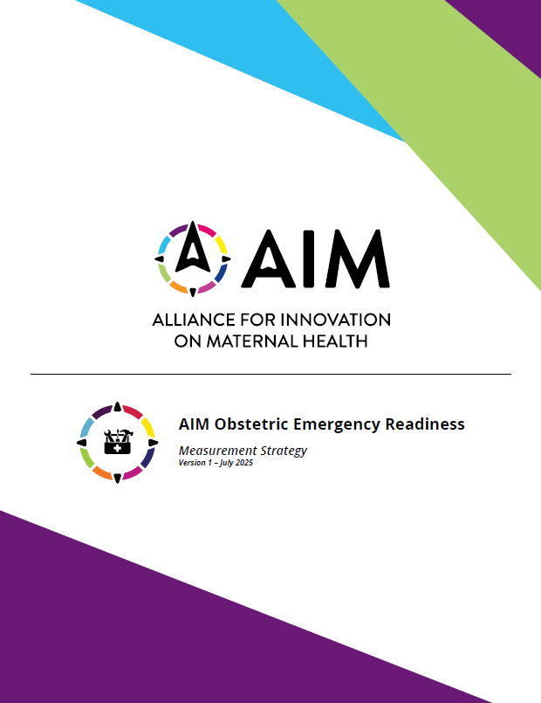
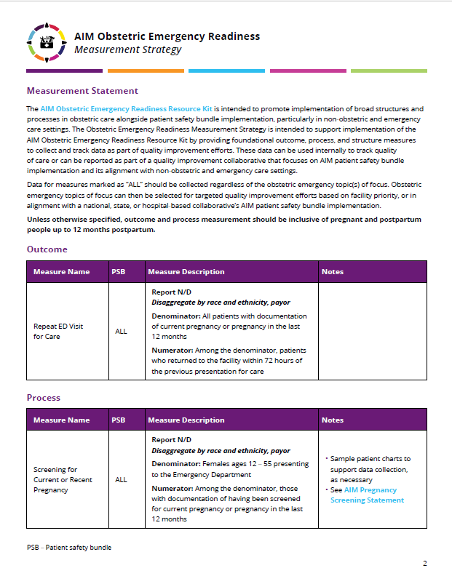
Diving In: Measurement Statement, Cont.
In the measurement strategy, there are measures labeled “ALL” or by an abbreviated bundle name
  “ALL” measures – Foundational measures that should be consistently collected
  Bundle-specific measures – Can be selected based on priority obstetric emergency topics in your state or hospital
    No need to collect data for every bundle-specific measure

Slide 42
Measurement Strategy

Slide 43
Outcome Measure

Slide 44
Repeat ED Visit for Care (ALL)
Description: The percentage of patients with documentation of current pregnancy or pregnancy in the last 12 months who returned to the ED within 72 hours of the previous presentation of care
Denominator
All patients with documentation of current pregnancy or pregnancy in the last 12 months
Numerator
Among the denominator, patients who returned to the facility within 72 hours of the previous presentation for care

Slide 45
Process Measures

Slide 46
Screening for Current or Recent Pregnancy (ALL)
Description: The percentage of females ages 12-55 presenting to the Emergency Department who were screened for current pregnancy or pregnancy in the last 12 months
Denominator
Females ages 12-55 presenting to the Emergency Department
Numerator
Among the denominator, those with documentation of having been screened for current or recent pregnancy in the last 12 months
Notes:
Sample, as needed
Discuss key points from AIM Pregnancy Screening Statement: AIM Pregnancy Screening Statement

Slide 47
Staff Education & Simulation Participation (ALL)
Description: The percentage direct patient care staff in the Emergency Department who have received at least one type of training on obstetric emergency topics in the last 6 months
Denominator
Emergency Department providers, nurses, and direct patient care staff
Numerator
Among the denominator, those who have completed at least one type of education, simulation, or training on obstetric emergency topics within the last 6 months
Notes:
Obstetric emergency topics may include hemorrhage, hypertension, sepsis, cardiac conditions, and mental health and substance use
Didactic or simulation-based education would be most beneficial. However, this could include case reviews at huddle and integration into pre-existing educational pathways.
Refer to AIM’s Obstetric Simulation Scenarios for the Emergency Department

Slide 48
Timely Treatment of Persistent Severe Hypertension (HTN)
Description: The percentage pregnant and postpartum people with persistent severe hypertension who were treated within 1 hour
Denominator
Pregnant and postpartum people with acute-onset severe hypertension that persists for 15 minutes or more, including those with preeclampsia, gestational or chronic hypertension
Numerator
Among the denominator, those who were treated within 1 hour, as measured from the first severe range BP reading
Notes:
Full measurement specifications can be found in this SMFM Special Statement

Slide 49
Mental Health Safety Protocol Activation (PMHC)
Description: The percentage or pregnant and postpartum people with mental health concerns who received an appropriate risk assessment or referral based on acuity of presenting concern
Denominator
Pregnant and postpartum people with a chief complaint of a mental health concern, or those who had a positive mental health screen using a validated screening tool at any time during the care encounter
Numerator
Among the denominator, those who received an appropriate risk assessment or referral based on acuity of presenting concern

Slide 50
Offering or Provision of Substance Use Disorder Treatment (SUD)
Description: The percentage or pregnant and postpartum people with substance use concerns who received appropriate offering or provision of substance use disorder treatment
Denominator
Pregnant and postpartum people with a chief complaint of a substance use concern, or those who had a positive substance use screen using a validated screening tool at any time during the care encounter
Numerator
Among the denominator, those who received an appropriate offering or provision of substance use disorder treatment

Slide 51
Timely Treatment with Antibiotics for Patients Diagnosed with Sepsis (SOC)
Description: The percentage or pregnant and postpartum people with a diagnosis of sepsis who received appropriate antibiotic administration within 1 hour of sepsis diagnosis
Denominator
All pregnant and postpartum patients with a diagnosis of sepsis
Numerator
Among the denominator, those with appropriate antibiotics administered within 1 hour of sepsis diagnosis
Notes:
If more than one is ordered, all must be given within one hour)
Sepsis codes are included in the measure notes

Slide 52
Cardiovascular Disease Assessment Among Pregnant and Postpartum People (CCOC)
Description: The percentage or pregnant and postpartum people with documentation of having received a cardiovascular disease assessment using a standardized tool
Denominator
All pregnant and postpartum people triaged or admitted for care
Numerator
Among the denominator, those with documentation of having received a cardiovascular disease assessment using a standardized tool
Notes:
Sample patient charts to support data collection, as necessary
Refer to Cardiovascular Disease Assessment in Pregnant and Postpartum Women developed by CMQCC for an example of a standardized tool

Slide 53
Structure Measures

Slide 54
Obstetric Protocol or Policy Availability (ALL)
Rate progress (not yet started, in progress, fully in place) towards putting and keeping the structure measure fully in place
Does your Emergency Department have written, accessible, and up-to-date policies and protocols for managing key obstetric emergencies?
Notes:
This may include hemorrhage, hypertension, cardiac conditions, and sepsis at minimum.
ACOG has Emergency Department algorithms and resources for review and use.

Slide 55
Transfer Readiness (ALL)
Rate progress (not yet started, in progress, fully in place) towards putting and keeping the structure measure fully in place
Does your Emergency Department have the following:
Written, accessible, and up-to-date policies and procedures for obstetric transport
Written and up-to-date transfer agreements with hospitals with obstetric services
Notes:
These should be measured as two sub-measures, not as a single combined measure.

Slide 56
Patient Education Materials on Urgent Maternal Warning Signs (ALL)
Rate progress (not yet started, in progress, fully in place) towards putting and keeping the structure measure fully in place
Has your department developed/curated patient education materials on urgent maternal warning signs that align with culturally and linguistically appropriate standards?
Notes:
Refer to Urgent Maternal Warning Signs for an example.

Slide 57
Obstetric Chart Review (ALL)
Rate progress (not yet started, in progress, fully in place) towards putting and keeping the structure measure fully in place
Does your Emergency Department have a process for regularly reviewing instances of obstetric care to identify opportunities for improvement?
Notes:
Refer to the forthcoming Obstetric Care Assessment for Resource Limited Environments tool for an example.

Slide 58
Obstetric Hemorrhage Emergency Supplies
Rate progress (not yet started, in progress, fully in place) towards putting and keeping the structure measure fully in place
Does your Emergency Department have immediate, on-unit access to the following to support rapid response to an obstetric hemorrhage:
Immediate access to bundled uterotonic medications and tranexamic acid (e.g., bundle in Pyxis or Omnicell)
Immediate access to non-surgical hemorrhage control devices
Notes:
These should be measured as two sub-measures, not as a single combined measure.

Slide 59
Optional – As Facility Priorities Allow

Slide 60
Bias-Free Obstetric Chart Documentation (ALL)
Description: The percentage obstetric charts reviewed with no stigmatizing or judgment language
Denominator
All patient charts with documentation of current pregnancy or pregnancy in the last 12 months
Numerator
Among the denominator, charts containing no stigmatizing or judgment language
Notes:
Sample patient charts to support data collection, as necessary
See Negative Patient Descriptors: Documenting Racial Bias in the Electronic Health Record for examples of stigmatizing and judgment language

Slide 61
Tying It All Together
Data collection and assessment can help inform implementation of the AIM OBERRK and ongoing quality improvement efforts in the Emergency Department
AIM’s measurement strategy for the OBERRK is one developed resource to support quality improvement efforts
Measurement is intended to be focused on priority areas for improvement; bundle-specific measures do not need to be collected simultaneously

Slide 62
Next Steps
Data collection tools
  REDCap
  Excel
  Others as recommended and feasible
Learning from you as the measurement strategy is used and adjusting it, as needed

Slide 63
High Impact Practice Sets (HIPS) to Improve Maternal Health: Strategies for the Sexual and Reproductive Health Setting
Meg Sheahan MSN, CNM, MPH
JSI Research & Training Institute, Inc./RHNTC
July 9, 2025
Notes:
Thanks <<name>> and thanks, everyone for being here and caring about this important topic. So, I’ve got a few minutes to share some of the work we’ve done with a resource series called the High Impact Practice Sets to Improve Maternal Health.
.

Slide 64
What I’ll share today
1
The purpose and development of the High Impact Practice Sets
2
How the High Impact Practice Sets and the AIM Obstetric Emergency Readiness Resource Kit complement each other for maximum impact
3
The High Impact Practice Sets data strategy to inform efforts to improve maternal health
Notes:
I’ll share a bit about the purpose and development of the High Impact Practice Sets, how the Sets and the AIM Obstetric Emergency Readiness Resource Kit complement each other, and the data strategy that the Sets use to inform efforts to improve maternal health.

Slide 65

What are the HIPS?
A series of publicly available resources
Support outpatient teams in implementing evidence-based practices to reduce maternal mortality, severe maternal morbidity, and maternal health differences
Focus on leading clinical causes of pregnancy-related deaths that are feasibly addressed in the outpatient setting:
  Hypertension
  Cardiac conditions
  Substance use disorders
  Mental health conditions
  Postpartum transition
Notes:
The High Impact Practice Sets, I’m going to call them HIPS from here on out, are a series of publicly available resources that support outpatient teams in implementing evidence-based practices to reduce severe maternal morbidity, mortality, and differences in maternal health outcomes.
The series focuses on leading clinical causes of pregnancy-related deaths that are feasibly addressed in the outpatient setting. Each set presents high impact practices that address one clinical issue:
Hypertension
Cardiac conditions
Substance use disorders
Mental health conditions
Postpartum transition

Slide 66

The 5 Rs
Readiness
Recognition and Prevention
Response
Reporting and Systems Learning
Respectful Care
https://saferbirth.org/patient-safety-bundles/
Notes:
The sets were adapted from the Alliance for Innovation on Maternal Health Patient Safety Bundles, so, they are structured around the 5 Rs:
Readiness to address the issue,
recognition and prevention of the issue
response to the issue
reporting and systems learning, and
respectful care.

Slide 67

What does each HIPS include?
Each set includes three resources to support implementation of high impact practices:
Webinar archive
Job aid
Measurement tool
Notes:
Each practice set includes three things:
A webinar archive -- we held live webinars every other month for almost a year
A job aid -- which I’ll show you a picture of in the next slide, and
A Measurement Tool -- which we’ll focus on in a minute.

Slide 68
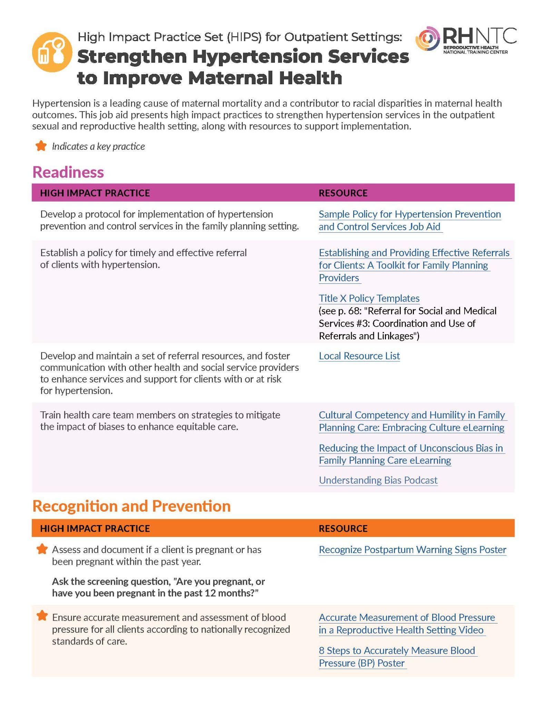
The HIPS provide recommendations and resources to strengthen the healthcare system by enhancing clinical care processes and continuity, and addressing maternal health differences across populations.
Notes:
In summary, the HIPS provide recommendations and resources to strengthen the healthcare system by enhancing clinical care processes, and addressing maternal health differences across populations.
This screenshot here is the job aid that presents the high impact practices to strengthen hypertension services. The column on the left presents the practices to implement, and the column on the right presents resources to support implementation of each practice. So, each set…each clinical condition represented, has its own job aid and set of relevant high impact practices.

Slide 69

How to access the HIPS series?
Search “high impact practice sets” on www.rhntc.org
Notes:
The resources and tools included in the practice sets are available free on the RHNTC website.
You can easily find them by searching “high impact practice sets” on rhntc.org and I’ll share the link in the chat in case you want to check it out now.
https://rhntc.org/resources/high-impact-practice-sets-hips-outpatient-settings-series

Slide 70


How were the HIPS developed?
Alliance for Innovation on Maternal Health (AIM) Patient Safety Bundles (PSBs) are collections of clinical condition-specific best practices to make birth safer.
In collaboration with ACOG, the RHNTC adapted a subset of the PSBs to create High Impact Practice Sets (HIPS) for the outpatient sexual and reproductive health (SRH) setting.
https://saferbirth.org/patient-safety-bundles/
Notes:
Recognizing that the field does have a lot of recommendations for implementation in birthing hospitals and during prenatal care, but not a lot of recommendations for outpatient providers, and seeing the great opportunity that outpatient providers have to improve improve maternal health outcomes, the Reproductive Health National Training Center partnered with ACOG, who led the development of the AIM Patient Safety Bundles, to address this gap.
So together, we adapted a subset of the Patient Safety Bundles to create the High Impact Practice Sets (HIPS). The High Impact Practice Sets highlight evidence-based practices that can be implemented in the outpatient setting to improve maternal health outcomes.

Slide 71
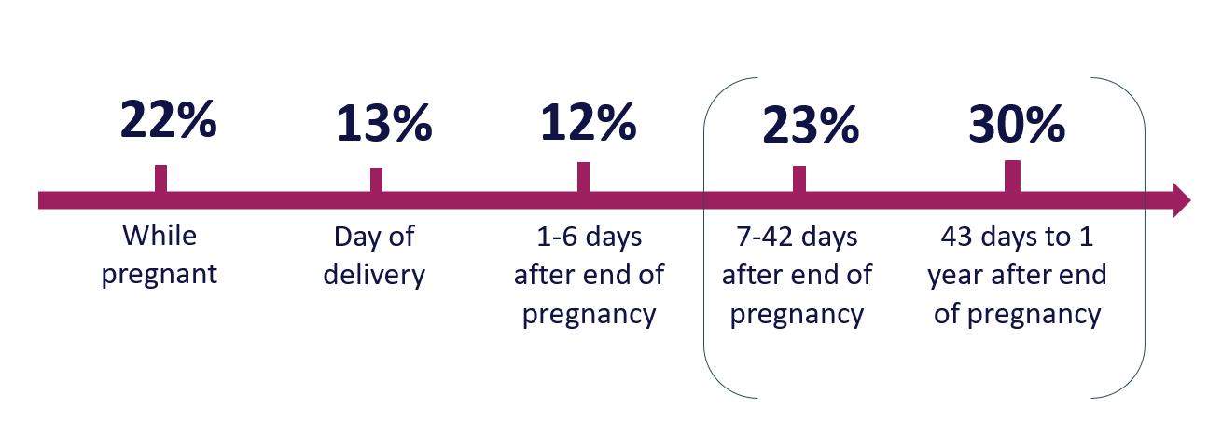
Why was the HIPS series developed?
Developed to address the maternal health crisis in the U.S.
The U.S. has made progress in addressing maternal mortality and severe maternal morbidity in inpatient/perinatal settings, but…
https://www.cdc.gov/reproductivehealth/maternal-mortality/erase-mm/data-mmrc.html
Notes:
I don’t think I need to tell this crowd, but… the US is in the midst of a maternal health crisis, and I think you all know intuitively why the HIPS series was developed. As I mentioned in the previous slide, the U.S. has made progress in addressing leading clinical causes of maternal mortality and severe maternal morbidity in inpatient and perinatal care settings, which is amazing. And we have evidence that delivery-related mortality in U.S. hospitals has decreased over the past decade. However, over half of pregnancy-related deaths occur between one week and one year after pregnancy, and the role of outpatient and non-obstetric settings has received comparatively less focus.

Slide 72

HIPS for the outpatient setting
Outpatient and non-obstetric settings have received less attention
Outpatient settings - especially those that provide SRH services - present a unique opportunity to intervene to prevent pregnancy-related complications
  Are often clients’ only or usual source of care
  Often see clients within a year of pregnancy
  Provide effective referrals and linkages to care
The HIPS series was designed to address this gap
Notes:
Outpatient settings are critical in providing continuity of care to individuals before, during, and after pregnancy, so they present a unique opportunity to implement upstream interventions that can prevent pregnancy-related complications.
Outpatient settings are often the first point of contact for individuals seeking healthcare, including when complications arise, so they’re crucial for delivering interventions that support maternal well-being and continuity of care, including linkages to inpatient or specialty services.
So, HIPS series was designed to address this gap.

Slide 73

What does the HIPS series seek to accomplish?
Goal: To strengthen the healthcare system by addressing programmatic and clinical care processes and continuity of care for individuals receiving services in outpatient settings
The HIPS support teams in implementing evidence-based, prevention-focused practices that address clinically specific conditions
Notes:
Ultimately, the goal is to strengthen the healthcare system by addressing and improving programmatic and clinical care processes and continuity of care for people receiving outpatient services.
And the HIPS do this by supporting teams in implementing evidence-based, prevention-focused practices that address clinically specific conditions that contribute significantly to maternal mortality.

Slide 74

How does the HIPS series complement the AIM Obstetric Emergency Readiness Resource Kit?
They are complementary resources aimed at improving maternal health outcomes
They approach the goal from different, yet synergistic, angles
Notes:
So, how does the HIPS series complement the AIM Obstetric Emergency Readiness Resource Kit? Well, they’re complementary resources, focused on many of the same clinical conditions, with the same goal of improving maternal health outcomes. They approach this goal from different, yet synergistic angles.

Slide 75
Purpose and focus
AIM Obstetric Emergency Readiness Resource Kit (AIM Kit):
Focuses on clinical preparedness for obstetric emergencies
Provides checklists, protocols, and readiness assessments to ensure teams and providers can respond rapidly and effectively to emergencies
RHNTC High Impact Practice Set series:
Focuses on systems-level and service delivery improvements including workforce training, quality improvement, and patient-centered care
Supports adoption of evidence-based practices to enhance service delivery, especially in outpatient SRH settings
AIM Kit addresses what to do in emergency situations. RHNTC HIPS support how to build systems that sustain high-quality care, including prevention.
Notes:
I’ll share a bit about the purpose and focus of each…the AIM Emergency Readiness Resource Kit and the HIPS…but know that I’m sharing a few of the highlights… the bullet points aren’t necessarily mutually exclusive only to the resource they fall under here on the slides.
The AIM Kit focuses on clinical preparedness for obstetric emergencies. The kit provides checklists, protocols, and readiness assessments to ensure teams and providers can respond rapidly and effectively to emergencies.
The HIPS series focuses on systems-level and service delivery improvements including workforce training, quality improvement, and patient-centered care, and supports adoption of evidence-based practices to enhance service delivery, especially in outpatient SRH settings.
So…if you’ve got an obstetric emergency unfolding in front of you, you need the AIM kit. If you’re working to undergird and build systems that sustain high quality care,the HIPS series can help guide your process.

Slide 76
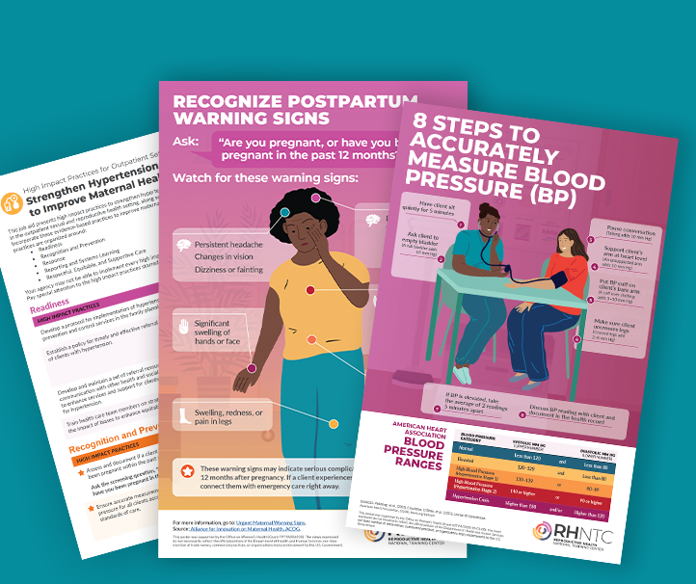
Target audience
AIM Obstetric Emergency Readiness Resource Kit (AIM Kit):
May particularly benefit Family Medicine and Emergency Medicine clinicians, nursing administrators, and other leaders in clinical settings that may not routinely encounter an obstetric emergency
RHNTC High Impact Practice Set series:
Designed for public health professionals, clinic managers, and reproductive health providers across a range of outpatient and community-based settings
Notes:
There’s definitely some overlap in the target audience of each resource, and also some distinguishing audience characteristics.
The AIM kit may particularly benefit Family Medicine and Emergency Medicine clinicians and providers, nursing administrators, and other leaders in clinical settings that may not routinely encounter an obstetric emergency but where an obstetric emergency could certainly take place.
The HIPS series is designed for public health professionals, clinic managers, and reproductive health providers across a range of outpatient and community-based settings.
So, while there’s definitely overlap, the AIM kit is more clinically focused, and the HIPS series, while it has some great resources for clinical staff and providers, focuses more on program level or administrative processes. So they’re synergistic.

Slide 77
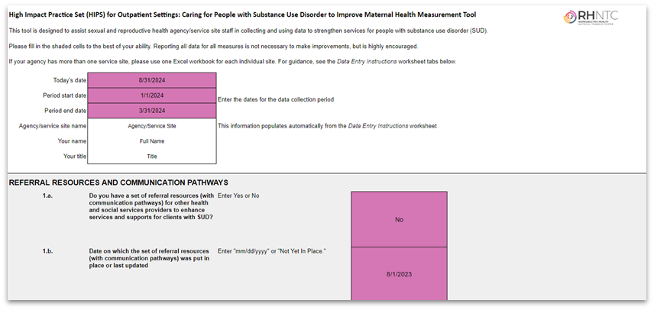
The Measurement Tool: From data to action
Each HIPS includes a Measurement Tool aligned with the clinical condition’s evidence-based strategies
Developed by ACOG with RHNTC
Helps collect, track and use data for quality improvement efforts
Offers a systematic method for analyzing data to monitor progress and identify gaps while integrating HIPS
Notes:
So let's talk about data… Each HIPS includes a Measurement Tool aligned with the clinical condition’s evidence-based strategies. The Measurement Tool was developed by ACOG with RHNTC. You can see a screenshot of a section of one of the Tools here. It’s an Excel spreadsheet that helps collect, track and use data for quality improvement efforts around the specific clinical condition. So each clinical condition has its own unique Measurement Tool that offers a systematic method for analyzing data to monitor progress and identify gaps while implementing the high impact practices.

Slide 78

Using data for quality improvement
Helps teams assess current implementation status of key high impact practices
Allows teams to use data to assess, adjust, and refine their efforts over time
Users can disaggregate data by race and ethnicity to ensure consistency in the provision of care
Highlights priority actions based on areas of low performance or high need
Notes:
The Measurement Tool, and using the data, helps teams assess current implementation status of key high impact practices, and allows teams to use data to assess, adjust, and refine their efforts over time. Users can disaggregate data by race and ethnicity to ensure consistency in the provision of care and identify and address any inconsistencies. The Tool, and the data in it, highlights priority actions based on areas of low performance or high need. And while the devil is in the detail of data collection, the Measurement Tool itself has really honed in on key data elements to collect for greatest impact, so the tool doesn’t ask programs to collect a million complicated data elements. It does try to keep it simple and impactful.

Slide 79
Notes:
Thanks, everyone! Please stay in touch! You can subscribe to the RHNTC newsletter, contact us via the website or LinkedIn, or sign up for an account. Our resources are designed specifically for the Title X and Teen Pregnancy Prevention networks, but really, so much of what we have to offer is relevant beyond those settings, so take a look.
Thanks!

Slide 80
Audience Q&A
Please ask your question in the chat or in Slido
If you are here for CE Credit, please continue to remain in the meeting to complete the required evaluation

Slide 81

Do not edit
How to change the design
Audience Q&A
The Slido app must be installed on every computer you’re presenting from

Slide 82


Evaluation
Please note the name, email and/or phone number associated with your zoom account as this will be entered in the evaluation to confirm your attendance
Please follow the link at the end of this session to complete the evaluation.
This is REQUIRED for CE credit.
CE Certificate will be sent to your email in 1-2 weeks

Slide 83
Thank you!
Any questions about this webinar or the series can be sent to AIM@acog.org
The recording will be emailed to all attendees once ready
AIM will also post the recording on our website, saferbirth.org
Remember to register for upcoming webinars!

