Slide 1




June 25th, 2025
3:00-4:15pm ET
AIM Obstetric Readiness Summer Learning Sprint:
Obstetric Care in Rural Environments: A Review of the Landscape and Opportunities for Care

Slide 2

The Alliance for Innovation on Maternal Health is a quality improvement initiative to support best practices that make birth safer, improve maternal health outcomes, and save lives.
You can find more information at saferbirth.org.

Slide 3

Disclaimer and Disclosures
This activity is facilitated by the Alliance for Innovation on Maternal Health which is funded through a cooperative agreement between ACOG and the Health Resource and Services Administration Maternal Child Health Bureau (HRSA MCHB).
Disclaimer: Any mention of commercial products, goods or services displayed or discussed during this CE activity should not be interpreted to imply endorsement by NPWH or ACOG.
Disclosure: The planners of this activity report no conflicts of interest. This activity has not received any commercial support.
This program is supported by a cooperative agreement with the Health Resources and Services Administration (HRSA) of the U.S. Department of Health and Human Services (HHS) under grant number UC4MC49476. This information or content and conclusions are those of the author and should not be construed as the official position or policy of, nor should any endorsements be inferred by HRSA, HHS or the U.S. Government.

Slide 4



Before we get started
This
Webinar
will be recorded
Resources should be used at your discretion
Resources discussed are not vetted or endorsed by AIM or ACOG and are provided for your convenience
If you need help during the call, please chat an AIM staff member

Slide 5
Continuing Education Credits
AIM is excited to offer continuing education credit to attendees of this live session.
To receive your certificate
Attend at least 60 minutes of live activity
Complete evaluation following activity
Certificates will be sent via email in 1-2 weeks
This activity is approved by the Continuing Education Approval Program of the National Association of Nurse Practitioners in Women’s Health for 1 continuing education contact hours, including 0 hours of pharmacology content. NPWH Activity Number [ insert # here]
The Continuing Education Approval Program of the National Association of Nurse Practitioners in Women’s Health, is accredited as a provider of continuing by the California State Board of Nursing, Provider Number CEP 13411
Notes:
Information on how to get CE – share the program in the chat at this time

Slide 6

Up Next!
Session #2:
Planning and Assessment of Obstetric Emergency Readiness: Moving Information to Action
Session #3:
Pre-Hospital Care: Collaboration with Emergency Medical Services (EMS) in OB Readiness
July 9th, 2025
3:00-4:15pm ET
July 23rd, 2025
3:00-4:15pm ET
Speakers: Sarah Truitt, MD, Izzy Taylor, MS, CPHQ David LaFlamme, PhD, MPH
Speakers: Nick Nudell, PhD(c), MS, MPhil, NRP, Anne Margaret Perry, BSN, RN, CLNC, Jamie Robinson, DNP, RN

Slide 7



Today’s Presenters
Kelly Bogaert
MD, MSc, FACOG
Shon Rowan
MD
Emily Bartlett
MD, MS
Notes:
KB: Kelly Bogaert, MD, MSc, FACOG is an Assistant Professor of Obstetrics & Gynecology at the University of Colorado and a practicing OB/GYN generalist at Denver Health in Denver, Colorado. She completed medical school at the University of Washington and her OB/GYN residency training at the Icahn School of Medicine at Mount Sinai in New York. She then went on to complete a two-year Global/Rural Health Fellowship (HEAL) through the University of California San Francisco. During fellowship, she split her time working with the Indian Health Service on Navajo Nation in Shiprock, New Mexico and Partners in Health in rural Rwanda, working on projects related to rural obstetric emergencies and medical education. She also completed a Masters in Epidemiology at the London School of Hygiene and Tropical Medicine. In her current work, she is focused on clinical care in an urban safety net hospital while pursuing research focused on education, training, and simulation related to obstetric emergencies in rural and global settings.
SR: Dr. Shon Rowan is an Obstetrician Gynecologist at West Virginia University. He serves at the medical director for the WV AIM and is the Immediate Past Chair for the WV section of ACOG. He is the Vice Chair of Operations for the OB-GYN department.
In his role with AIM, he has worked with the state perinatal partnership to deliver presentations to rural emergency rooms on obstetrical emergencies since 2019.
EB: Dr. Emily Bartlett is a board-certified Emergency Medicine physician working with the Indian Health Service at Gallup Indian Medical Center. She completed an emergency medicine residency training at the University of Washington – Harborview program in Seattle Washington, where she completed a focused population health track and received a University of Washington Global Opportunities in Health fellowship award to support on emergency medicine development in Guatemala. Her ongoing work within the IHS has included leadership in emergency department operations, readiness for pediatric and maternal emergencies, and interventions spanning the emergency department-public health interface. Based on this work, she has received the Navajo Area Director’s award and the IHS Director’s Award for team performance. In 2024, she completed the George Washington University Atlantic Fellows for Health Equity fellowship, focused on interdisciplinary leadership skills for healthcare improvement in complex environments, and remains a senior fellow of the Atlantic Institute.

Slide 8

Obstetric Care in Rural Environments: A Review of the Landscape and Opportunities for Care

Slide 9
Introductions
Emily Bartlett, MD, MSc, Gallup Indian Medical Center
Kelly Bogaert, MD, MSc, Denver Health/University of Colorado
Shon Rowan, MD, West Virginia University

Slide 10
Why is this an issue?
Notes:
Kelly

Slide 11
Maternity Care Deserts (MCDs)
“…any county without a hospital or birth center offering obstetric care and without any obstetric providers” (March of Dimes 2022)
Qualified as:
Low access: ...one or no hospital, fewer than 60 obstetric providers per 10,000 births, women without health insurance > 10 percent.
Moderate access: same but proportion of women without health insurance <10 percent.
Full access: ...2+ hospitals or more than 60 obstetric providers per 10,000 births
Notes:
Kelly

Slide 12
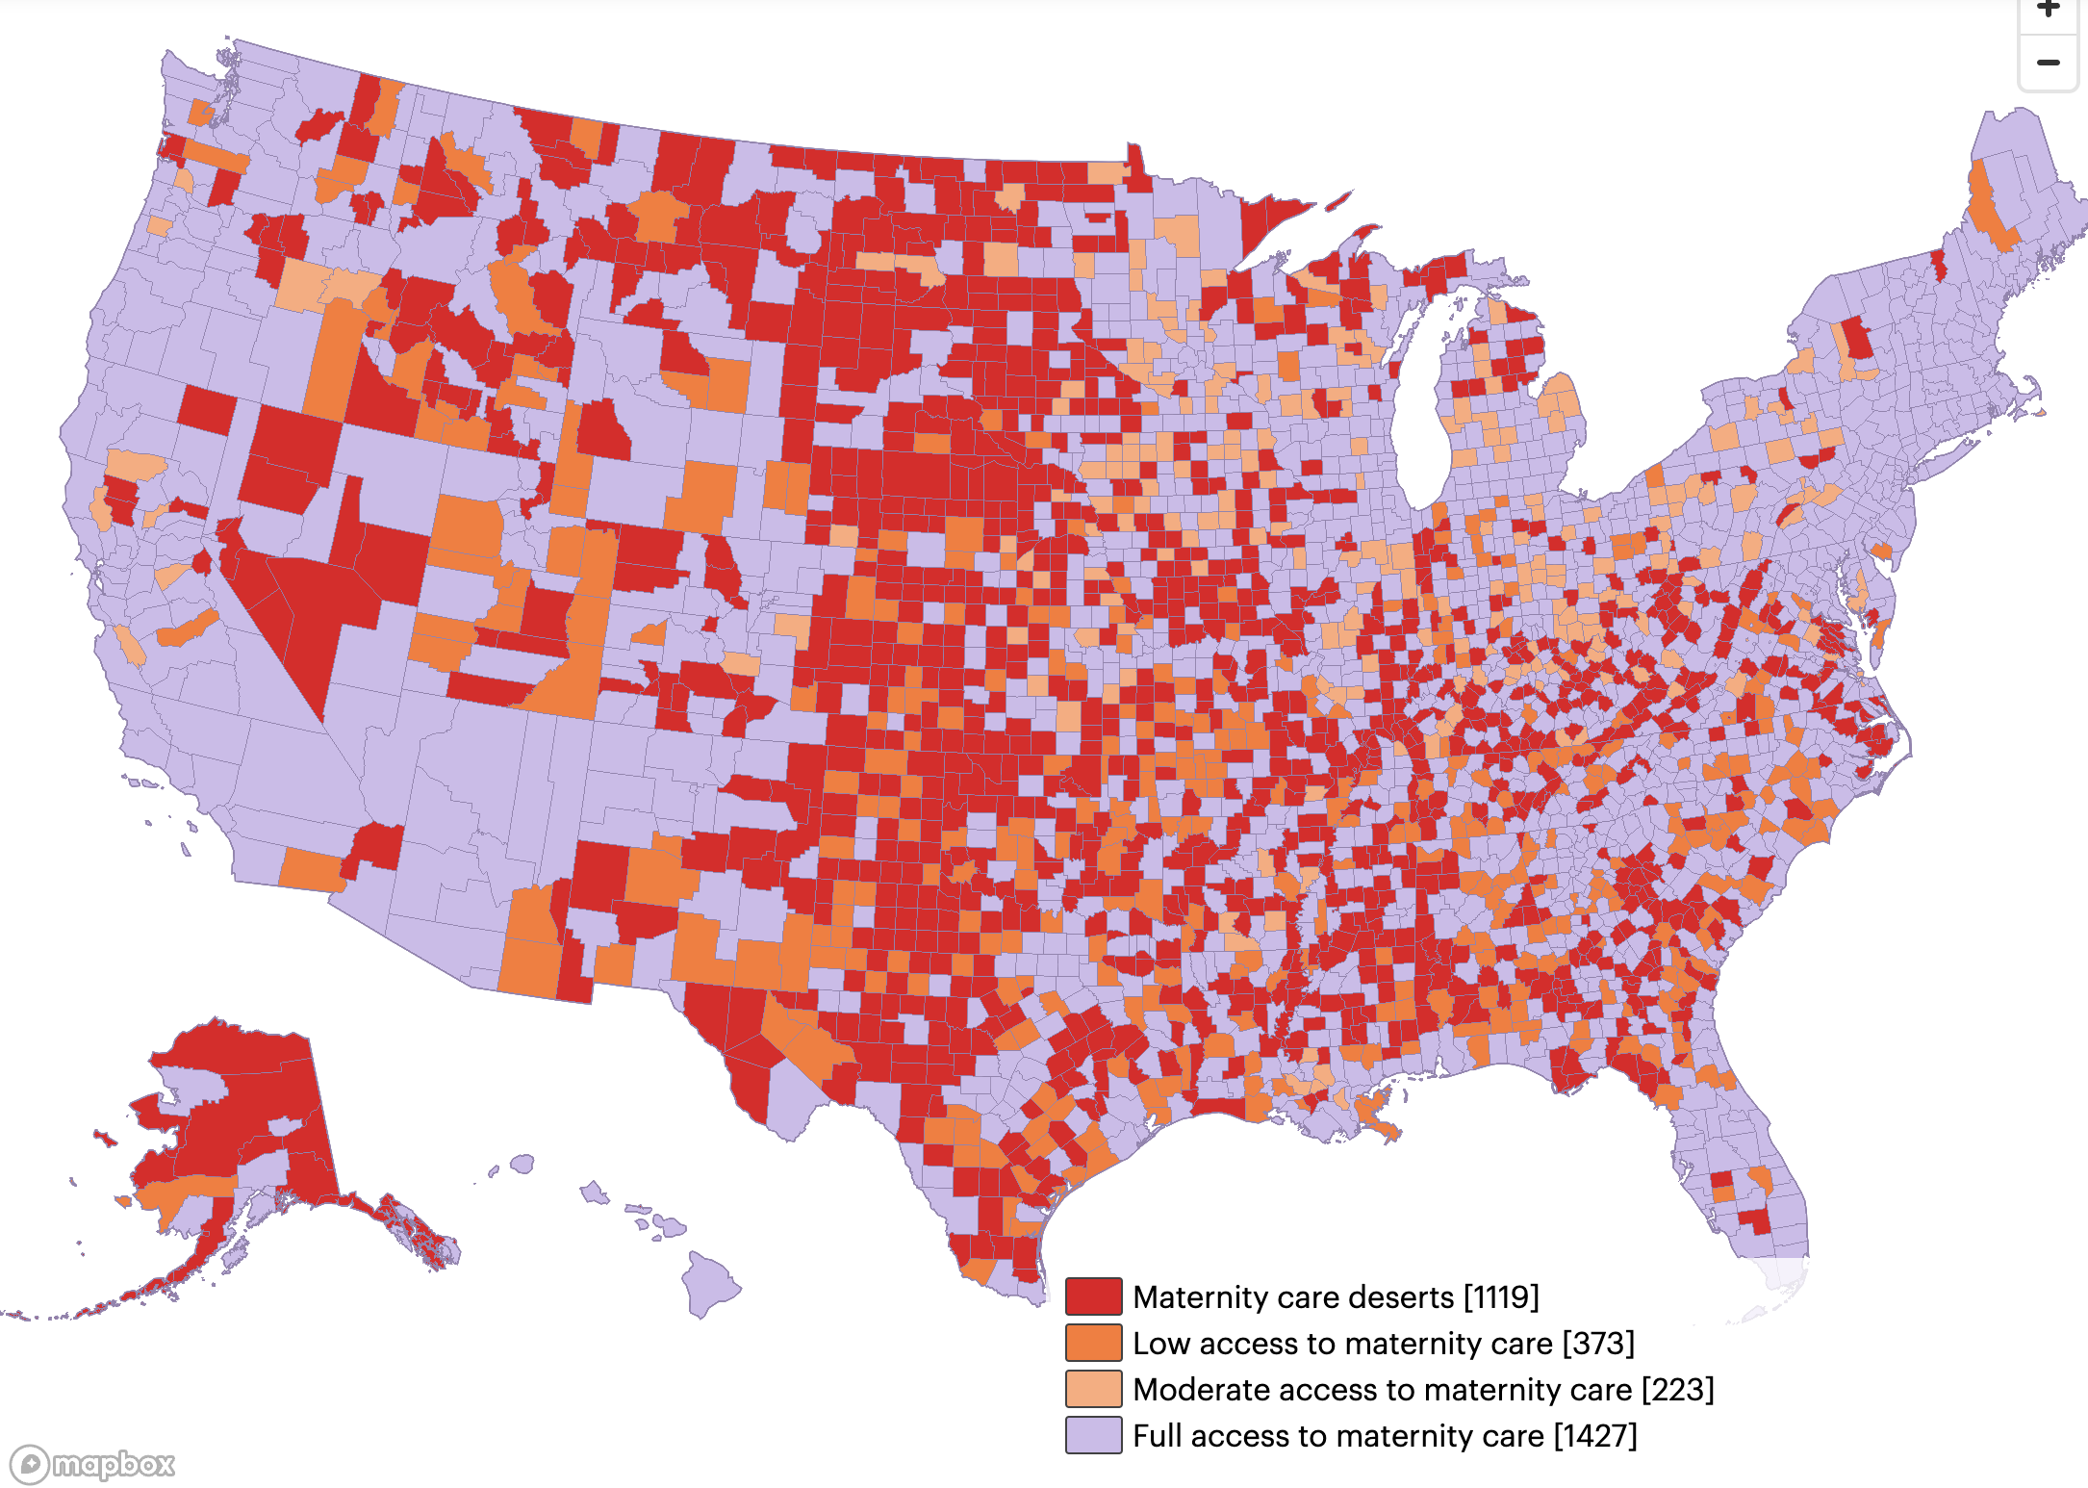
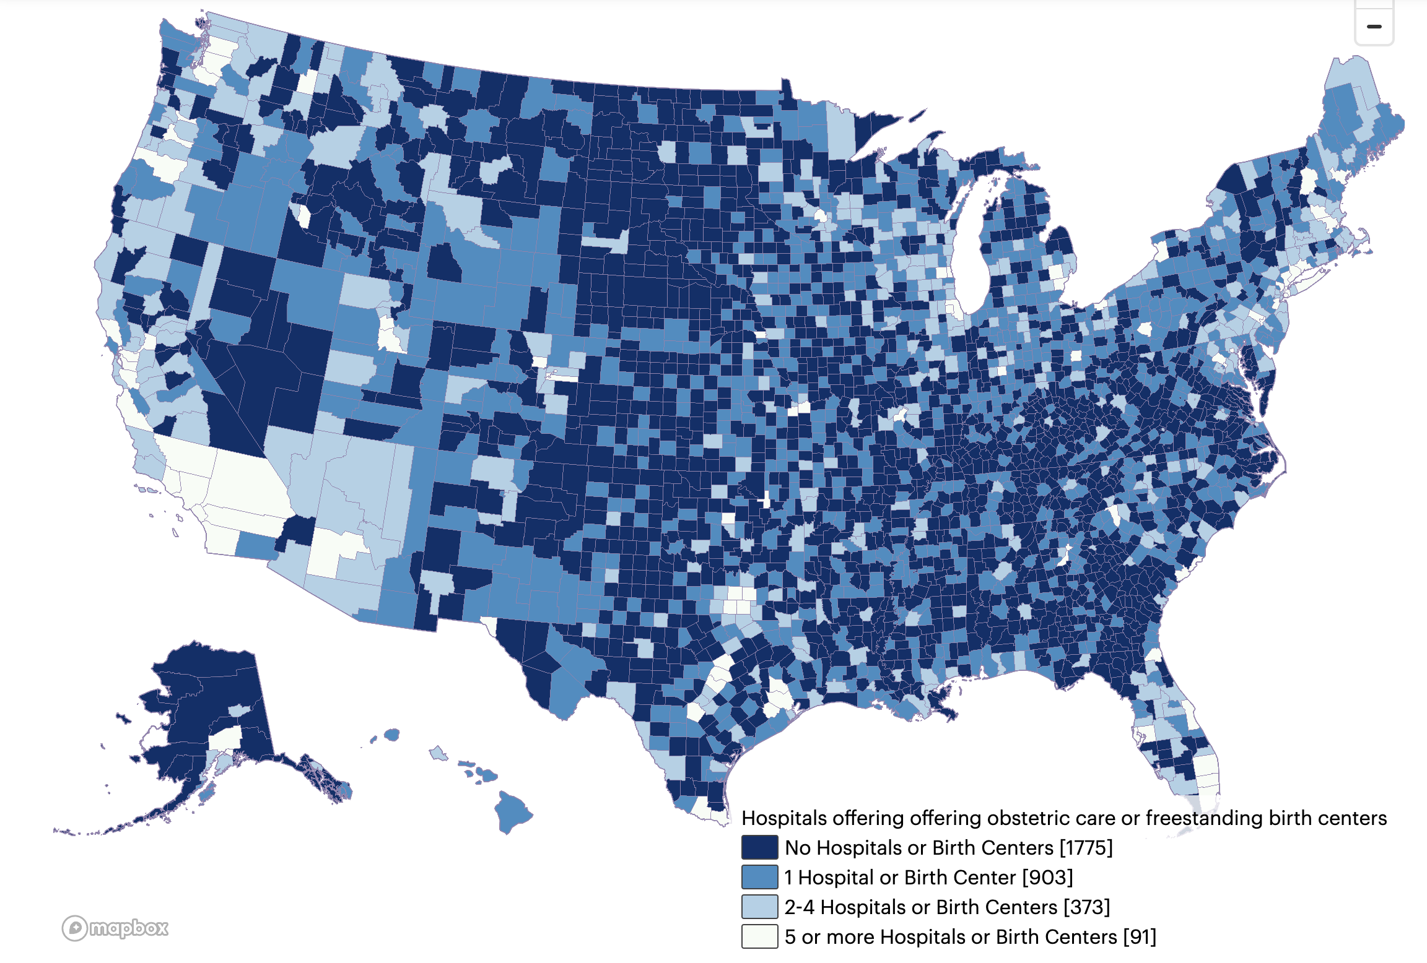
Images: https://www.marchofdimes.org/maternity-care-deserts-report
Notes:
Kelly
36% of US counties are considered MCDs.
More than 2.2 million birthing people of childbearing age live in MCDs with no hospital offering obstetric care, no birth center, and no obstetric provider.
More than 146,000 infants were born in MCDs in 2022.
March of Dimes 2022

Slide 13
MCDs by the Numbers
From 2010 to 2022, more than 500 hospitals closed their labor and delivery units, leaving many rural hospitals and more than a third of urban hospitals without obstetric care. (Kozhimannil et al 2024)
While there are IHS and tribal planned birth facilities in seven states, 41% percent of IHS Emergency Departments report having no obstetric services available. (IHS internal survey 2014)
Maternity care deserts are linked to a lack of adequate prenatal care or treatment for pregnancy complications and an increased risk of maternal death for a year after giving birth. (Wallace et al, 2020)
Notes:
Kelly

Slide 14
MCDs are not the full story for AI/AN birthing people
80.2% of AI/AN women didn’t have OB services within 15 miles and have the highest travel time to obstetric care compared to all other predominant races/ethnicities. AI/AN people are 2.1x more likely to be without a car compared to rural white peers. (March of Dimes 2022, Fontenet et al 2024, Wang et al 2023)
Maternal mortality is 3.8x more likely in AI/AN women than white women. 93% of those deaths are preventable. (Chen et al 2025, Trost et al 2022)
Notes:
Kelly
Rural AI/AN areas are farther from hospital obstetric units, have less internet access, lower SES and insurance rates, higher unemployment and poverty compared to rural areas without highly represented MRGs – all of which are known to compromise maternal health.

Slide 15
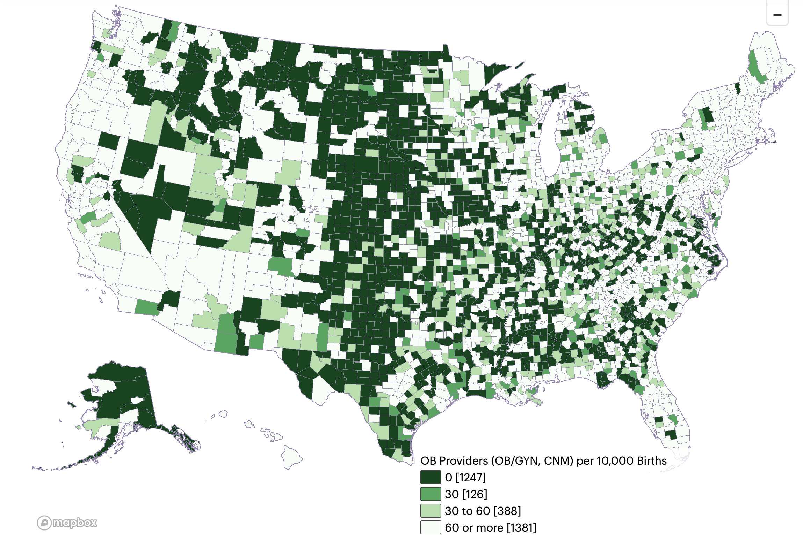
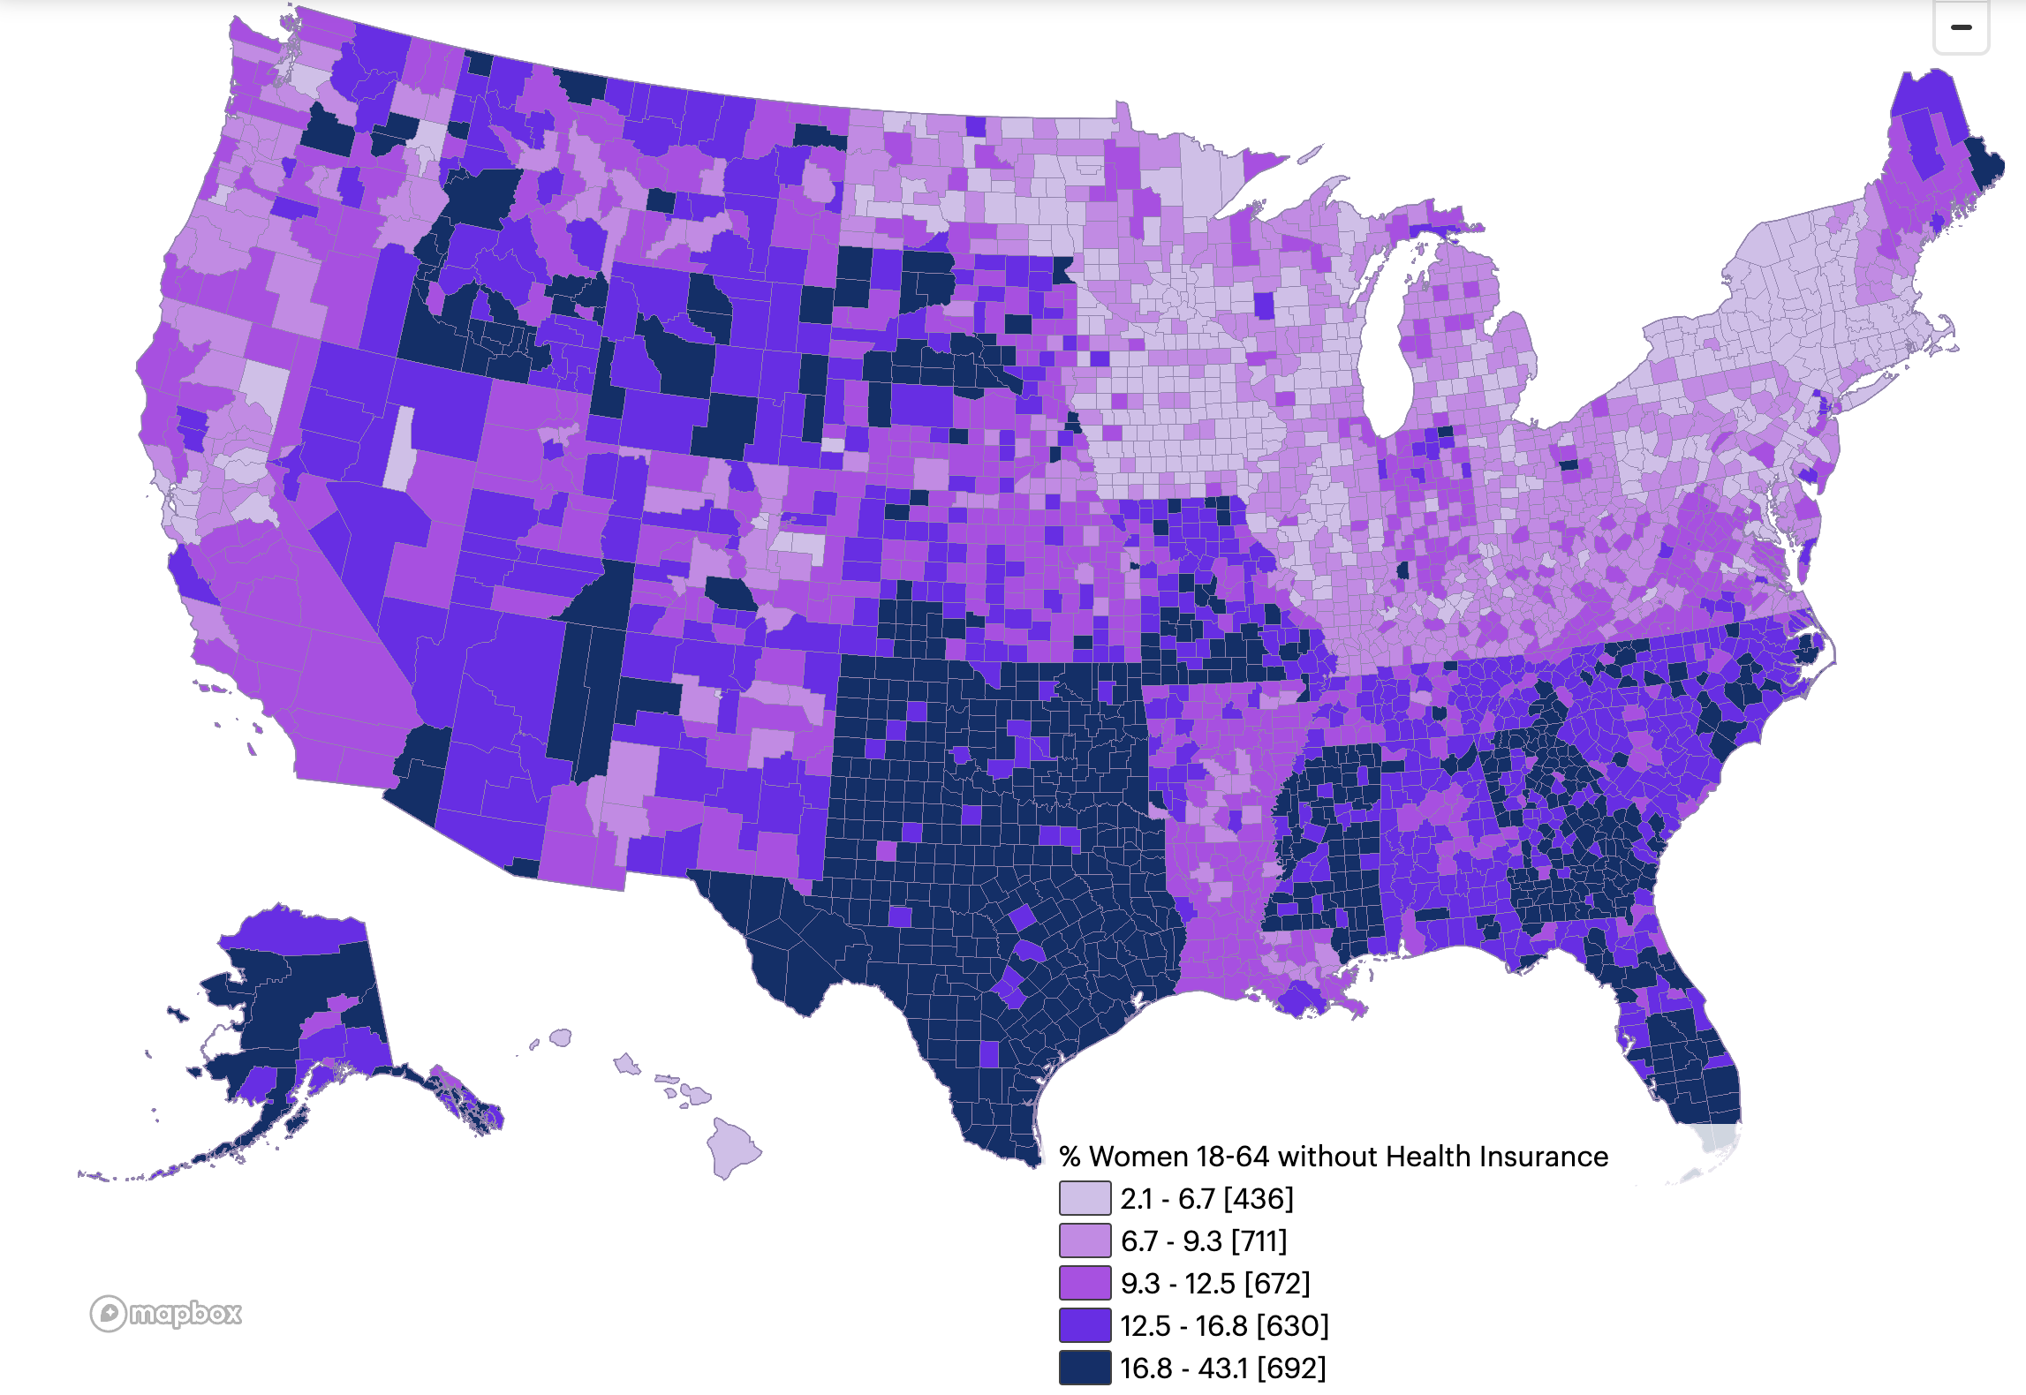
Images: https://www.marchofdimes.org/maternity-care-deserts-report
Notes:
Shon
Left: OB providers per 10,000 births
Right: % women 18-64 without health insurance

Slide 16
What does this mean for EM and non-OB providers?
Notes:
Shon (transition)

Slide 17
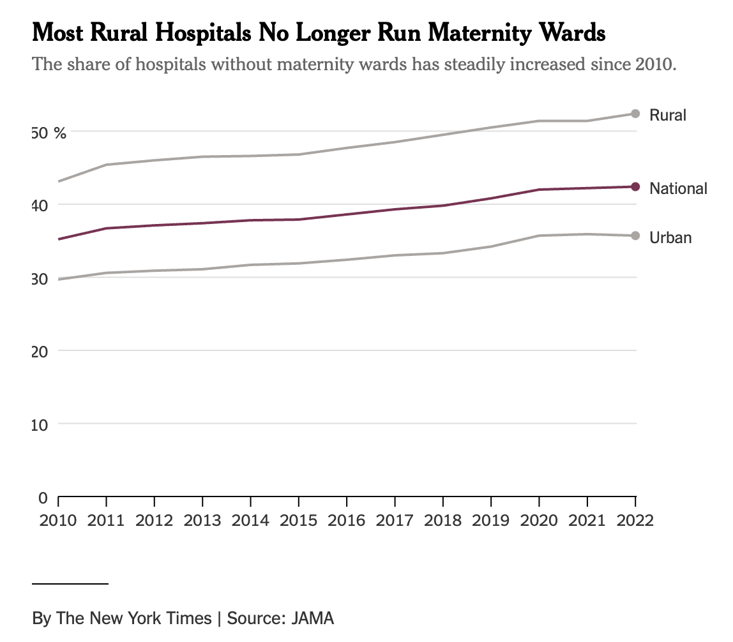
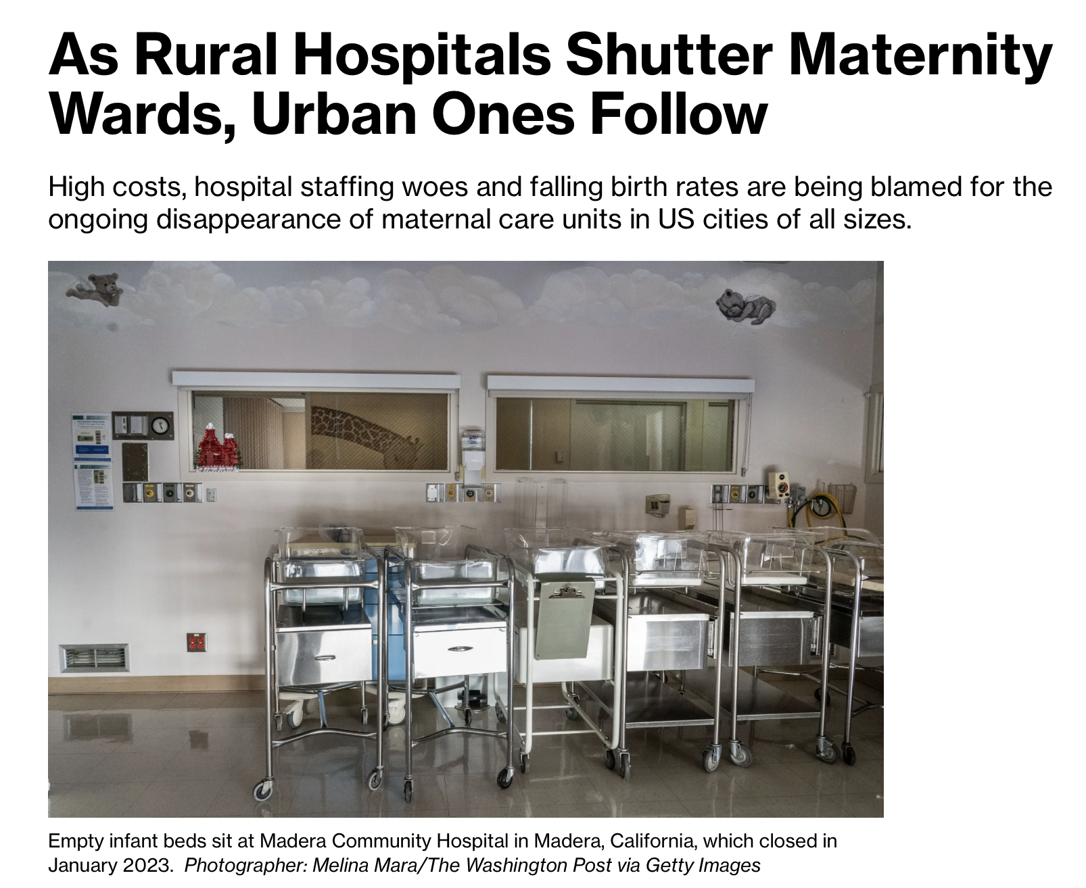
Notes:
It is important to note that this is an issue affecting both rural and urban areas. Patients may present to an ED or urgent care setting regardless of whether obstetric services are offered at that facility.
-A small subset of births occur in emergency departments, however the changing landscape of rural healthcare may mean that more patients are seen in these settings. (Callahan 2023). Closure of L&D units are associated with increased out-of-hospital births and births in hospitals without an obstetric unit. (Kozhimannil 2018). -women with rural/remote residence more likely to visit the ED during pregnancy (Matenchuk 2022).
-majority of residency training programs are in urban settings, where trainees are more likely to be an environment that has OB and other specialty back-up
https://www.bloomberg.com/news/articles/2024-08-27/hospital-cuts-claim-maternity-wards-in-both-rural-and-urban-us
https://www.nytimes.com/2024/12/04/health/maternity-wards-closing.html#:~:text=wards%2Dclosing.html-,Most%20Rural%20Hospitals%20Have%20Closed%20Their%20Maternity%20Wards%2C%20Study%20Finds,areas%20and%20large%20cities%20alike.&text=Sarah%20Kliff%20is%20an%20investigative,at%20nytimes.com%2Ftips.
Callahan M. Emergency Delivery. Emerg Med Clin North Am. 2023 May;41(2):281-294. doi: 10.1016/j.emc.2022.12.002. Epub 2023 Feb 20. PMID: 37024164.
Matenchuk BA, Rosychuk RJ, Rowe BH, Metcalfe A, Chari R, Crawford S, Jelinski S, Serrano-Lomelin J, Ospina MB. Emergency Department Visits During Pregnancy. Ann Emerg Med. 2023 Feb;81(2):197-208. doi: 10.1016/j.annemergmed.2022.06.021. Epub 2022 Aug 6. PMID: 35940991.
Kozhimannil KB, Hung P, Henning-Smith C, Casey MM, Prasad S. Association Between Loss of Hospital-Based Obstetric Services and Birth Outcomes in Rural Counties in the United States. JAMA. 2018 Mar 27;319(12):1239-1247. doi: 10.1001/jama.2018.1830. PMID: 29522161; PMCID: PMC5885848.

Slide 18

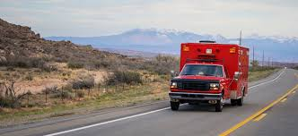
Notes:
-However, emergency departments have a duty to treat all life- and limb-threatening emergencies, including obstetrics (Cooper 2016).
-Emergency departments must be prepared to manage a delivery and delivery complications in a non-obstetric setting, associated neonatal resuscitation and complications such as post-partum hemorrhage. (Cooper 2016)
-Training of frontline providers working in non-obstetric settings including EM physicians, EMS teams and FM providers may have more limited exposure to obstetrics care and complications during their formal training programs (Nickerson 2023)
https://www.route-fifty.com/infrastructure/2023/08/life-rural-ambulance-desert-means-sometimes-help-isnt-way/389706/?oref=rf-topic-lander-river
Nickerson J, McCollum N, Abdulrahman E, Marko K, Soghier L, Rucker A, Madati J, Zhao X. Asynchronous Learning Module for Pediatric Emergency Medicine Physicians on How to Manage Vaginal Birth and Neonatal Resuscitation in the Emergency Department. Pediatr Emerg Care. 2023 Jun 1;39(6):397-401. doi: 10.1097/PEC.0000000000002959. PMID: 37163676.
Cooper MI, Papanagnou D, Meguerdichian M, Bajaj K. Emergency Obstetrics for the Emergency Medicine Provider. MedEdPORTAL. 2016 Oct 13;12:10481. doi: 10.15766/mep_2374-8265.10481. PMID: 30984823; PMCID: PMC6440410.

Slide 19
Emergency Medicine OB Training
ACGME requirements: 10 low-risk spontaneous vaginal deliveries (ACGME 2023)
Survey of EM residents:
  Comfort level for dealing with OB emergencies was only “somewhat comfortable” for most residents
  56% reported adequate exposure to OB emergencies (Janicki et al 2016)
Notes:
Kelly

Slide 20
Over 80% of pregnancy-related deaths are preventable
CDC 2020
Notes:
pregnancy-related adverse outcomes occurred during pregnancy and up to 1 year post-partum. Over 80% of pregnancy-related deaths are preventable.
https://www.cdc.gov/maternal-mortality/php/data-research/index.html

Slide 21
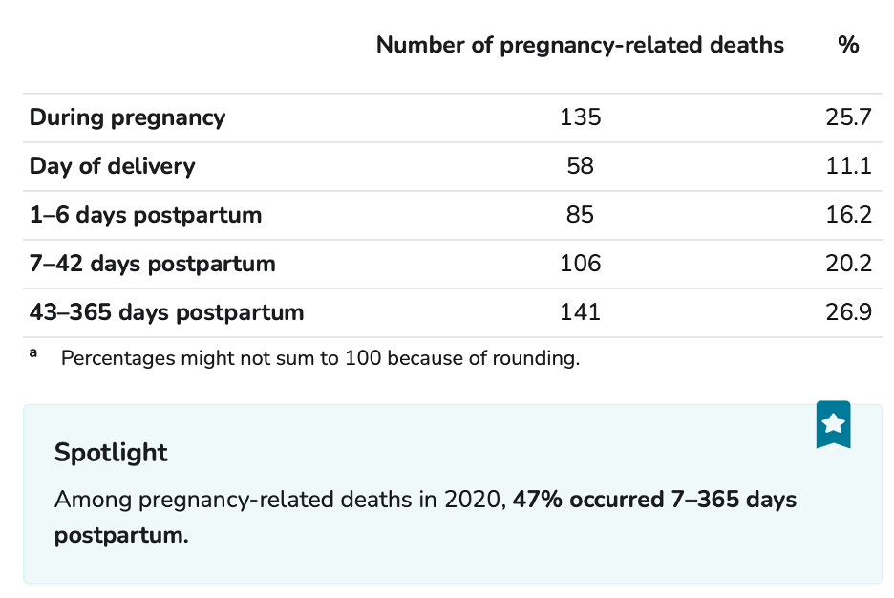
CDC 2020
Notes:
Among the 525 pregnancy-related deaths, an underlying cause of death was identified for 511 deaths. In 2020, the six most frequent underlying causes of pregnancy-related death—mental health conditions, cardiovascular conditions, infection, hemorrhage, embolism, hypertensive disorders of pregnancy—accounted for over 82% of pregnancy-related deaths (Table 4).
https://www.cdc.gov/maternal-mortality/php/data-research/index.html

Slide 22
 | % of pregnancy-related deaths
Mental health conditions | 22.5
Cardiovascular conditions | 16.6
Infection | 16.4
Hemorrhage | 11.2
Embolism | 8.6
Hypertensive disorders of pregnancy | 7.1
82%
CDC 2020
Notes:
a striking statistic is that 47% of pregnancy-related deaths occur 7-365 days post-partum. The most frequent causes of pregnancy-related deaths are conditions that may be seen in EDs including mental health conditions, cardiovascular conditions such as cardiomyopathy, infection, hemorrhage, embolism and hypertensive disorders of pregnancy. All told, these conditions account for 82% of pregnancy-related deaths. (CDC 2024)
https://www.cdc.gov/maternal-mortality/php/data-research/index.html

Slide 23
Patient experience
Notes:
Kelly

Slide 24

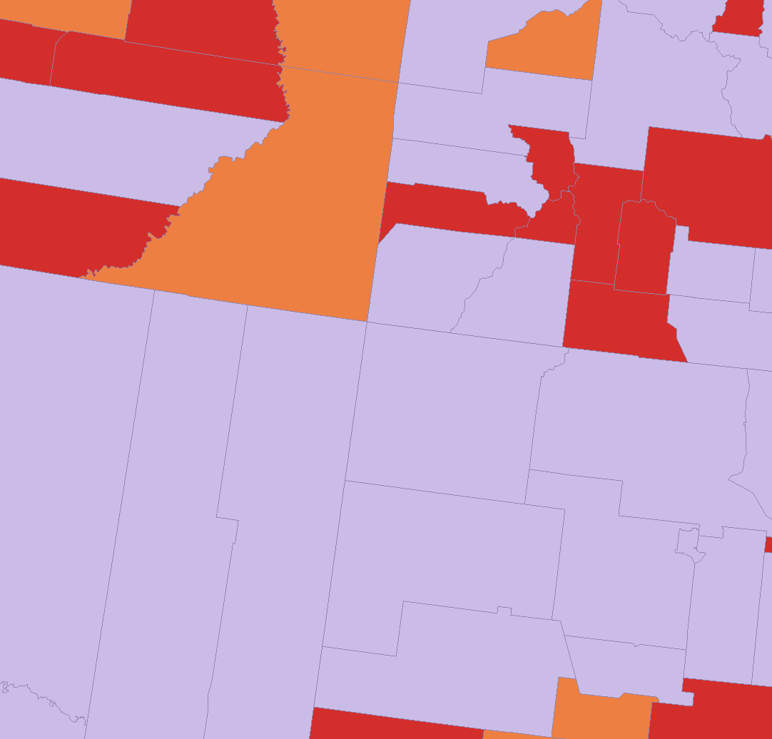
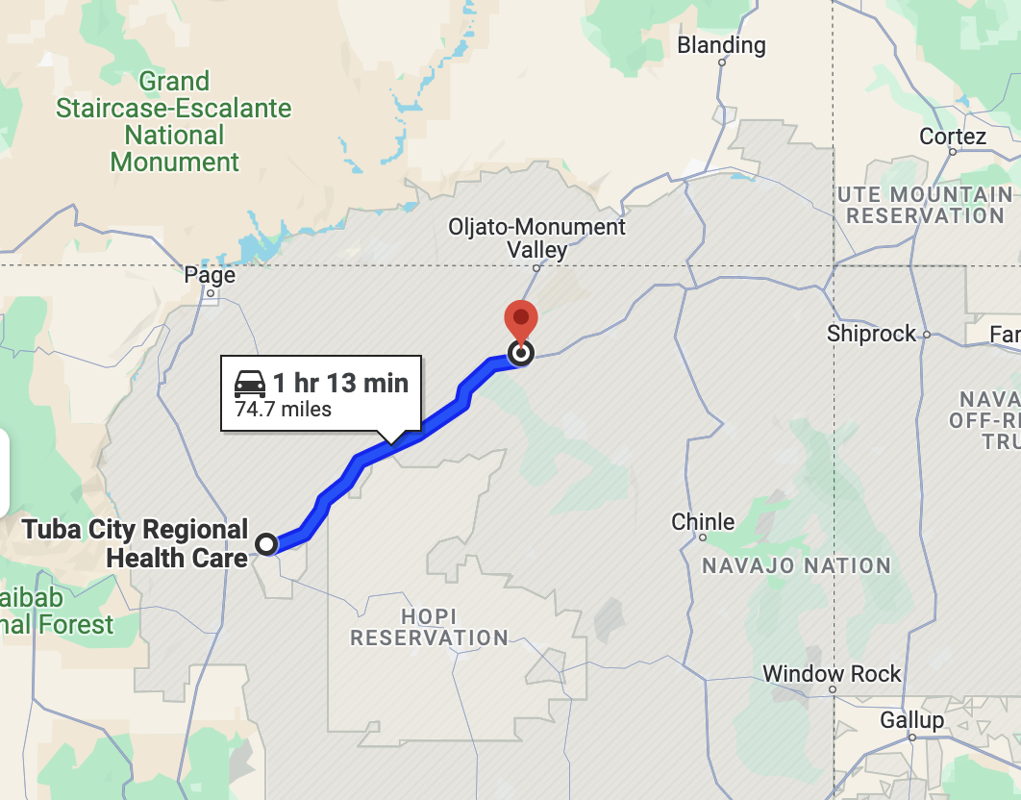
Images: Previously credited and Google Maps
Notes:
Kelly
Map on left is driving distances to obstetric care, dark red >30 miles
Map in middle shows maternity care deserts, which these counties are technically not, but they are very large.
Map on right, if someone shows up to Kayenta, there is no OB care and the nearest facility is >1hr away.

Slide 25
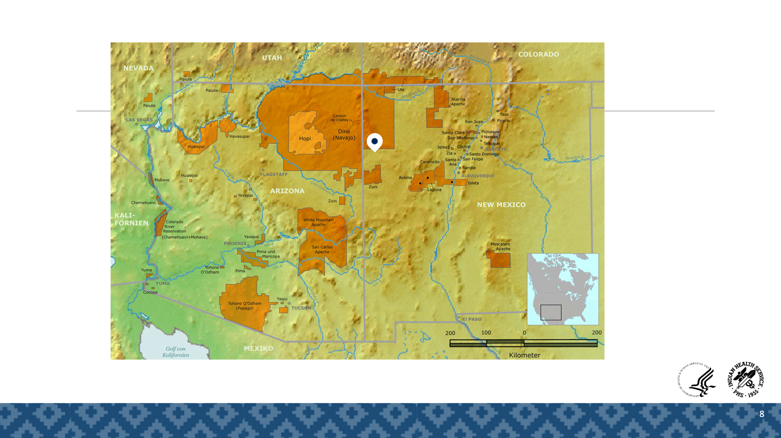
Images: Previously credited and Google Maps
Notes:
Kelly
Map on left is driving distances to obstetric care, dark red >30 miles
Map in middle shows maternity care deserts, which these counties are technically not, but they are very large.
Map on right, if someone shows up to Kayenta, there is no OB care and the nearest facility is >1hr away.

Slide 26


Slide 27
Examples of initiatives
Notes:
Emily

Slide 28
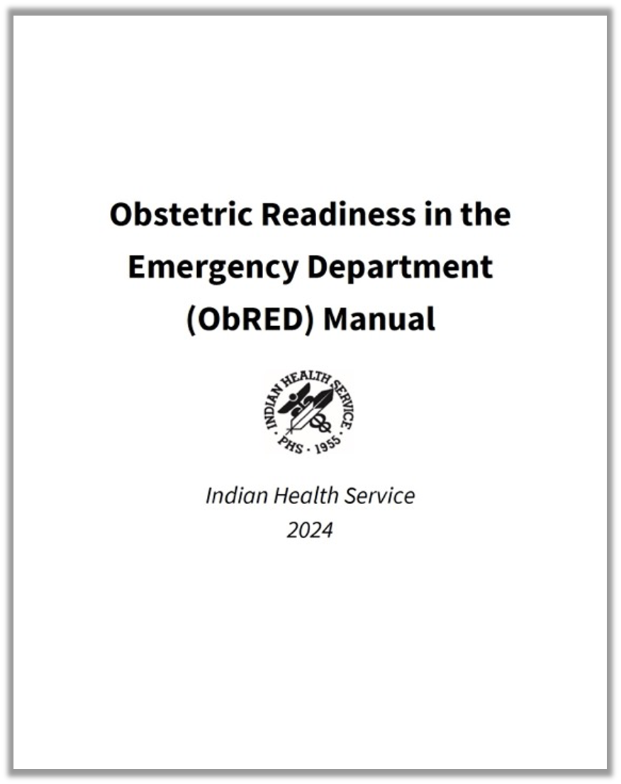
ObRED
Notes:
Kelly

Slide 29
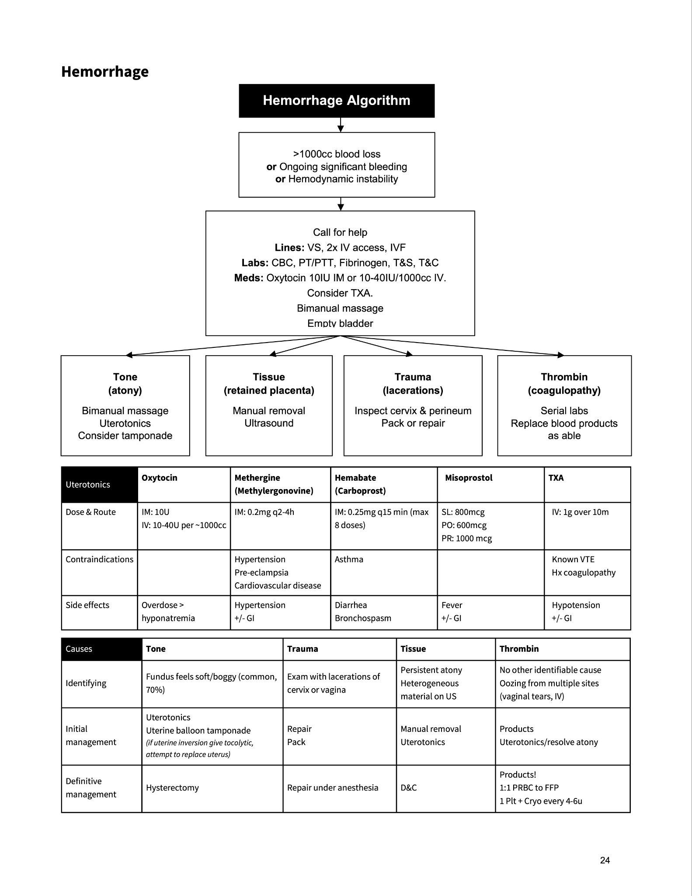
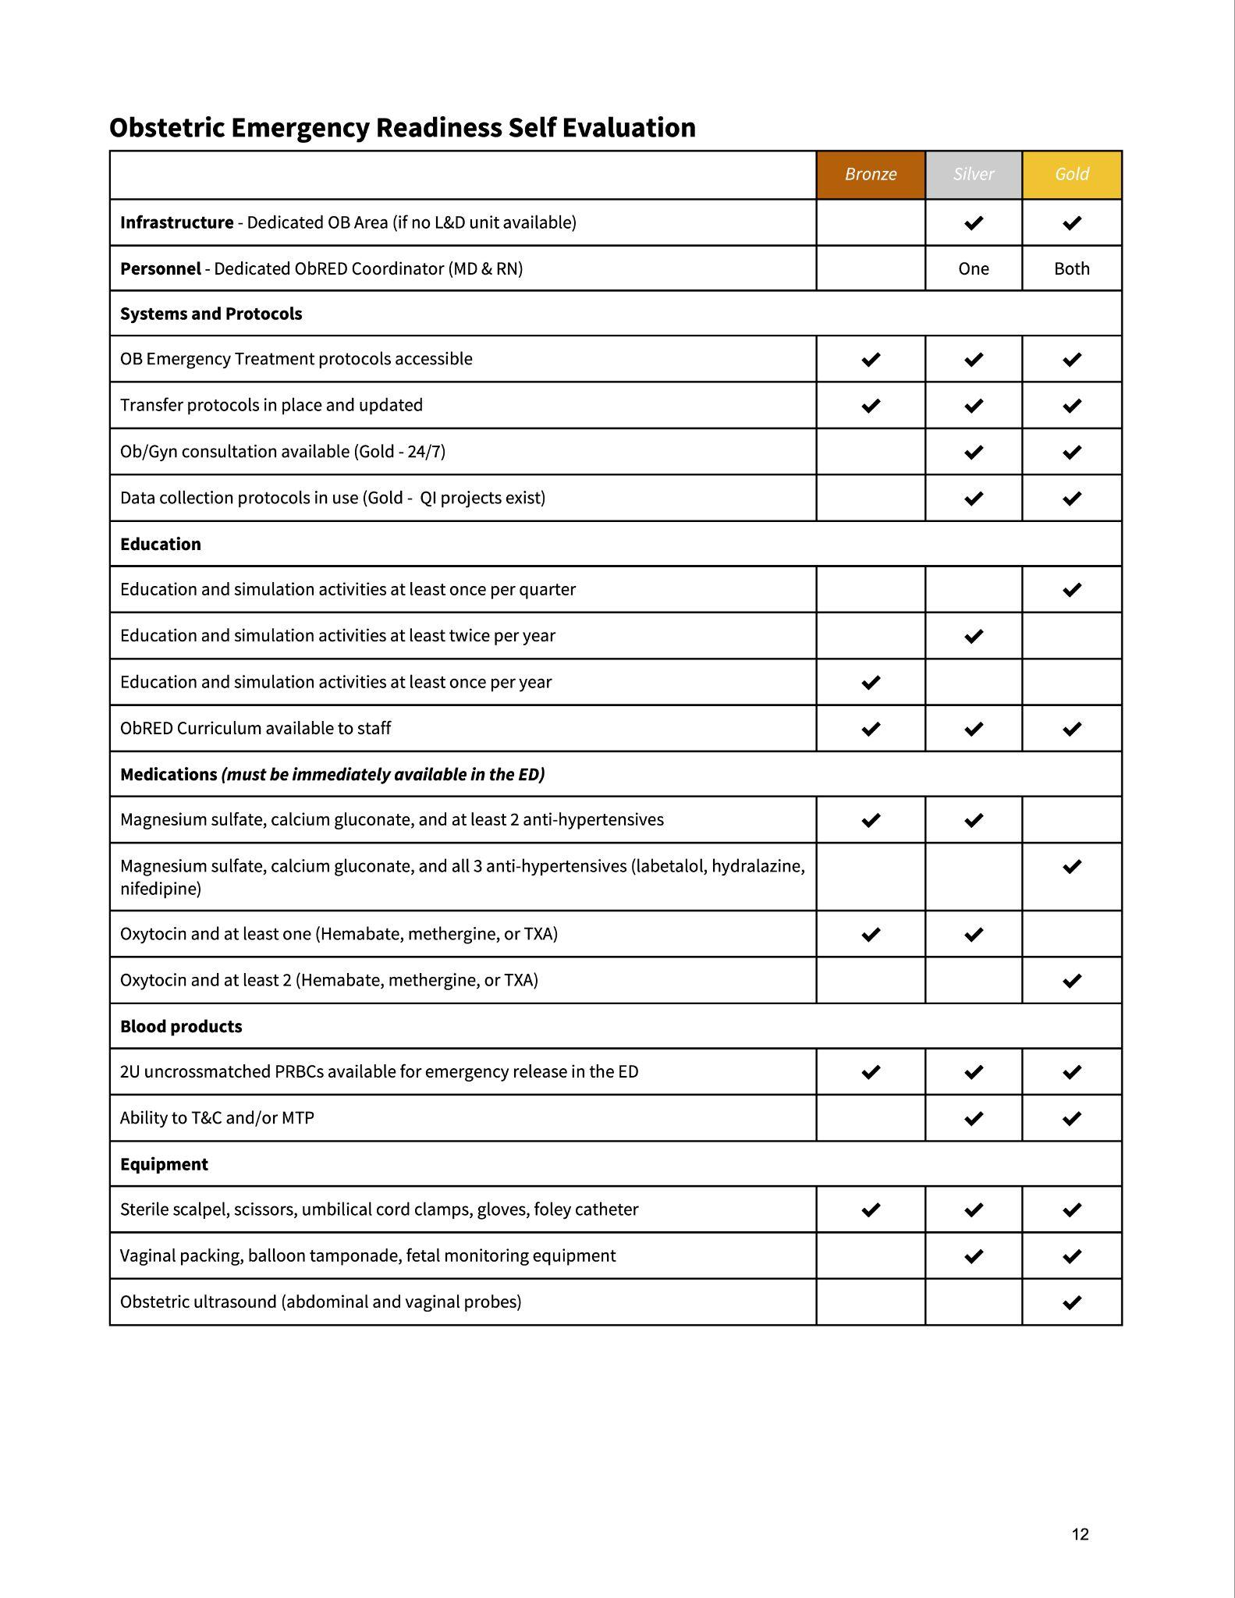
Readiness checklists & evaluations
Education & simulation
Notes:
Kelly/Emily

Slide 30
West Virginia Experience
ACOG and Perinatal partnership
Visit rural Emergency Rooms without OB care
Provide education
  Triage process
  Hypertension in pregnancy
  Postpartum Hemorrhage
  Vaccines
  Maternal mental health
Provide resources
Delivery simulation
Notes:
Shon

Slide 31
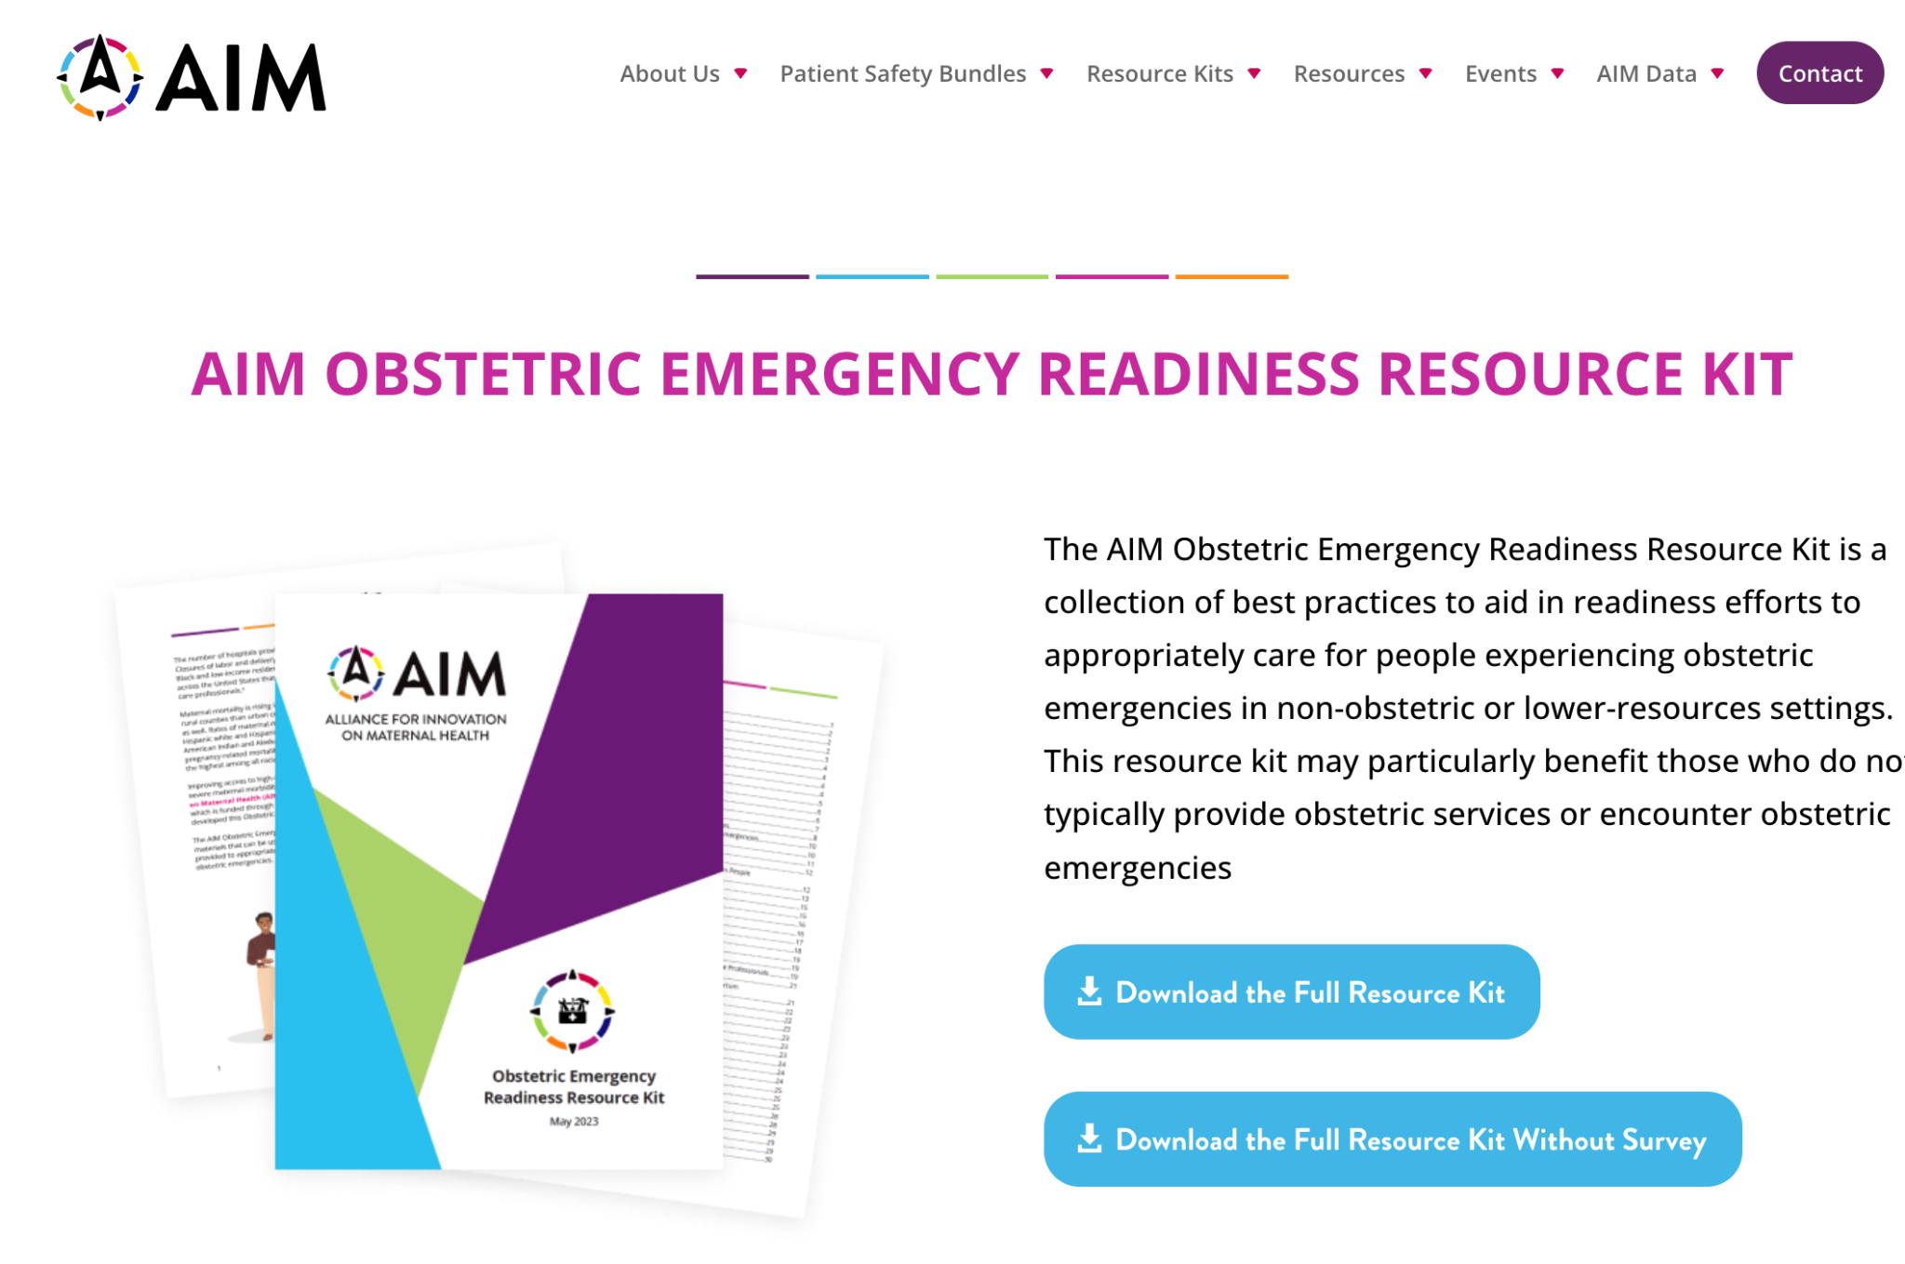
Notes:
Shon

Slide 32
Taking action

Slide 33

https://www.pexels.com/photo/high-five-hands-6146822/
Notes:
Emily
Everyone has a role to play and everyone can become a champion to care for our communities.

Slide 34

https://flic.kr/p/8zKQyY
Notes:
Emily
The important thing is to get started

Slide 35
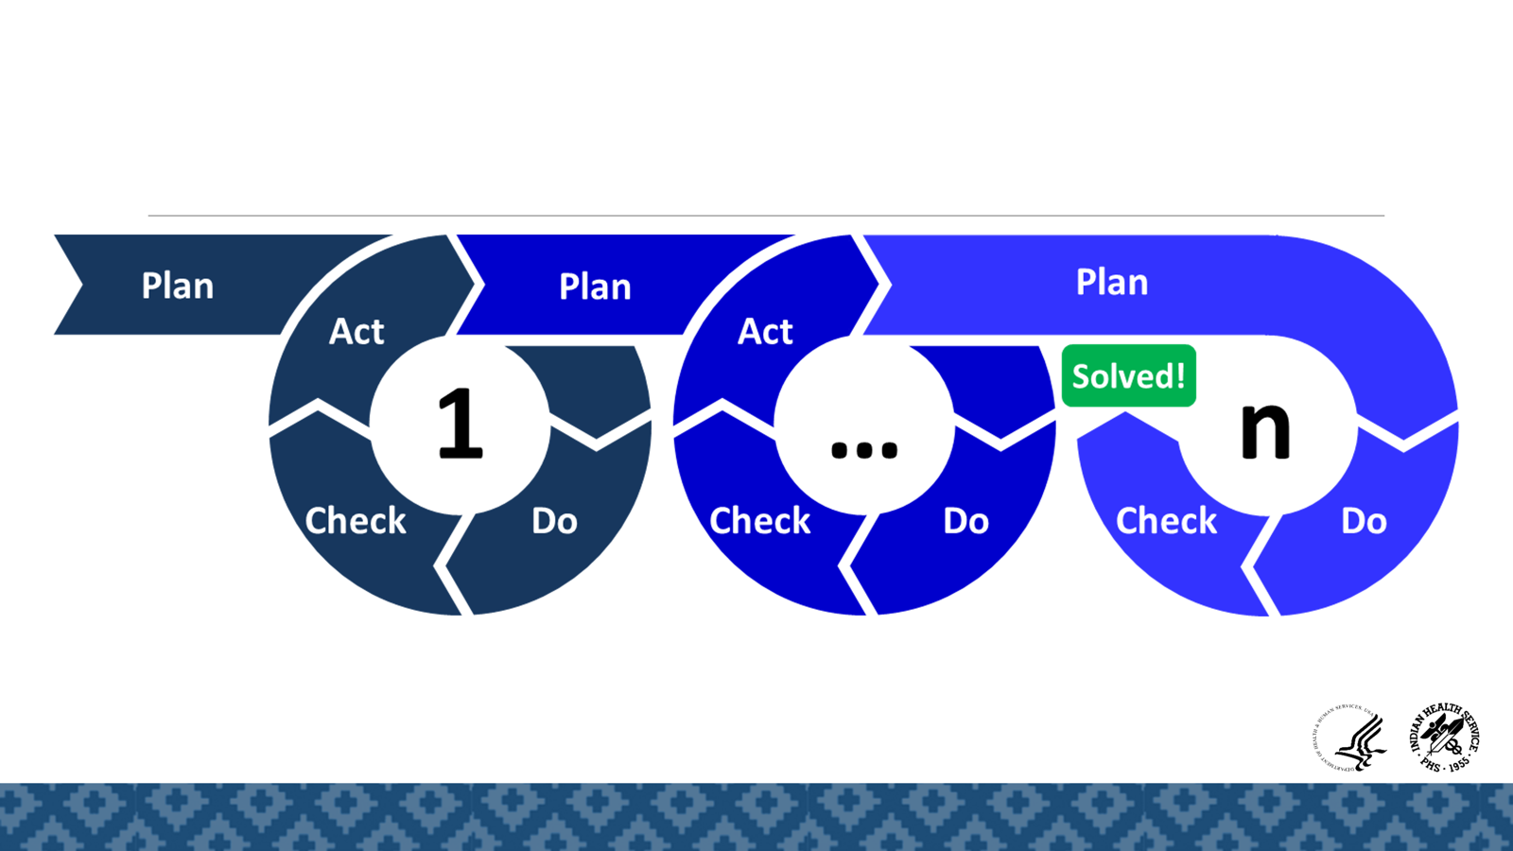
https://commons.wikimedia.org/wiki/File:PDCA-Multi-Loop.png
Notes:
Emily
FAIL = first attempt in learning
Iterative plan-do-check-act cycles support continuous quality improvement efforts
https://commons.wikimedia.org/wiki/File:PDCA-Multi-Loop.png
“Drills for obstetric emergencies are now being recommended by the Joint Commission, which
suggests that hospitals and providers can prevent maternal death using drills “to train staff in the
protocols, to refine local protocols, and to identify and fix systems problems that would prevent
optimal care.”1 …Simulation helps improve patient
safety through providing education, enhancing communication, improving patient hand-offs, and driving system
changes…Although materials such as obstetric simulators can be expensive, there are lowfidelity,
low-cost, simulators available that are very effective…However, we remind
the reader that the top two issues consistently causing safety concerns are based on communication and
teamwork. A high-tech mannequin is not necessary to work on these issues.”https://saferbirth.org/wp-content/uploads/FINAL_AIM_ObstetricInSituDrill-ProgramManual.pdf
https://saferbirth.org/wp-content/uploads/FINAL_AIM_ObstetricInSituDrill-ProgramManual.pdf
https://saferbirth.org/wp-content/uploads/FINAL_AIM_ObstetricInSituDrill-ProgramManual-2.pdf

Slide 36

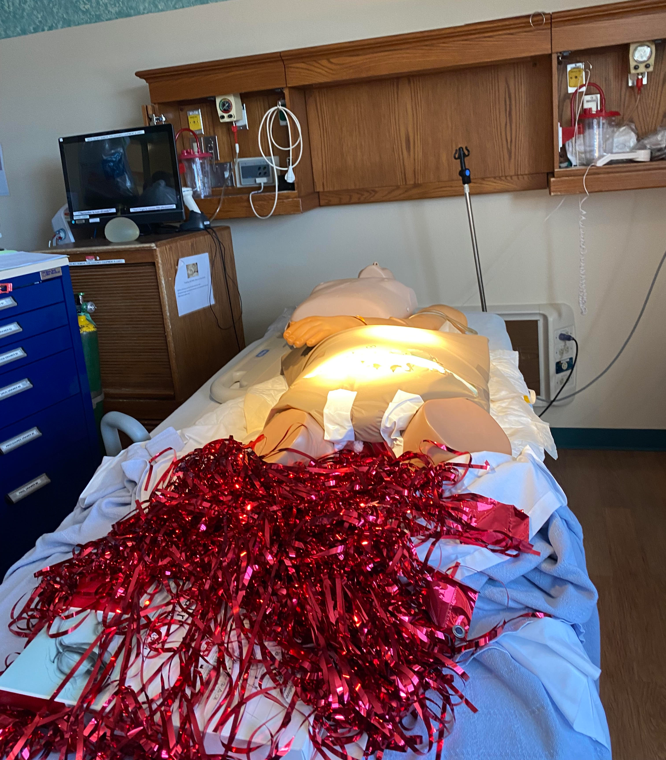
Top two issues causing safety concerns:
Communication
Teamwork
AIM 2022
Notes:
Emily
Expensive resources and tech are not needed to get underway.
“Drills for obstetric emergencies are now being recommended by the Joint Commission, which
suggests that hospitals and providers can prevent maternal death using drills “to train staff in the
protocols, to refine local protocols, and to identify and fix systems problems that would prevent
optimal care.”1 …Simulation helps improve patient
safety through providing education, enhancing communication, improving patient hand-offs, and driving system
changes…Although materials such as obstetric simulators can be expensive, there are lowfidelity,
low-cost, simulators available that are very effective…However, we remind
the reader that the top two issues consistently causing safety concerns are based on communication and
teamwork. A high-tech mannequin is not necessary to work on these issues.”https://saferbirth.org/wp-content/uploads/FINAL_AIM_ObstetricInSituDrill-ProgramManual.pdf
https://saferbirth.org/wp-content/uploads/FINAL_AIM_ObstetricInSituDrill-ProgramManual.pdf
https://saferbirth.org/wp-content/uploads/FINAL_AIM_ObstetricInSituDrill-ProgramManual-2.pdf

Slide 37
Innovative Solutions

Slide 38

Telehealth
Image: https://images.app.goo.gl/qso1kFxQCvfDhSQDA
Notes:
Shon/Kelly
Expanding telehealth can help women who live long distances away for post-partum checks
[ ]add image

Slide 39

Artificial intelligence/ remote monitoring
Image: https://images.app.goo.gl/SzN2QokhNhoRaxC4A
Notes:
Shon
AI/remote monitoring
[ ]add image

Slide 40
Thank you!

Slide 41
References
Maternity Care Deserts Report. March of Dimes, 2022. https://www.marchofdimes.org/maternity-care-deserts-report
Fontenot J, Brigance C, Lucas R, Stoneburner A. Navigating geographical disparities: access to obstetric hospitals in maternity care deserts and across the United States. BMC Pregnancy Childbirth. 2024 May 8;24(1):350. doi: 10.1186/s12884-024-06535-7. PMID: 38720255; PMCID: PMC11080172.
Wang, W., Espeland, S., Barajas, J.M. et al. Rural–nonrural divide in car access and unmet travel need in the United States. Transportation (2023). https://doi.org/10.1007/s11116-023-10429-6
Restoring Access to Maternity Care in Rural America. The Commonwealth Fund. 2021. https://www.commonwealthfund.org/publications/2021/sep/restoring-access-maternity-care-rural-america
Trost SL, Beauregard J, Njie F, et al. Pregnancy-Related Deaths Among American Indian or Alaska Native Persons: Data From Maternal Mortality Review Committees in 36 U.S. States, 2017–2019. Centers for Disease Control and Prevention, US Department of Health and Human Services; 2022.
Eberth, Jan M., et al. "The Problem Of The Color Line: Spatial Access To Hospital Services For Minoritized Racial And Ethnic Groups: Study examines spatial access to hospital services for minoritized racial and ethnic groups." Health Affairs 41.2 (2022): 237-246. https://www.ruralhealthresearch.org/publications/1517
Janicki AJ, MacKuen C, Hauspurg A, Cohn J. Obstetric training in Emergency Medicine: a needs assessment. Med Educ Online. 2016 Jun 28;21:28930. doi: 10.3402/meo.v21.28930. PMID: 27357908; PMCID: PMC4928067.https://www.ncbi.nlm.nih.gov/pmc/articles/PMC4928067/
Chen Y, Shiels MS, Uribe-Leitz T, Molina RL, Lawrence WR, Freedman ND, Abnet CC. Pregnancy-Related Deaths in the US, 2018-2022. JAMA Netw Open.
2025 Apr 1;8(4):e254325. doi: 10.1001/jamanetworkopen.2025.4325. PMID: 40202759; PMCID: PMC11983229.
Kozhimannil KB, Interrante JD, Carroll C, et al. Obstetric Care Access at Rural and Urban Hospitals in the United States. JAMA. 2025;333(2):166–169. doi:10.1001/jama.2024.23010
Accreditation Council for Graduate Medical Eduation (ACGME). Emergency Medicine Program Requirements Effective 7/1/2023. Available at <https://www.acgme.org/globalassets/pfassets/programrequirements/110_emergencymedicine_2023.pdf>
https://www.bloomberg.com/news/articles/2024-08-27/hospital-cuts-claim-maternity-wards-in-both-rural-and-urban-us

Slide 42
References
https://www.nytimes.com/2024/12/04/health/maternity-wards-closing.html#:~:text=wards%2Dclosing.html-,Most%20Rural%20Hospitals%20Have%20Closed%20Their%20Maternity%20Wards%2C%20Study%20Finds,areas%20and%20large%20cities%20alike.&text=Sarah%20Kliff%20is%20an%20investigative,at%20nytimes.com%2Ftips.
\Callahan M. Emergency Delivery. Emerg Med Clin North Am. 2023 May;41(2):281-294. doi: 10.1016/j.emc.2022.12.002. Epub 2023 Feb 20. PMID: 37024164.
Matenchuk BA, Rosychuk RJ, Rowe BH, Metcalfe A, Chari R, Crawford S, Jelinski S, Serrano-Lomelin J, Ospina MB. Emergency Department Visits During Pregnancy. Ann Emerg Med. 2023 Feb;81(2):197-208. doi: 10.1016/j.annemergmed.2022.06.021. Epub 2022 Aug 6. PMID: 35940991.
Kozhimannil KB, Hung P, Henning-Smith C, Casey MM, Prasad S. Association Between Loss of Hospital-Based Obstetric Services and Birth Outcomes in Rural Counties in the United States. JAMA. 2018 Mar 27;319(12):1239-1247. doi: 10.1001/jama.2018.1830. PMID: 29522161; PMCID: PMC5885848.
Centers for Disease Control and Prevention. Pregnancy-Related Deaths: Data From Maternal Mortality Review Committees in 38 U.S. States, 2020 https://www.cdc.gov/maternal-mortality/php/data-research/index.html
Alliance for Innovation in Maternal Health (AIM). 2022. Obstetric In-Situ Drill Program Manual. https://saferbirth.org/wp-content/uploads/FINAL_AIM_ObstetricInSituDrill-ProgramManual.pdf

Slide 43
Any questions?

Slide 44

Evaluation
Please follow the link at the end of this session to complete the evaluation.
This is REQUIRED for CE credit.
CE Certificate will be sent to your email in 1-2 weeks

Slide 45
Thank you!
Any questions about this webinar or the series can be sent to AIM@acog.org
The recording will be emailed to all attendees once ready
AIM will also post the recording on our website, saferbirth.org
Remember to register for upcoming webinars!

