Slide 1




July 23, 2025
AIM Obstetric Readiness Summer Learning Sprint
Pre-Hospital Care: Collaboration with Emergency Medical Services (EMS) in OB Readiness
Nick Nudell, PhD(c), MS, MPhil, NRP
Anne Margaret Perry, BSN, RN, CLNC, CEN, NRP, CP-C
Jaimee Robinson, DNP, RN, EBP-C, NPD-BC, RNC-OB, C-EFM, C-ONQS

Slide 2


This program is supported by a cooperative agreement with the Health Resources and Services Administration (HRSA) of the U.S. Department of Health and Human Services (HHS) under grant number UC4MC49476. This information or content and conclusions are those of the author and should not be construed as the official position or policy of, nor should any endorsements be inferred by HRSA, HHS or the U.S. Government.
The Alliance for Innovation on Maternal Health is a quality improvement initiative to support best practices that make birth safer, improve maternal health outcomes, and save lives.
You can find more information at saferbirth.org.

Slide 3
Disclaimer and Disclosures
Disclaimer: Any mention of commercial products, goods or services displayed or discussed during this CE activity should not be interpreted to imply endorsement by NPWH or ACOG.
Disclosure: The planners of this activity report no conflicts of interest. This activity has not received any commercial support.
This activity is facilitated by the Alliance for Innovation on Maternal Health which is funded through a cooperative agreement between ACOG and the Health Resource and Services Administration Maternal Child Health Bureau (HRSA MCHB).

Slide 4



Before we get started
This
Webinar
will be recorded
Resources should be used at your discretion
Resources discussed are not vetted or endorsed by AIM or ACOG and are provided for your convenience
If you need help during the call, please chat an AIM staff member

Slide 5

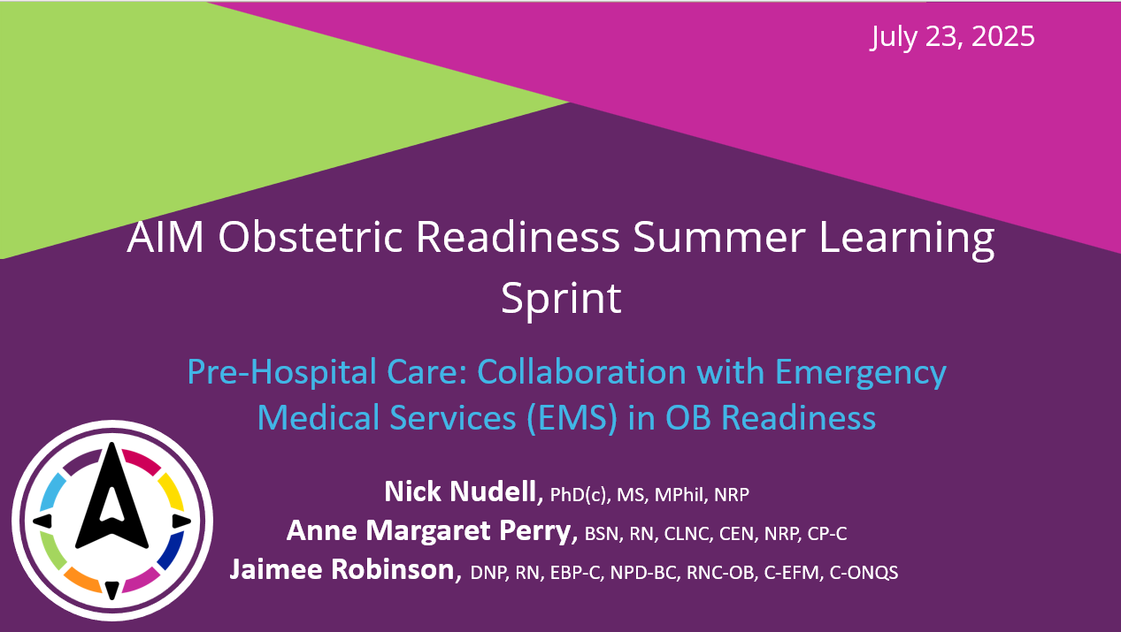
Zoom Webinar Features
New Features:
Participants automatically join in viewer mode
Polls are integrated into Zoom
Participants can ask questions in the Q&A box

Slide 6
Continuing Education Credits
AIM is excited to offer continuing education credit to attendees of this live session.
To receive your certificate
Attend at least 60 minutes of live activity
Complete evaluation following activity
Certificates will be sent via email in 1-2 weeks
This activity is approved by the Continuing Education Approval Program of the National Association of Nurse Practitioners in Women’s Health for 1 continuing education contact hours, including 0 hours of pharmacology content. NPWH Activity Number 25-12-03
The Continuing Education Approval Program of the National Association of Nurse Practitioners in Women’s Health, is accredited as a provider of continuing by the California State Board of Nursing, Provider Number CEP 13411
Notes:
Information on how to get CE – share the program in the chat at this time

Slide 7
Session Description
This webinar will examine the intersection of Emergency Medical Services and hospital teams in the setting of obstetric care and obstetric emergencies. The presenters will identify opportunities for collaboration between EMS and obstetric teams in hospital settings and freestanding birth centers. This discussion will highlight resources available for EMS teams to prepare for obstetric emergencies and will discuss strategies to facilitate and improve communication between EMS and hospital-based obstetric teams.
Learning Objectives
At the end of this webinar, participants will be able to:
Identify key opportunities for collaboration between EMS and obstetric teams during pregnancy, delivery, and postpartum
Design strategies to improve communication between EMS and obstetric care teams, including team debriefs following emergency events
Describe existing readiness resources and toolkits for EMS teams to establish and maintain obstetric care protocols
Adapt planning and coordination for EMS clinicians and hospital teams across various care landscapes, including urban and rural settings

Slide 8

Up Next!
SHARING BEST PRACTICES IN OBSTETRIC SIMULATIONS FOR THE EMERGENCY DEPARTMENT
OBSTETRIC CARE ASSESSMENT FOR RESOURCE LIMITED ENVIRONMENTS
August 6th, 3-4:15pm ET
August 13th, 3-4:15pm ET
Jennifer Mitzman, MD
Gina Grabowski, MSN, RN, CHSE
Lisa Wolf, PhD, RN
Catherine Eppes, MD, MPH

Slide 9
Who is in the Audience?
Respond to the poll questions on your screen to share a bit about yourself!

Slide 10



Today’s Presenters
Nick Nudell
PhD(c), MS, MPhil, NRP
Anne Margaret Perry
BSN, RN, CLNC, CEN, NRP, CP-C
Jaimee Robinson
DNP, RN, EBP-C, NPD-BC, RNC-OB, C-EFM, C-ONQS

Slide 11

Pre-Hospital Care: Collaboration with Emergency Medical Services (EMS) in OB Readiness
Nick Nudell, PhD(c), MS, MPhil, NRP
July 2025

Slide 12
Land Acknowledgment
I have worked or lived on the land of the Blackfeet Nation, Crow, Snoqualmie, Suquamish, Cayuse, Umatilla, Walla Walla, Stillaguamish and currently live on the land of the Apache, Arapaho, Ute, and Cheyenne nations.
As I work to improve emergency medical and trauma services, I do so with respect for the land and the communities that have called it home for generations.

Slide 13

Disclosures
I have no disclosures or conflicts of interest to report.

Slide 14



Current Roles
PhD candidate in Public Policy & Administration
Paramedic scientist @ The Paramedic Foundation & for UCHealth in Colorado
Executive Director of Northeast Colorado Regional Emergency Medical and Trauma Services Advisory Council (NCRETAC)
Board member of:
EMS Association of Colorado
Colorado Chapter of the National Association of EMS Physicians
Chair of the American College of Paramedics

Slide 15
Create The Future
“You never change things by fighting the existing reality.
To change something, build a new model that
makes the existing model obsolete”
Buckminster Fuller

Slide 16
Why OB Readiness Matters
Patients who develop signs or symptoms of serious pregnancy-related complications and conditions during this period (during or within one year of the end of pregnancy) may seek emergency care in non-obstetric settings, including:
Emergency Medical Services transport
Hospital-based emergency department
Rural hospital emergency department with limited or no obstetrical support
Stand-alone emergency room
Urgent care facility
Notes:
Multi-year partnership with CDC to enhance recognition and response to obstetric emergencies in non-OB settings.

Slide 17
Pregnancy related emergencies are high-risk, low-frequency events

Slide 18
Underlying Causes of Pregnancy-Related Deaths, Data from Maternal Mortality Review Committees in 36 US States, 2017-2019
Notes:
Maternal Mortality Review Committees or MMRCs conduct comprehensive reviews of pregnancy-related deaths—that is, those during or within one year of the end of pregnancy—to understand the medical and non-medical contributors to deaths in order to develop actionable recommendations to prevent future deaths.

Slide 19
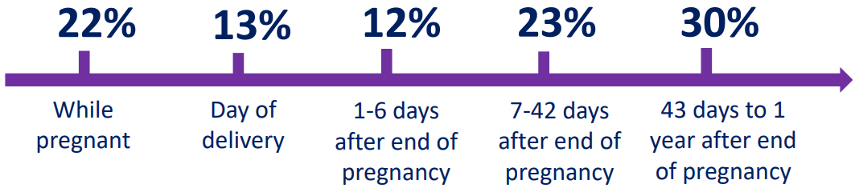
Among pregnancy-related deaths, 53% occurred 7 days to 1 year after the end of pregnancy.
Notes:
Pregnancy-related deaths can occur during or within one year of the end of pregnancy
Underlying causes of pregnancy-related deaths can include hemorrhage; cardiovascular conditions such as cardiomyopathy; hypertensive emergencies such as preeclampsia, eclampsia, and stroke; and conditions related to mental health such as suicide and overdose.

Slide 20
Realities of OB care in the EMS Setting
EMS providers' scope, limitations, and variability across states/systems
Challenges EMS faces:
Lack of OB-specific training and equipment
Navigating unpredictable settings (home births, roadside deliveries, etc.)
Uncommon patient, especially in rural areas
EMS's first-contact role and potential for outcome influence

Slide 21
EMS Role in Improving Outcomes
Journal articles report:
Ohio MMRC data identified EMS response and lack of transport to appropriate care as contributing factors in some maternal deaths.
In a Columbus study of 1,575 EMS transports involving pregnant patients, only one reported hypertension as a complaint—yet nearly one-third were hypertensive on EMS assessment, highlighting missed recognition.
Improved understanding of obstetric patient acuity is critical for EMS training and system planning.
EMS providers must be equipped to recognize and initiate care for maternal hypertension and hemorrhage, which can be lifesaving.

Slide 22
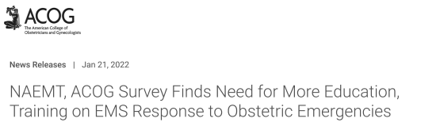
NAEMT/ACOG Survey
Survey response:
1,702 EMS practitioners responded
Respondents were largely paramedics and EMTs providing prehospital care in the US
Survey findings:
Less than 1/2 of respondents feel they have adequate knowledge of the altered physiology of postpartum patients
Nearly 75% of survey respondents do not ask if patients have been pregnant within the past year
Notes:
ACOG partnered with NAEMT to learn more. We fielded a survey aimed to:
Determine level of EMS practitioner experience in responding to & treating pregnant & postpartum patients during emergencies
Identify gaps and opportunities for prehospital education and training
Released January 21, 2022
NAEMT, ACOG Survey Finds Need for More Education, Training on EMS Response to Obstetric Emergencies | ACOG

Slide 23
Health Issues Encountered ≠ Topical Education and Training Desired
Notes:
Have you encountered any of these health issues among pregnant or postpartum patients in the last year?

Slide 24


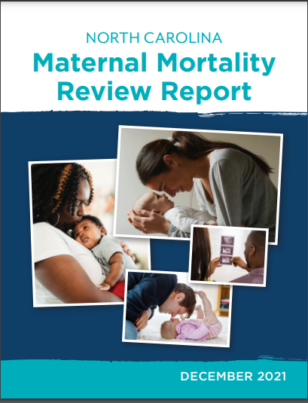
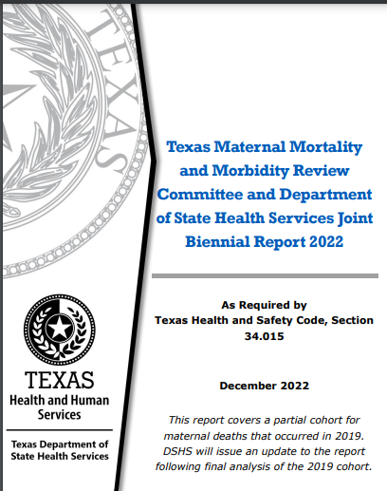
EMS OB Readiness Resources
AZ: Develop a resource for Arizona EMS providers to educate on urgent maternal warning signs and maternal resuscitation strategies
PA: Review and update existing EMS protocols for pregnancy and postpartum hemorrhage and continue educational efforts on the recognition and treatment of emergency conditions related to pregnancy.
NC: Better communication and coordination between EMS, mental health, prenatal care and hospital providers.
TX: Implement EMS obstetric-specific training and simulations
Notes:
EMS identification of obstetric complications in the field is critical to timely management of the pregnant or postpartum patient upon arrival to the emergency department. EMS readiness to also stabilize pregnant or postpartum patients is important, especially in rural areas where there may be long transports to a facility with obstetric care.
MMRCs have confirmed that EMS practitioners are important in addressing this issue and made specific recommendations for the prehospital care setting.

Slide 25
Key Opportunities for Collaboration
Shared Protocol Development:
Pre-arrival instructions, transport preferences, risk flagging
Cross-training and OB Simulations:
Invite EMS to participate in hospital OB drills
Prenatal Risk Communication:
Known high-risk pregnancies flagged in EMS Computer Aided Dispatch software or hospital records
Freestanding Birth Centers & EMS Coordination:
Memorandum of Understandings and shared expectations for when EMS is activated

Slide 26
Communication Strategies
Prenotification Best Practices:
Standardizing what OB teams need to know: gestational age, parity, vital signs, fetal movement, bleeding, etc.
Use of SBAR or MIST Handoffs:
EMS adaptations for obstetrics
Post-Event Debriefs & Feedback Loops:
Structured interdisciplinary case reviews
Creating a culture of shared learning between EMS and hospital staff

Slide 27
Closing Thoughts & Call to Action
EMS plays a critical role in OB readiness
Encourage hospitals, birth centers, and EMS agencies to connect
Questions?
Let’s Collaborate!

Slide 28
References
Trost SL, Beauregard J, Njie F, et al. Pregnancy-Related Deaths: Data from Maternal Mortality Review Committees in 36 US States, 2017-2019. Atlanta, GA: Centers for Disease Control and Prevention, US Department of Health and Human Services; 2022
DeSisto CL, Oza-Frank R, Goodman D, Conrey E, Shellhaas C. Maternal transport: an opportunity to improve the system of risk-appropriate care. J Perinatol 2021;41(9):2141-2146. doi: 10.1038/s41372-021-00935-9
Hutchcraft ML, Ola O, McLaughlin EM, Hade EM, Murphy AJ, Frey HA, Larrimore A, Panchal AR. A one-year cross sectional analysis of emergency medical services utilization and its association with hypertension in pregnancy. Prehosp Emerg Care 2022;26(6):838-847. doi: 10.1080/10903127.2021.1988775
Malavé G, Bressman P, Brooks K, Dixson L, Petrie, K. Obstetric emergency education and simulation in the prehospital environment. JEMS 2022 June 28.
Cash RE, Swor RA, Samuels-Kalow M, Eisenbrey D, Kaimal AJ, Camargo CA Jr. Frequency and severity of prehospital obstetric events encountered by emergency medical services in the United States. BMC Pregnancy Childbirth 2021;21(1):655. doi: 10.1186/s12884-021-04129-1
https://www.acog.org/programs/obstetric-emergencies-in-nonobstetric-settings

Slide 29
Thank you!
Contact:
Nick Nudell
+1 970.699.8522
nnudell@paramedicfoundation.org
https://orcid.org/0000-0002-2414-2025

Slide 30

Collaborative Efforts Across Specialties:
Enhancing EMS and Obstetric Team Coordination
Anne Margaret Perry
MSN, APRN, FNP-BC, FNP-C, CLNC, CEN, NRP, CP-C, DICO-C
Salty Goddess Ventures, LLC
www.saltygoddessventures.com
ventures@saltygoddessventues.com

Slide 31



Webinar Overview and Learning Objectives
Scope and Goals of the Webinar
This webinar aims to enhance collaboration between EMS and obstetric teams by improving coordination across pregnancy, delivery, and postpartum phases to optimize emergency care outcomes.
1
Expected Learning Outcomes
Participants will learn to identify collaboration opportunities, improve communication strategies, utilize readiness resources, and adapt coordination for diverse care settings.
2
Importance of EMS and Obstetric Team Collaboration
Effective teamwork between EMS and obstetric providers ensures timely responses, reduces risks, enhances safety, and improves maternal and neonatal outcomes, especially in resource-limited areas.
3
Notes:
Welcome, everyone, and thank you for joining today's session. Our goal is to deepen collaborative efforts between EMS and obstetric teams, especially in emergency contexts. We’ll explore not only what collaboration looks like across the pregnancy continuum but also how improved communication, training, and shared protocols can transform outcomes. By the end of this session, you'll be equipped with actionable insights and tools for enhancing interdisciplinary coordination.

Slide 32
Importance of Collaboration Between
EMS and Obstetric Teams
Benefits of Interdisciplinary Teamwork
Impact on Patient Safety and Outcomes
Challenges Addressed Through Collaboration
Collaboration between EMS and obstetric teams enhances patient safety by pooling diverse expertise and promoting timely interventions during pregnancy and emergencies.
Effective teamwork reduces communication errors, supports continuous learning, and fosters a culture of trust, leading to improved maternal and neonatal outcomes.
Collaboration mitigates professional hierarchies, resource disparities, and communication barriers, enabling equitable and coordinated obstetric care across settings.
Notes:
In obstetric emergencies, time and teamwork are everything. Interdisciplinary collaboration isn’t just beneficial, it’s essential. When EMS and OB teams work seamlessly, we reduce delays, minimize risk, and improve patient outcomes. We’ll also talk about how addressing communication and structural barriers can elevate equity and trust in care delivery.

Slide 33

Overview of Obstetric Care Continuum:
Pregnancy, Delivery, Postpartum
Stages of Obstetric Care Continuum
1
Obstetric care includes pregnancy, delivery, and postpartum stages, each requiring coordinated clinical management to ensure maternal and neonatal safety.
Key Clinical Considerations at Each Stage
2
Pregnancy focuses on prenatal education and risk identification; delivery requires managing labor and emergencies; postpartum involves monitoring complications and care continuity.
EMS Role Throughout Obstetric Care
3
EMS provides emergency response, prehospital assessment, urgent transport, and coordination with obstetric teams to optimize outcomes across all care stages.
Notes:
Let’s take a bird’s-eye view of the obstetric care continuum. Each stage, pregnancy, labor, postpartum, and as such, each requires tailored, responsive care. This is where EMS plays a critical, often under-discussed role, from prehospital assessment to emergency transport. Understanding how we fit into this continuum enables better planning, response, and integration.

Slide 34
Key Roles of EMS
in Obstetric Emergencies
EMS Responsibilities in Obstetric Emergencies : EMS personnel provide rapid assessment, stabilization, and prepare pregnant patients for transport while coordinating with hospital obstetric teams.
Prehospital Assessment and Interventions : EMS conducts vital sign and fetal status evaluation, manages airway and circulation, administers medications, and assists emergency deliveries when needed.
Rapid Transport and Communication : Timely transport and real-time communication with hospitals ensure preparedness and improve maternal and neonatal outcomes in emergencies.
Notes:
EMS providers are often the first line of defense in obstetric emergencies. From rapid assessment to stabilization and emergency deliveries, EMS must be trained and ready to communicate effectively with OB teams. Highlighting these roles sets the foundation for why strong protocols and readiness matter.

Slide 35
Common Obstetric Emergencies Encountered by EMS
Frequent Obstetric Emergencies in EMS : EMS commonly encounters hemorrhage, eclampsia, preterm labor, prolapsed cord, breech delivery, shoulder dystocia, and maternal sepsis during pregnancy and delivery.
Key Signs and Symptoms to Recognize : EMS providers must identify excessive bleeding, severe hypertension, seizures, preterm contractions, visible umbilical cord, abnormal fetal positions, and maternal infection signs promptly.
Initial EMS Management Strategies : Focus on airway, breathing, circulation support, bleeding control, fetal monitoring, emergency delivery preparation, communication with obstetric teams, and rapid transport to appropriate facilities.
Notes:
the most frequent obstetric emergencies EMS teams encounter. Recognizing key symptoms early, like eclamptic seizures or shoulder dystocia, can make the difference between life and death. Combining evidence-based prehospital strategies, training and early coordination with OB teams changes the outcome, for these moms and babies for the better!

Slide 36


Identifying Opportunities for
Collaboration During Pregnancy
1
2
3
Prenatal Education and Risk Assessment
Communication Pathways with Obstetric Providers
Community Outreach and Support
Engaging EMS in prenatal education improves understanding of pregnancy risks and enables early identification of high-risk patients for tailored emergency preparedness.
Establishing clear communication channels between EMS and obstetric teams ensures routine information sharing and coordinated emergency response planning.
Joint EMS and obstetric outreach educates pregnant women on emergency signs and promotes prenatal care compliance to reduce delayed responses.
Notes:
There are multiple avenues open to increase collaboration across the EMS and OB specialties

Slide 37



Collaborative Strategies During Labor and Delivery Emergencies
Establishing Joint Response Protocols
Develop and implement standardized protocols for EMS and obstetric teams to ensure timely identification, intervention, and coordinated transport during labor emergencies.
1
Coordinated Decision-Making and Resource Allocation
2
Facilitate effective communication using tools like SBAR and ensure availability of obstetric emergency toolkits to optimize on-scene care and transport decisions.
Role Clarity and Teamwork Enhancement
Define clear roles for EMS and obstetric teams, promote mutual understanding, and conduct post-event debriefings to improve collaboration and patient outcomes.
3

Slide 38
Postpartum Care:
EMS and Obstetric Team Coordination
1
Postpartum Complications Requiring EMS Intervention
Postpartum complications such as hemorrhage, sepsis, hypertension emergencies, and thromboembolism require EMS recognition and prompt management to ensure maternal safety.
2
Monitoring and Transport Protocols
EMS must continuously monitor vital signs and symptoms, manage acute conditions, and ensure rapid transport while coordinating with obstetric teams for timely care.
3
Communication for Continuity of Care
Effective communication between EMS and obstetric providers is essential for seamless care, including detailed clinical information exchange and post-event documentation.

Slide 39
Case Study:
Successful EMS-Obstetric Collaboration in a Delivery Emergency
Scenario and Response Actions : EMS personnel rapidly assessed and managed a delivery emergency on-site, ensuring timely communication with hospital obstetric teams for seamless care transition.
Key Success Factors : Effective communication, clear role definitions, ongoing training, structured debriefings, and use of evidence-based protocols were critical to the successful outcome.
Lessons for Future Practice : Joint protocols, continuous education, structured communication, post-event debriefs, and context-specific readiness improve EMS-obstetric emergency collaboration.

Slide 40



Communication Challenges
Between EMS and Obstetric Teams
Common Communication Barriers
Impact on Patient Care and Team Dynamics
Need for Standardized Communication Tools
Terminology differences, timing issues, and unclear jargon hinder effective communication between EMS and obstetric teams, especially in emergencies.
Communication failures can delay interventions, worsen outcomes, and strain team relationships due to conflicting perceptions and poor conflict resolution.
Implementing protocols like SBAR and simulation training improves clarity, reduces errors, and enhances teamwork and patient safety in obstetric emergencies.

Slide 41
Designing Effective Communication Protocols for EMS and Obstetric Teams
Key Elements of Communication Protocols : Effective protocols use clear language, standardized tools like SBAR, defined roles, and thorough documentation to ensure coordinated care.
Technology Integration for Seamless Communication : Telehealth, EHR interoperability, and live communication platforms enable real-time consultation and data sharing between EMS and obstetric teams.
Training and Protocol Adherence : Regular simulation training, psychological safety culture, structured debriefs, and leadership support promote protocol adherence and continuous improvement.

Slide 42



Role of Team Debriefs Following Obstetric Emergency Events
Purpose and Benefits of Debriefing
1
Debriefing after obstetric emergencies improves patient outcomes, enhances team communication, reduces provider stress, and supports continuous quality improvement.
Timing and Structure of Effective Debriefs
2
Effective debriefs occur soon after events, following steps from gathering information to implementing changes to optimize future responses.
Challenges and Solutions in Debriefing
3
Challenges include time constraints and fear of blame; solutions focus on psychological safety, open communication, and trained facilitators.

Slide 43
Best Practices for Conducting Team Debriefs:
EMS and Obstetric Perspectives
1
2
3
Creating a Supportive Environment
Delivering Constructive Feedback
Ensuring Documentation and Follow-up
Establish a safe, confidential space where all team members feel comfortable sharing experiences without fear of blame or exclusion.
Focus feedback on learning and quality improvement using active listening and structured formats to analyze clinical decisions and outcomes.
Document debrief findings and action plans promptly, with leadership support to integrate improvements into routine practice and quality initiatives.

Slide 44
Tools and Technologies to Support
EMS-Obstetric Communication
teamwork
Pulsara
telehealth
Enhancing
EMS-Obstetric
Communication
Advanced Communication
Tools and Protocols
Integration of
Telehealth and Training
Effective communication in obstetric emergencies requires teamwork to exchange concise, relevant information, overcoming frequent communication failures that hinder coordinated care.
Technologies like Pulsara enable live consultations and updates among first responders and hospital teams, while protocols such as SBAR ensure clarity and reduce misunderstandings.
Telehealth and mobile units improve coordination in rural areas, supported by simulation-based training and video debriefing to enhance clinical skills and team collaboration.

Slide 45
Overview of
Existing Readiness Resources for
EMS Obstetric Care
1
Comprehensive EMS Obstetric Guidelines
New guidelines developed with specialty organizations provide structured approaches for EMS to manage obstetric emergencies effectively.
2
Simulation-Based Training Modules
Training programs include hands-on simulations and video-assisted debriefing to enhance technical and communication skills in obstetric emergencies.
3
Organizational Support Toolkits
Toolkits offer checklists, protocols, and telehealth strategies to support EMS readiness, especially in rural and resource-limited settings.

Slide 46



Review of Key Toolkits
for EMS Obstetric Protocol Development
Comprehensive Toolkits Overview
1
Multiple toolkits support EMS teams in developing obstetric protocols, offering guidance, equipment lists, training, and best practices for emergency readiness.
Key Toolkit Components
2
Essential elements include equipment checklists, prehospital care protocols, triage strategies, training recommendations, and coordination guidelines.
Adaptability and Evidence-Based Practices
3
Toolkits are adaptable for diverse EMS settings and emphasize simulation training, standardized communication, and continuous protocol updates.

Slide 47
Implementing Obstetric Care Protocols in EMS Systems
Steps for Protocol Adoption and Integration
1
Effective implementation requires collaboration between EMS leadership and obstetric providers, policy evaluation, ongoing clinical training, and continuous monitoring to ensure protocol efficacy.
Stakeholder Engagement and Training Needs
2
Engaging EMS clinicians, obstetricians, and administrators fosters shared ownership. Training must be accessible, especially for rural EMS, emphasizing practical skills and interdisciplinary teamwork.
Monitoring and Evaluation Mechanisms
3
Standardized data collection, structured debriefings, and quality improvement cycles ensure protocols remain effective, scientifically grounded, and patient-centered.

Slide 48
Training and Education Resources
for EMS Providers in Obstetric Care
1
2
3
Specialized Courses and Certifications
Simulation and Hands-On Training
Continuing Education and Collaboration
EMS providers can enhance obstetric care skills through targeted courses like the SAFE Obstetric Anesthesia refresher and ACOG-guided EMS protocols.
Simulation-based training improves teamwork, communication, and clinical skills in obstetric emergencies, supported by video-assisted debriefing.
Ongoing training, competency assessments, and interdisciplinary programs ensure EMS readiness, especially in rural areas with limited access.

Slide 49
Adapting EMS Obstetric Protocols
for Urban Care Settings
1
2
3
Challenges and Resources in Urban EMS
Coordination with Healthcare Facilities
Rapid Response and Training
Urban EMS benefits from specialist personnel and multiple obstetric facilities but faces high call volumes, traffic congestion, and complex coordination demands.
Effective communication with diverse maternity hospitals using tools like SBAR and telehealth enhances timely transport and continuity of obstetric care.
Urban EMS prioritizes rapid dispatch, efficient routing, and ongoing interdisciplinary training to manage high-acuity obstetric emergencies effectively.

Slide 50
Coordination Between
EMS and Hospital Obstetric Teams:
Urban Context
Established Communication Channels
Urban EMS and hospital obstetric teams use direct radio, dedicated phone lines, and integrated EHR systems to exchange critical patient information promptly, enhancing preparedness and resource allocation.
1
Joint Training and Emergency Drills
Regular interdisciplinary training and simulation-based drills improve teamwork, clarify roles, and refine emergency response protocols for obstetric emergencies in urban settings.
2
Rapid Handoff and Patient Transfer
Standardized handover protocols like SBAR ensure concise communication during patient transfer, reducing delays and prioritizing rapid transport to appropriate obstetric units.
3

Slide 51
Coordination Between
EMS and Hospital Obstetric Teams:
Rural Context
1
Geographic and Staffing Challenges in Rural EMS-Obstetric Coordination
Rural EMS faces significant challenges due to long distances, limited transport, and staffing shortages, resulting in reduced training opportunities and clinical competencies compared to urban areas.
2
Technology-Enabled Support for Rural Obstetric Emergencies
Telehealth and mobile care units provide real-time specialist guidance, while simulation-based training and regional outreach enhance EMS competency and care coordination in rural settings.
3
Community Engagement and Resource Sharing to Improve Outcomes
Collaboration among EMS, hospitals, and community stakeholders fosters culturally sensitive protocols, shared resources, and integrated maternal health services tailored to rural needs.

Slide 52
Planning for Obstetric Emergencies Across Diverse Care Landscapes
Comprehensive Emergency Preparedness : Develop coordinated plans covering pre-hospital EMS to hospital obstetric care ensuring seamless transitions and timely interventions.
Integration of EMS and Obstetric Services : Promote collaboration between EMS personnel and obstetric providers with shared protocols and clear role definitions.
Adaptability to Local Needs : Tailor emergency plans to urban and rural settings using telemedicine, mobile units, and flexible protocols to address resource variability.

Slide 53
Strategies to Enhance
Interdisciplinary Collaboration and Trust
Promote Mutual Respect and Role Clarity : Recognize distinct expertise of EMS and obstetric teams, address hierarchy conflicts, and encourage joint training to clarify roles and foster cooperation.
Encourage Regular Joint Training and Meetings : Implement interdisciplinary simulations and routine meetings to build teamwork, improve communication, and coordinate care approaches effectively.
Foster Open Communication and Shared Goals : Develop standardized communication protocols, promote transparent dialogue, and establish psychological safety to align teams around patient safety and quality improvement.

Slide 54
Measuring Outcomes:
Impact of Collaborative EMS-Obstetric Efforts
1
Key Performance Indicators in EMS-Obstetric Collaboration
Performance is measured by communication effectiveness, team coordination, clinical decision-making, and patient morbidity and mortality rates, supported by diverse quantitative data collection methods.
2
Data Collection and Analysis Approaches
Evaluations use pre-post designs, retrospective analyses, and RCTs, combining questionnaires, observations, and interviews to assess both immediate and sustained impacts on clinical outcomes.
3
Improved Patient Outcomes from Collaborative Efforts
Collaboration enhances nontechnical skills and protocol adherence, reducing maternal morbidity and mortality through simulation training, standardized protocols, and telehealth support in rural EMS.

Slide 55
Overcoming Barriers to Collaboration:
Lessons Learned
Common Obstacles and Solutions in EMS-Obstetric Collaboration
Success Stories and Best Practices
Continuous Quality Improvement for Sustained Collaboration
Collaboration faces communication gaps, hierarchical conflicts, rural training limitations, and patient-related challenges. Solutions include standardized communication tools, multidisciplinary training, regular debriefings, telemedicine support, and leadership fostering psychological safety.
CQI relies on performance metrics, feedback loops, transparency, leadership advocacy, and inter-agency partnerships to evolve protocols and enhance maternal and neonatal outcomes.
Structured communication, joint simulation training, inclusive team culture, clear protocols, adaptable toolkits, continuous development, and telehealth use have improved coordination and patient safety in obstetric emergencies.

Slide 56
Future Directions:
Innovations in EMS and Obstetric Team Collaboration
Telehealth
Guidelines
Research
Emerging Technologies Enhancing EMS-Obstetric Collaboration
Policy and System Innovations Supporting Collaborative Care
Research Priorities Driving Quality Improvement
Advancements in telehealth, communication devices, and mobile care units improve EMS and obstetric team coordination, especially in rural areas, enabling real-time specialist guidance and seamless data sharing.
Updated EMS guidelines developed with obstetric experts standardize protocols and expand readiness toolkits, promoting equitable care access and collaborative training across diverse settings.
Focus on evaluating integrated EMS-obstetric interventions, enhancing interdisciplinary communication, and workforce development to improve maternal and neonatal outcomes.

Slide 57
Summary and Key Takeaways
Importance of EMS-Obstetric Collaboration
Communication and Training Protocols
Readiness and Quality Improvement
Collaborative efforts between EMS and obstetric teams are crucial for managing emergencies during pregnancy, delivery, and postpartum to enhance patient safety and outcomes.
Effective communication strategies, including standardized tools and team debriefs, improve coordination, patient outcomes, and provider well-being in obstetric emergencies.
Utilizing readiness toolkits and continuous quality improvement initiatives supports EMS in maintaining obstetric care capabilities and adapting to diverse urban and rural settings.

Slide 58


Everything OB EMS Provider Training
July 23, 2025
Image by OpenClipart-Vectors from Pixabay
Image from https://loonylabs.org/2014/08/10/pregnancy-antibacterial-soap/
Jaimee Robinson, DNP, RN, EBP-C, NPD-BC, RNC-OB, C-EFM, C-ONQS
Labor & Delivery Clinical Nurse Educator
Inova Loudoun Hospital

Slide 59
Learning Objectives
Discuss the development, implementation, and return on investment (ROI) of an inter-professional simulation course for EMS providers.
Recognize the value of simulation-based education in enhancing EMS confidence and clinical performance.
Discuss a structured debriefing process following real-world experiences.

Slide 60

Background
EMS providers represent a vital link in the system providing care to OB patients
EMS providers are called to assess:
Pregnancy complication
Medical complication while pregnant
Pregnant trauma patient
Newborns
EMS must:
Understand pregnancy changes in anatomy & physiology
Know the complications that can arise in medical and trauma cases
Tailor assessment and treatment to the pregnant patient’s needs
Image by BRUNA from Pixabay

Slide 61

Everything OB
Hospital-led obstetrical training for EMS providers
Led by:
Obstetricians
CNMs
RNs (L&D, NICU, Trauma)
Launched in 2017, starting small
Now integrated into paramedic and AEMT curriculum
Provided regionally across the DMV area
Over 400 EMS providers trained to date
Notes:
ILH background: ~3000 deliveries, suburbs/rural mix

Slide 62
Everything OB Lecture: 1 Hour
History
OB History
Medical / Surgical History
Normal Physiologic Changes
Cardiac
Respiratory
Uterus
Vaginal Bleeding
Previa
Accreta
Abruption
Trauma
Uterine Rupture
OB Trauma
ACLS Modifications
Hypertensive Disorders
Preeclampsia
Eclampsia
Severe HTN
EGA

Slide 63





Slide 64
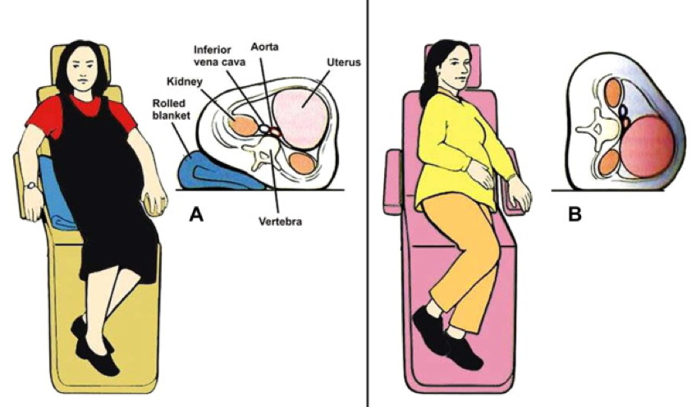
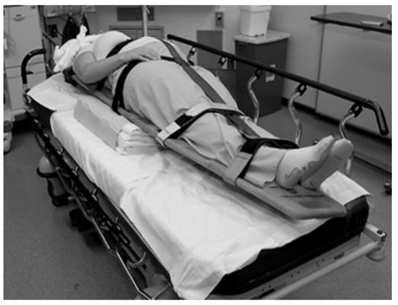

Left Uterine Displacement

Slide 65

Everything OB Simulations: 20 min stations
Vaginal Delivery & Prolapsed Cord
Postpartum Hemorrhage
Vaginal Breech Delivery
Shoulder Dystocia
McRoberts & Suprapubic Pressure
Posterior Arm Delivery
Normal Newborn Care & Neonatal Resuscitation
Full Term / Preterm
Image from https://site.pishposhbaby.com/blog/2013/09/02/labor-day-pun-intended/
Always follow local EMS protocols!

Slide 66
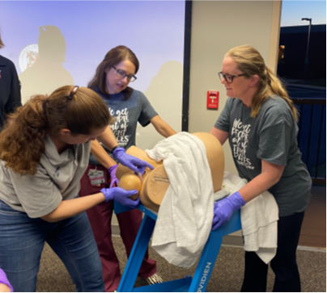
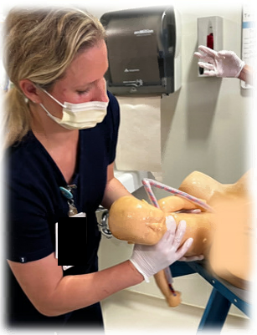
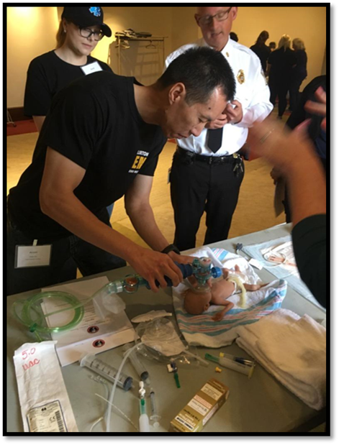
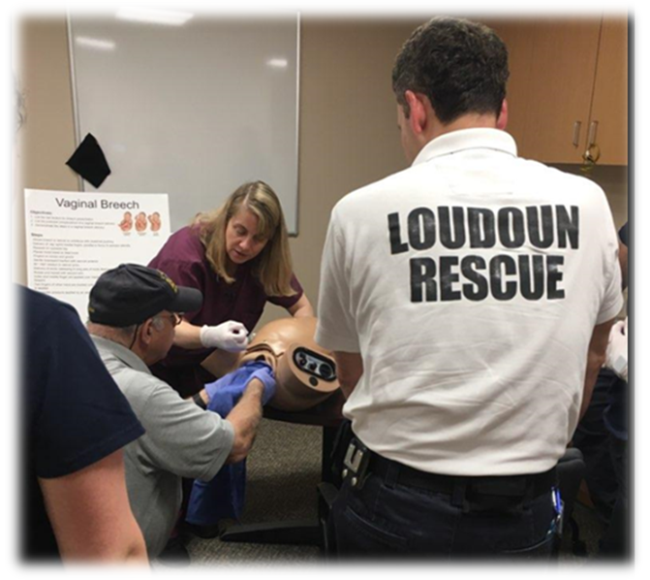
Simulations- Use Their Equipment

Slide 67
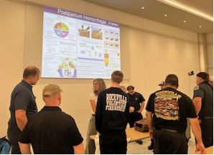
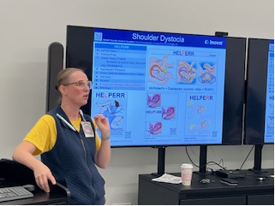
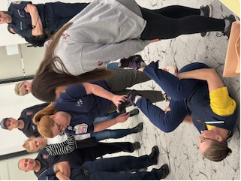
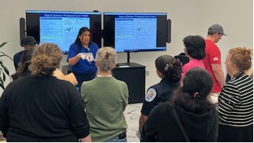
Video links
QR Codes
Follow their protocols

Slide 68


Slide 69
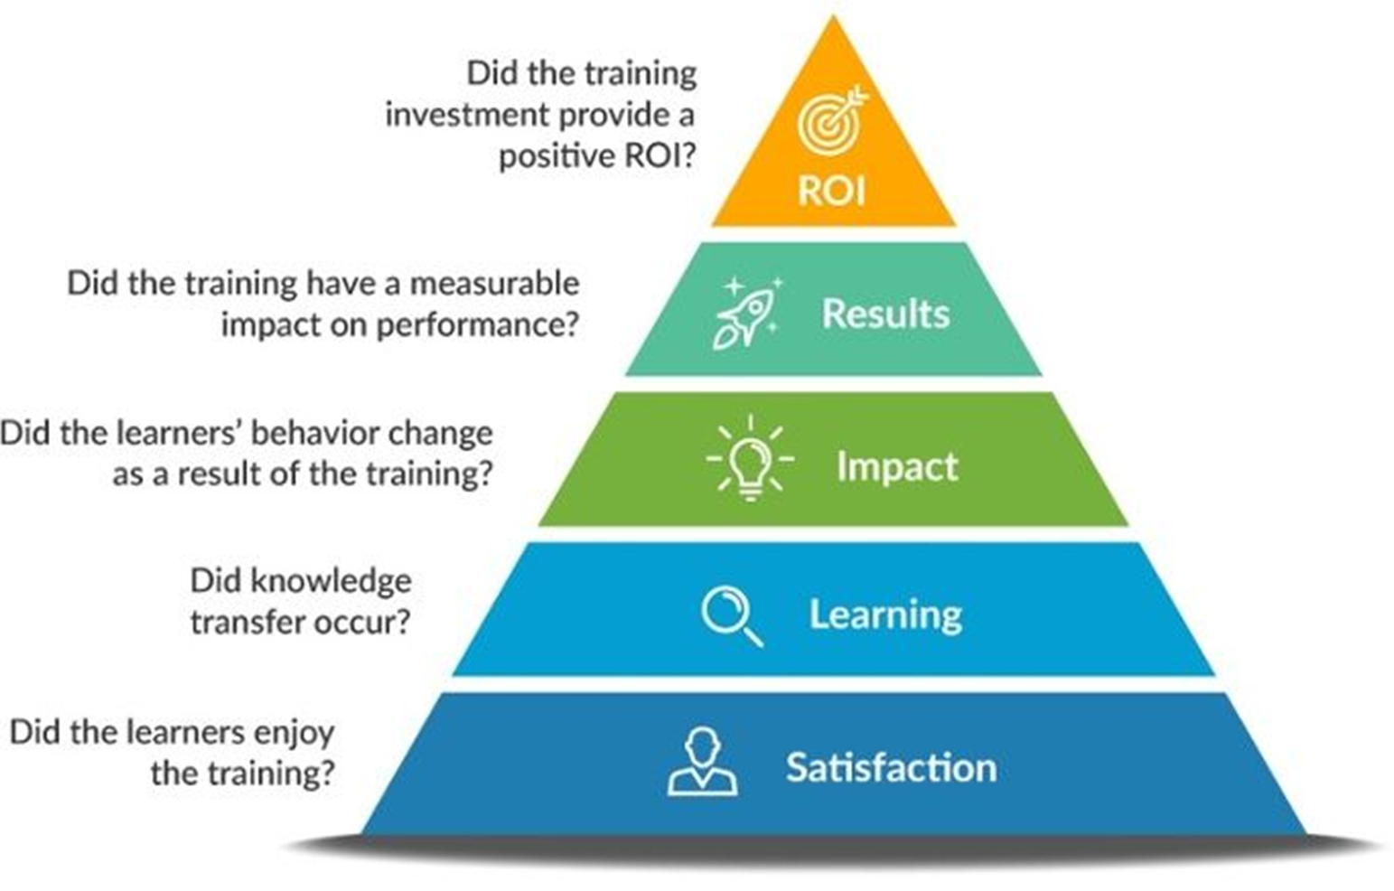
The Kirkpatrick Model

Slide 70
Satisfaction
“Outstanding! Motivated instructors, great information. I leave here a better man!”
“One of the best continuing ed classes I’ve attended! Not just the same old outdated info they teach us in EMS Class!”
“Very good info and great group of nurses and Dr’s. This should be part of ALL EMS training.”
“I recommend having this course again! I would highly encourage my crew members to attend.”
Satisfaction:
Did the learners enjoy the training?

Slide 71
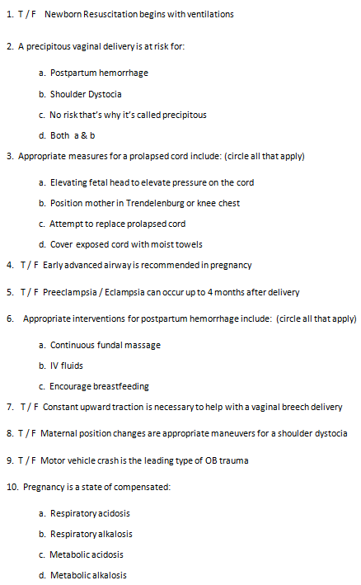
Learning
Learning:
Did knowledge transfer occur?

Slide 72
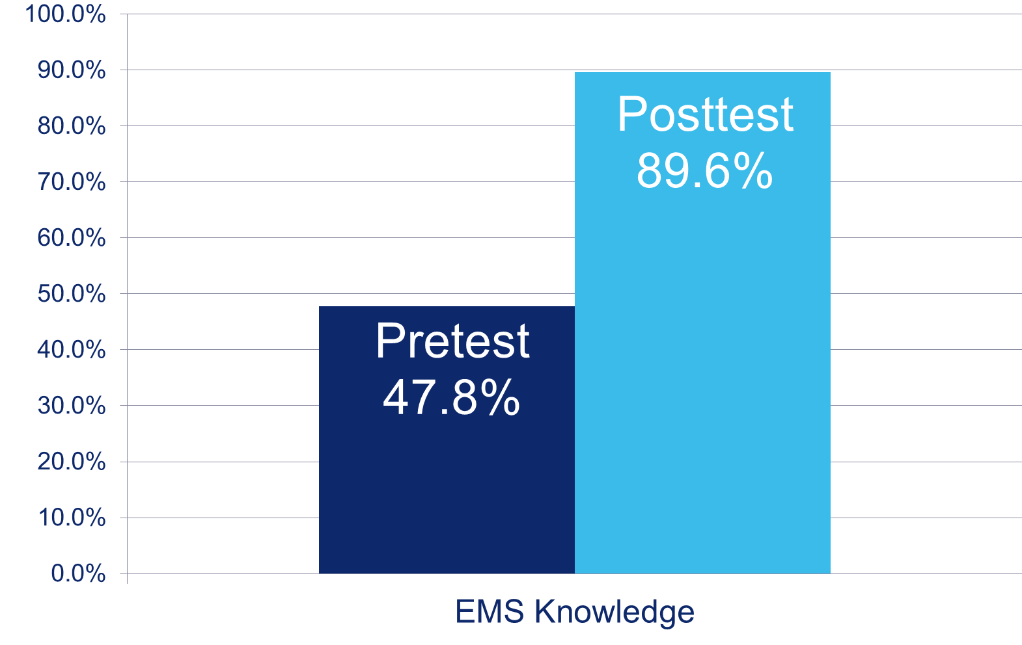
EMS Knowledge

Slide 73

Impact
Impact:
Did the learners behavior change as a result of the training?
Statistically significant improvements in CONFIDENCE
Notes:
Practice change- encourage pregnant patient s/p MVC to call OB and be seen

Slide 74
Results
Results: Did the training have a measurable impact on performance?
33 week abruption
Eclamptic seizure
Retained placenta
24 week delivery

Slide 75
Return on Investment
Enhanced Interprofessional Teamwork / Collaboration
Structured Debriefing Culture
Informal: After every EMS-to-hospital transfer
Formal: Following OB / Neonatal complications
Influenced EMS policies & equipment updates
Curriculum integration across EMS levels & roles
Paramedic & Advanced EMT Curriculum
ROI:
Did the training investment provide a positive ROI

Slide 76
References
AWHONN: Association of Women’s Health Obstetric and Neonatal Nursing
American Heart Association Advanced Cardiac Life Support Course (2020)
ACLS-OB (2015)
NRP: Neonatal Resuscitation Provider (2020)
Barss, V. (2019). Precipitous birth not occurring on a labor and delivery unit. UpToDate. www.uptodate.com. Retrieved September 26, 2019.
Blackburn, S.T. (2014). Physiologic changes of pregnancy. In K.R. Simpson and P.A. Creehan (eds). AWHONN’s perinatal nursing, 4th edition (pp.71-88). Washington, DC: Lippincott, Williams and Wilkins
Bush, M., Eddleman, K., Belogolovkin, V. (2019). Umbilical cord prolapse. UpToDate. www.uptodate.com. Retrieved September 26, 2019.
Hofmeyr., G. (2019). Delivery of the singleton fetus in breech presentation. UpToDate. www.uptodate.com. Retrieved September 26, 2019.
Peterkin, V., Robinson, J., Marko, E. (2020). The impacts of obstetrical simulation training for emergency medical service providers [40G].Obstetrics and Gynecology (New York. 1953), 135 Suppl 1(S 1), 81S–81S. https://doi.org/10.1097/01.AOG.0000664980.32947.4d
Robinson. (2021). Obstetrical and neonatal training for emergency medical services providers. Journal of Obstetric, Gynecologic, and NeonatalNursing, 50(5), S8–S9. https://doi.org/10.1016/j.jogn.2021.08.008
Rodis, J. (2019). Shoulder Dystocia: Intrapartum diagnosis, management, and outcome. UpToDate. www.uptodate.com Retrieved September 26, 2019.
Troiano, N., Witcher, P., Baird, S. (2019). Guidelines for the Care of the Obstetric Trauma Patient. Association of Women’s Health Obstetric and Neonatal Nursing. High Risk and Critical Care: Obstetrics, 4th Edition. Lippincott Williams & Wilkins

Slide 77


Thank you! Jaimee.Robinson@inova.org

Slide 78
CE Requirements Reminder
Certificates will be granted to participants who:
Attended 60 minutes of session as recorded by Zoom
Completed the evaluation following today’s session

Slide 79
Audience Q&A
Please ask your questions in the Q&A feature.
If you are here for CE Credit, please remain in the meeting to complete the required evaluation.

Slide 80


Evaluation
Please note the name, email and/or phone number associated with your zoom account as this will be entered in the evaluation to confirm your attendance
Please follow the link at the end of this session to complete the evaluation.
This is REQUIRED for CE credit.
CE Certificate will be sent to your email in 1-2 weeks

Slide 81
Thank you!
Any questions about this webinar or the series can be sent to AIM@acog.org
The recording will be emailed to all attendees once ready
AIM will also post the recording on our website, saferbirth.org
Remember to register for upcoming webinars!

