Slide 1
How to Use this Template
This template is intended to help AIM participating entities create a visually engaging 1-pager of their AIM impact statement.
Once you have finalized your impact statement, you can copy & paste the text into this template for use on your website, newsletter, or in communications with staff and external stakeholders. There are examples for a standard impact statement and a preliminary impact statement.
Please refer to the 2026 AIM Impact Statement Guide for instructions for developing impact statements.
For AIM patient safety bundle graphics and guidance around their use, please see the AIM Promotional Toolkit.
If you need more space for each section, you can adjust the text boxes in the Slide Master under the View menu.
Once content is complete, download the slide as a PDF either through File > Save As or through the Acrobat “Create a PDF” extension.

Slide 2
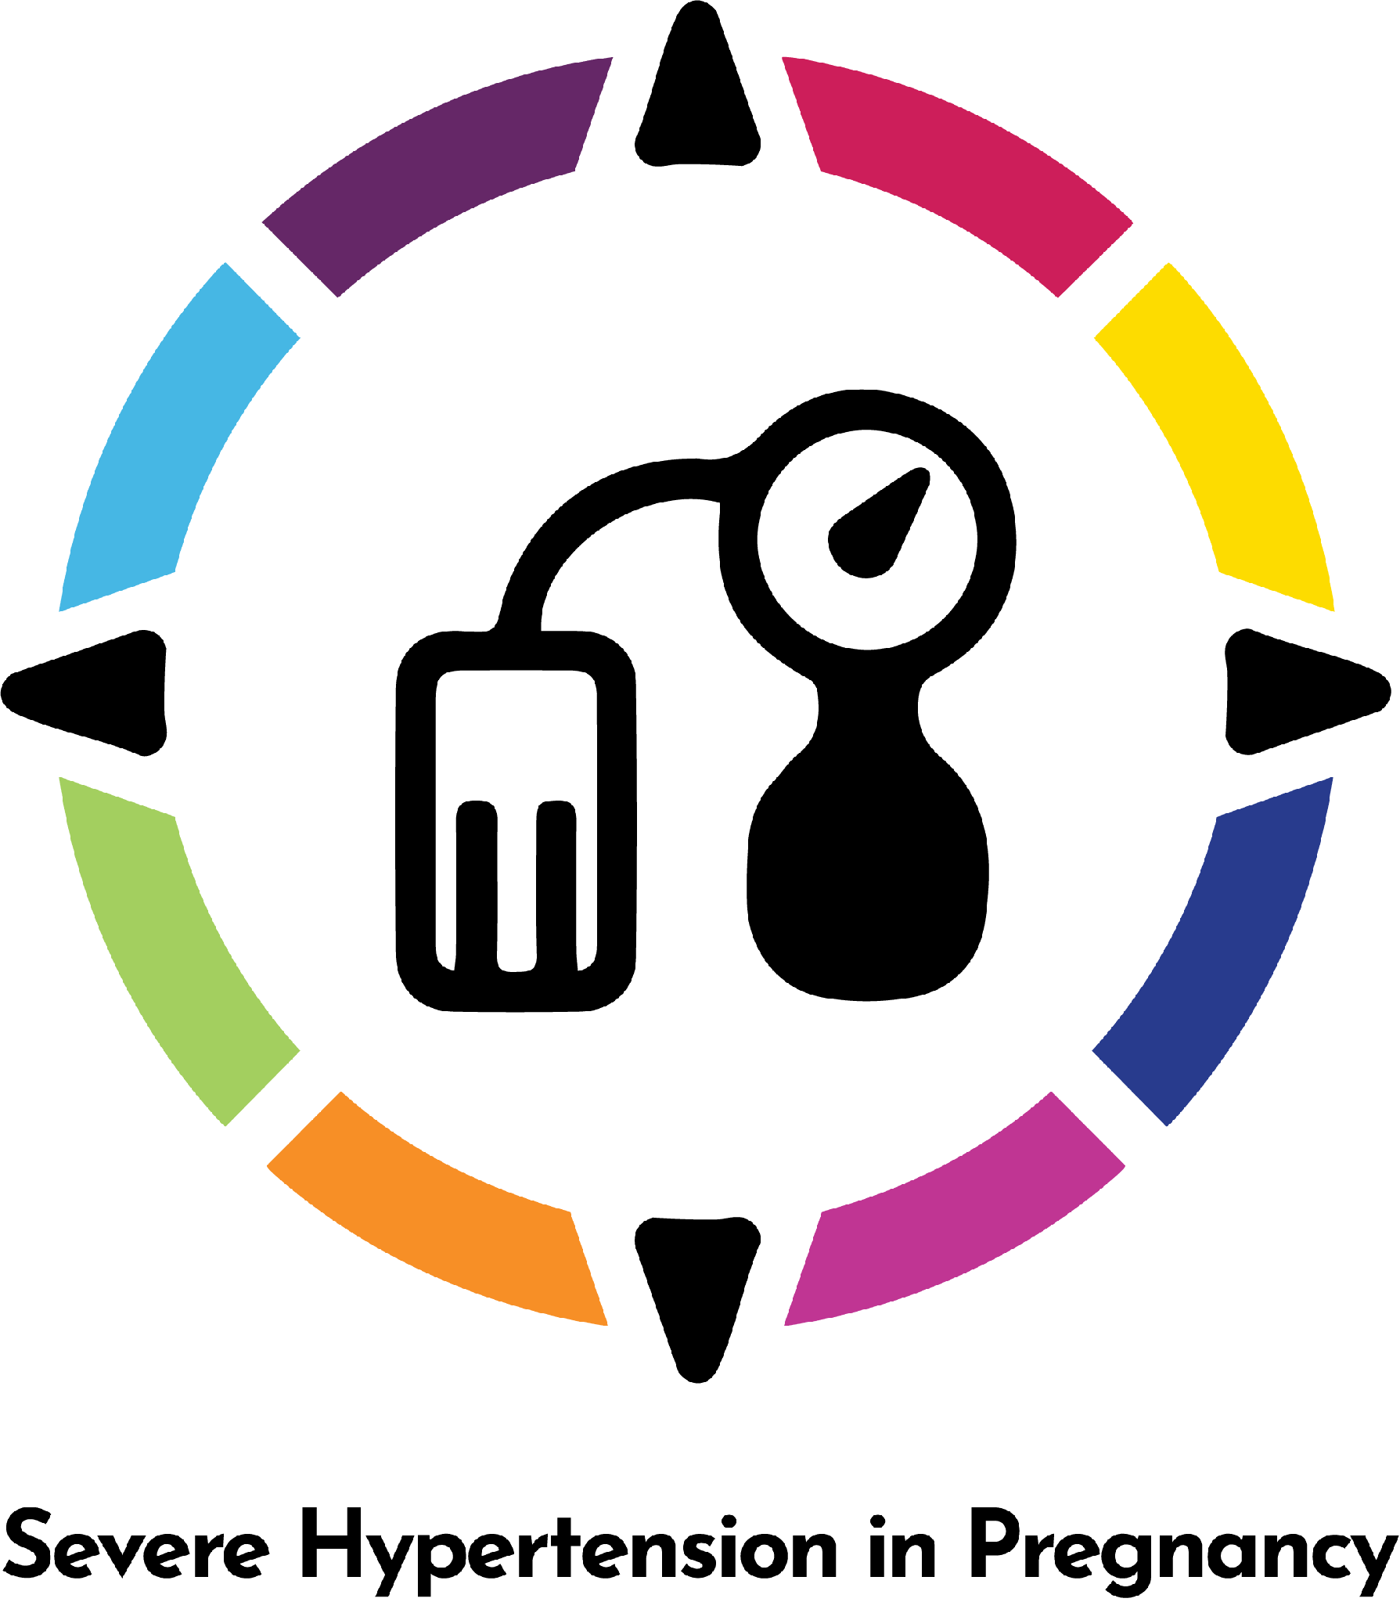

EXAMPLE: STANDARD
AIM Impact Statement
State/Jurisdiction: ABC
Patient Safety Bundle logo
State ABC surveillance data showed that the rate of severe hypertension during pregnancy across the state increased by 25.0%, from 2.0% to 2.5% between 2019 and 2022.
The Problem Statement and Intervention make up Block 1 of your impact statement.
To address this trend, the State Perinatal Quality Collaborative began implementation of the AIM Severe Hypertension in Pregnancy Patient Safety Bundle in July 2023 across 24 of the state's 45 birthing facilities (53.3%).
Progress should include Block 2 & 3 of your impact statement, reported as relative percent change.
29.5% increase
Timely treatment of persistent severe hypertension among participating facilities increased by 29.5%, from 57.7% to 74.7% between the 2023 fourth quarter baseline and 2025 first quarter follow-up reporting periods.
35% increase
During this same timeframe, postpartum follow-up scheduling at these facilities increased by 35.0%, from 60.0% to 81.0%
20% decrease
Severe maternal morbidity (excluding blood transfusions alone) among patients with hypertensive disorders at participating facilities decreased by 20.0%, from 9.5% in 2023 to 7.6% in 2025.
Looking Ahead should include any details about future implementation and sustainability.
The collaborative continues to support participating facilities through coaching, education, and sustainability activities.
Participating entity logo

Slide 3
EXAMPLE: PRELIMINARY
AIM Impact Statement
State/Jurisdiction: ABC
Patient Safety Bundle logo
State ABC surveillance data showed that the rate of severe hypertension during pregnancy across the state increased by 25.0%, from 2.0% to 2.5% between 2019 and 2022.
The Problem Statement and Intervention make up Block 1 of your impact statement.
To address this trend, the State Perinatal Quality Collaborative began early onboarding activities in June 2026 for the upcoming launch of the AIM Severe Hypertension in Pregnancy Patient Safety Bundle, with a projected participation of 30 of the state's 45 birthing facilities (66.7%).
Progress should include Block 2 & 3 of your impact statement, reported as relative percent change.
Initial readiness assessments show a baseline where only 15.0% of these projected facilities currently have standardized severe hypertension treatment protocols in place.
Additionally, early tracking indicates that 40.0% of clinical staff at these hospitals have completed the introductory bundle training modules.
Looking Ahead should include any details about future implementation and sustainability.
Participating entity logo
Moving forward, the collaborative will focus immediate activities on completing facility onboarding and providing targeted technical assistance for early data extraction. The team plans to begin formal collection of Severe Maternal Morbidity (excluding blood transfusions alone) data in the first quarter of 2027 to establish a clear clinical outcome baseline.
Notes:
State ABC surveillance data showed that the rate of severe hypertension during pregnancy across the state increased by 25.0%, from 2.0% to 2.5% between 2019 and 2022. To address this trend, the State Perinatal Quality Collaborative began early onboarding activities in June 2026 for the upcoming launch of the AIM Severe Hypertension in Pregnancy Patient Safety Bundle, with a projected participation of 30 of the state's 45 birthing facilities (66.7%). Initial readiness assessments show a baseline where only 15.0% of these projected facilities currently have standardized severe hypertension treatment protocols in place. Additionally, early tracking indicates that 40.0% of clinical staff at these hospitals have completed the introductory bundle training modules. Moving forward, the collaborative will focus immediate activities on completing facility onboarding and providing targeted technical assistance for early data extraction. The team plans to begin formal collection of Severe Maternal Morbidity (excluding blood transfusions alone) data in the first quarter of 2027 to establish a clear clinical outcome baseline.

Slide 4
AIM Impact Statement Template Page
XX% increase
XX% increase

