Slide 1


Implementing the AIM PMHC Bundle in Outpatient Setting
Perinatal Mental Health: Treatment and Support of the Mother-Baby Dyad
October 13, 2026

Slide 2


TECHNICAL ASSISTANCE CENTER
The Alliance for Innovation on Maternal Health (AIM) is a quality improvement initiative to support best practices that make birth safer, improve maternal health outcomes, and save lives.
The AIM TA Center is supported by a cooperative agreement (Award Number 7 UC4MC55412‐01‐00) with the Health Resources and Services Administration (HRSA) of the U.S. Department of Health and Human Services (HHS). The contents are those of the authors. They may not reflect the policies of HRSA, HHS, or the U.S. Government.

Slide 3



AIM TA Center Team
Cora Kakalec
Program
Coordinator, AIM TA
Center,
JSI Research &
Training Institute, Inc.
Meg Sheahan MSN,
CNM, MPH
TA Specialist, AIM TA Center,
JSI Research & Training Institute, Inc.
Vira David-Rivera, MA
TA Specialist, AIM TA Center,
JSI Research & Training Institute, Inc.

Slide 4


Policy Center for Maternal Mental Health
Joy Burkhard, MBA
Executive Director & CEO

Slide 5
Perinatal Mental Health Conditions in the Outpatient Setting Community of Learning
What We are Not Covering in our 6-session CoL:
Substance Use Disorder
Though we acknowledge implementing these bundles together
in the outpatient setting could be advantageous.
This is not a clinical training
We will share resources for comprehensive training programs for clinicians.
Notes:
https://policycentermmh.org/certificate-training/

Slide 6
Perinatal Mental Health Conditions in the Outpatient Setting Community of Learning
Session 1: Aug 11, 2pm ET The Maternal Mental Health Crisis and Why Pregnancy is the Intervention Window
Session 2: Sept 8, 2pm ET Implementing the AIM PMHC Bundle in Outpatient Obstetric Clinics -Screening and Diagnosis
Session 3: Oct 13, 2pm ET Treatment, and Support for the Mother - Infant Dyad
Session 4: Nov 10, 2pm ET Maternity Care Payment Reform and Partnering with Health Plans
Session 5: Dec 8, 2pm ET Quality Measurement, HEDIS, and Medicaid Accountability
Session 6: Jan 12, 2pm ET State Policy, Rural Access, and Scaling Change
Notes:
Policy Center’s Maternal Suicide Prevention Webinar: https://www.youtube.com/watch?si=9JATCrUhecnnWa4y&v=LxP9xFEpmY8&feature=youtu.be
https://policycentermmh.org/past-webinars/

Slide 7

Experience In Real Life
Cassie’s Story:
Getting Treatment from her OB Clinic
Notes:
(2023 FORUM Welcome & a Mother’s Story): https://www.youtube.com/watch?v=HjxQ5x4qAdc&list=PLvPN5cp8pnJ7lFcdOCkeDDu-RQM_f5zag&index=4

Slide 8


Guest Speakers
Sarah Mallard Wakefield, MD
Medical Director, Texas PeriPAN
Chair of Psychiatry,
Texas Tech University Health Science Center
Constance Guille, MD, MSCR
Director and Professor, Women’s Reproductive Behavioral Health Division
Medical University of South Carolina

Slide 9

Today’s Learning Objectives
By the end of this session
participants will be able to:
Describe key components of the AIM Perinatal Mental Health Conditions Bundle that address treatment and support of the mother-baby dyad.
Describe a range of maternal mental health treatments and interventions, including talk therapy, pharmacologic treatments, and emerging treatment options.
Explain resources available to support obstetric providers, including telepsychiatry consultation access programs, as well as a range of treatment options.

Slide 10

Pause to Reflect
What stood out to you about the care Cassie received?

Slide 11

The AIM Perinatal Mental Health Conditions Patient Safety Bundle

Slide 12

Build the Response
Integrate Mental Health Care Across the Perinatal Period
Preconception through postpartum
Pharmacotherapy when indicated
Feasible response protocol
Defined roles and escalation pathways
Implementation in practice
Embed response steps into OB/midwifery workflows and the EHR
Identify who responds to a positive screen
Map local treatment, referral, and crisis resources
Establish mental health consultation pathways
Know who responds, what they do, and where the patient goes next.

Slide 13
Patient-Centered, Evidence-Based Response (1 of 2)
Consider:
Condition and severity
Patient values and needs
Strengths and supports
Cultural context
Available resources
Treatment and support may include:
Psychotherapy
Pharmacotherapy
Other evidence-based interventions
Community and peer supports

Slide 14
Patient-Centered, Evidence-Based Response (2 of 2)
Implementation in practice
Standardized assessment and treatment pathways
Shared decision-making
Current referral/resource list
Telehealth when appropriate

Slide 15
Standardize the Safety Response
When Immediate Action Is Needed: Suicidal ideation | Risk of harm | Psychosis
Implementation in practice
Standardized suicide risk assessment
Clear escalation criteria
Defined roles and responsibilities
Crisis and emergency pathways
Safety planning and follow-up
Staff training and simulation
High-risk findings should trigger a reliable, standardized response—not an improvised one.

Slide 16

Connection to Care
Coordinate Treatment and Follow-Up Across OB/Midwifery, Mental Health, Primary Care, and Community Partners
Implementation in practice
Warm handoffs
Closed-loop referrals
Provider-to-provider communication
Telepsychiatry consultation
Assigned responsibility for follow-up
Reassessment of symptoms and treatment response
Ask: Did the patient actually connect with care?
A referral is a process step. Connection to appropriate care is the goal.

Slide 17
Use PMHC Data to Drive Improvement
Use PMHC data to understand where the system is working—and where changes are needed.
Measure | Analyze | Use
PMHC prevalence: How often are PMHCs identified among people during the birth admission? SMM among people with PMHC: How often does SMM occur among those with a PMHC diagnosis? Disaggregate: Examine findings by demographics and payor QI measures: Track relevant process and structure measures to understand implementation | Trends over time Variation across facilities Gaps in implementation and care Differences across patient populations | Identify opportunities for improvement Target QI interventions Monitor whether changes are working Sustain and spread effective practices

Slide 18
Treatment Within the Pathway
01
02
03
04
05
build_circle
tune
health_and_
safety
hub
insights
Build the response
Establish foundational protocols, resources, and clinical workflows.
Tailor treatment
Individualize care options using shared decision-making.
Respond to risk
Promptly address severe symptoms, crisis, or escalating needs.
Coordinate care
Align behavioral health, OB care, and support networks.
Measure & improve
Track outcomes data to refine and sustain system impact.

Slide 19

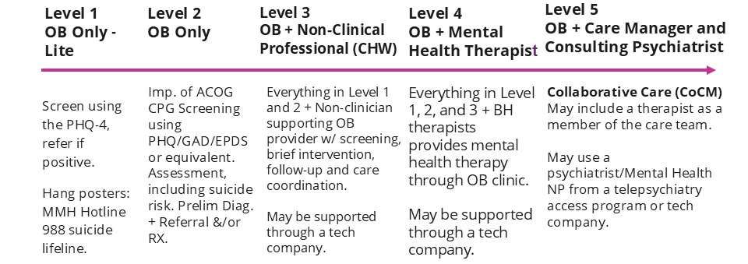
Integrating Behavioral Health into Obstetrics, a Continuum
Implementation of American College of Obstetricians and Gynecologists (ACOG) Perinatal Mental Health Clinical Practice Guidelines
Notes:
https://mchb.hrsa.gov/national-maternal-mental-health-hotline/order
https://www.samhsa.gov/resource/988/988-suicide-crisis-lifeline-poster

Slide 20
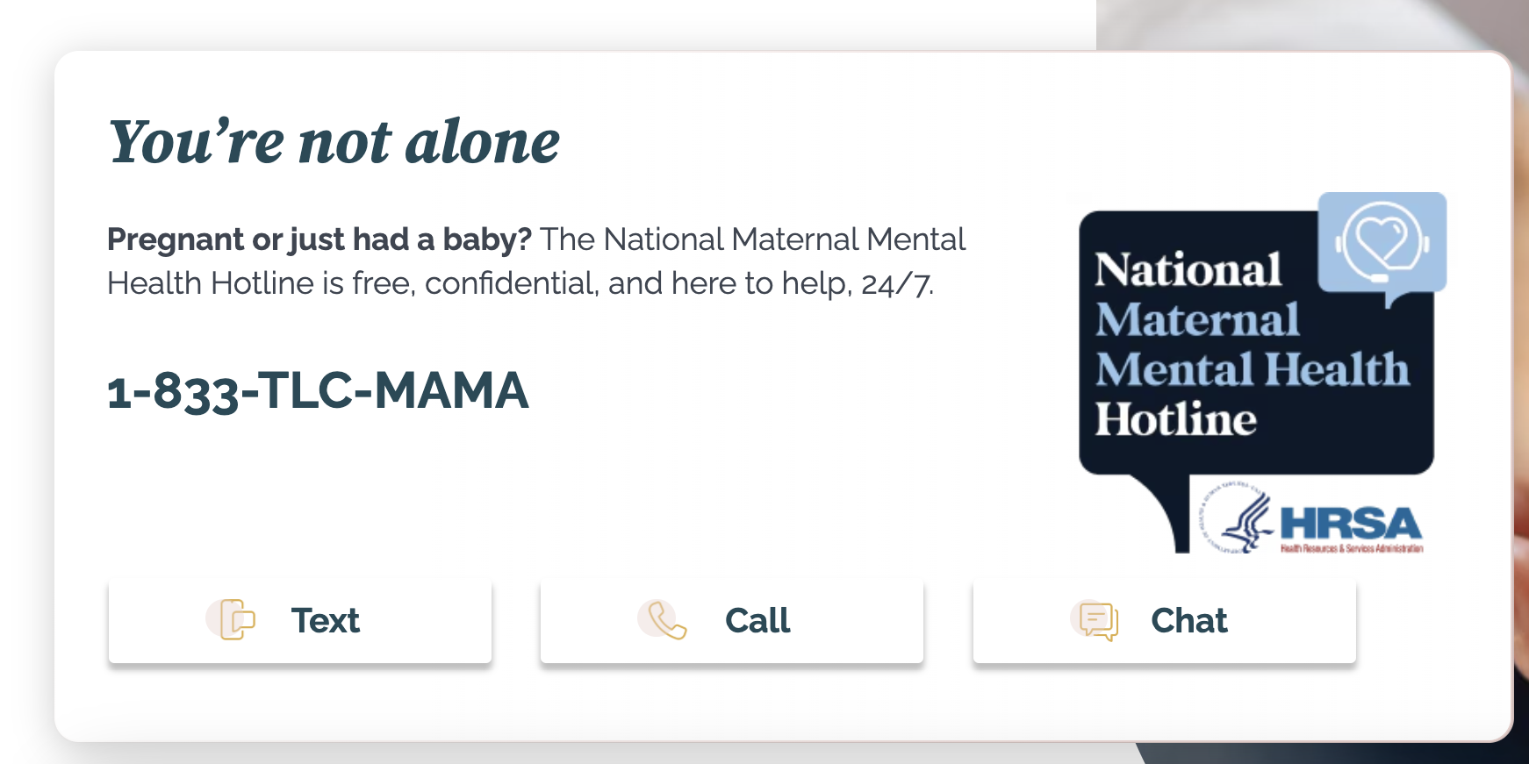
National Maternal Health Hotline 1-833-TLC-MAMA

Slide 21
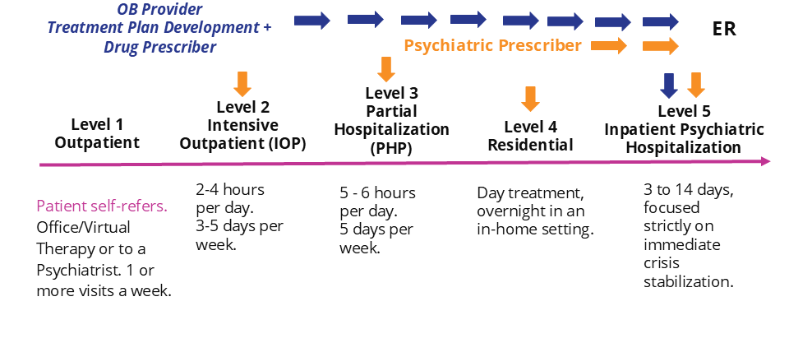
Mental Health Levels of Care
Levels of care define outpatient and inpatient levels of care.

Slide 22
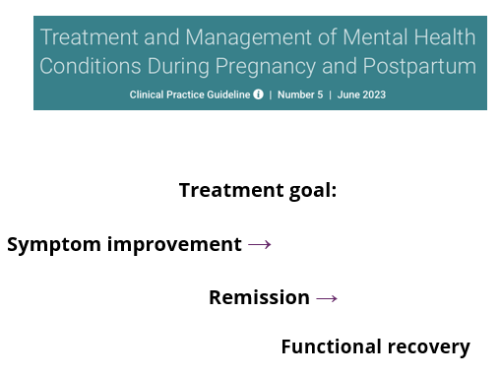
ACOG Clinical Practice Guideline No. 5: Treatment and Management
Treat the condition — more than simply monitoring the score
Treatment options include:
Psychotherapy
Pharmacotherapy
Combination therapy
Psychiatric consultation/referral when indicated
Coordination with behavioral health and other clinicians
ACOG emphasizes shared decision-making.
Consider:
Severity of illness
Prior treatment response
Risks of untreated illness
Medication risks/benefits
Pregnancy/lactation considerations
Patient preferences and values

Slide 23
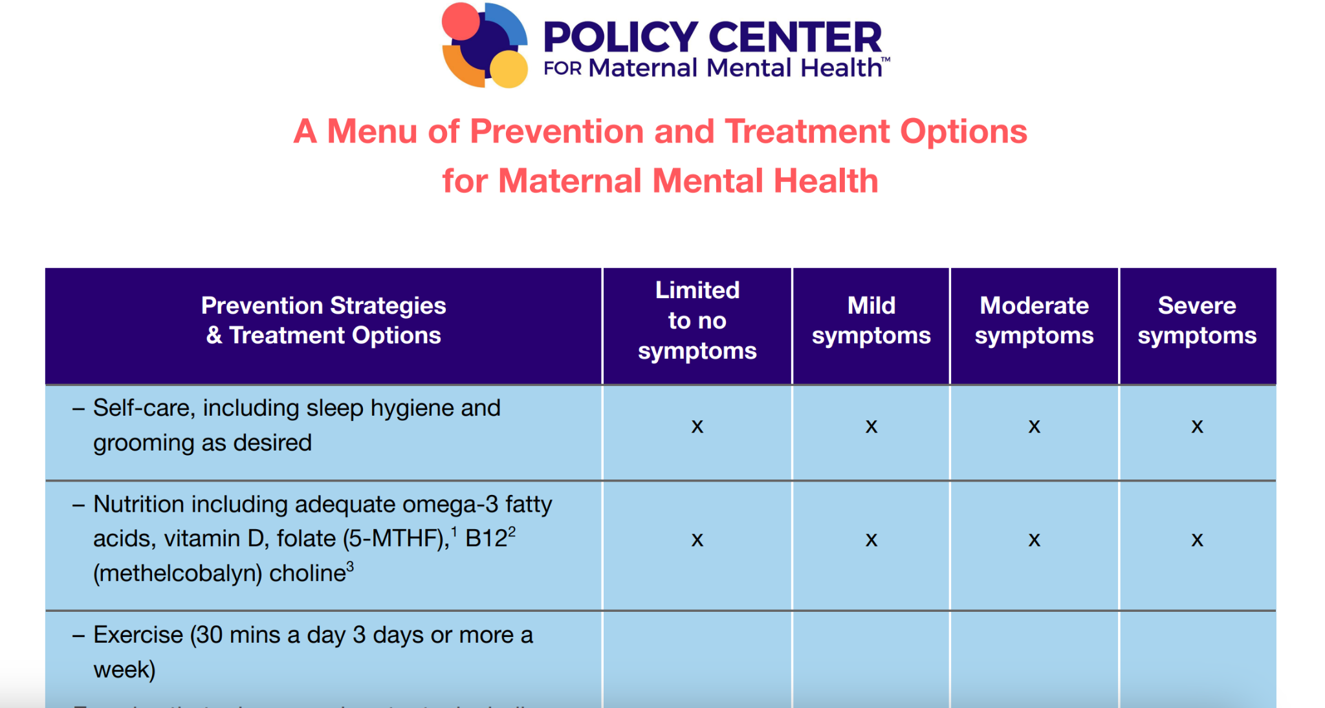
Menu of Treatment Options
Open the Link and Explore Treatments and Interventions Now
Recommended Citation: Policy Center for Maternal Mental Health. (2026, September). A Menu of Prevention and Treatment Options for Maternal Mental Health. https://policycentermmh.org/menu-of-prevention-and-treatment-options-for-maternal-mental-health/
Notes:
https://policycentermmh.org/menu-of-prevention-and-treatment-options-for-maternal-mental-health/

Slide 24
Psych Consult Programs
Many states offer a live telepsychiatry consultation program for OB providers to support them in preliminary diagnosis, treatment plan development, prescription treatments, and referral to psychiatry for complex patients.
Does your state have a consultation program?
Policycentermmh.org/2026-perinatal-psychiatry-consultation-program-list
Postpartum Support International offers non-live service to OB providers in states without consult programs
https://postpartum.net/professionals/perinatal-psychiatric-consultation
Along with national mental health advocacy organizations, we are advocating for a national telepsychiatry program for primary care and OB providers in states where such programs do not exist.
Notes:
https://policycentermmh.org/2026-perinatal-psychiatry-consultation-program-list/
https://postpartum.net/professionals/perinatal-psychiatric-consultation/

Slide 25
Common Treatment Options
Psychotherapy (Individual therapy and group therapy):
Patients Self-Refer:
Such as: Cognitive Behavioral Therapy, Interpersonal Psychotherapy, Behavioral Activation*, Exposure Response Therapy (OCD), Dialectical Behavioral Therapy
*Can be provided through a trained non-clinical professional
Pharmacotherapy:
Effective dosing of selective serotonin reuptake inhibitors (SSRIs) is recommended, specifically sertraline or escitalopram
Serotonin-norepinephrine reuptake inhibitors (SNRIs)
Zuranolone - fast-acting PPD specific treatment (generally requires insurer prior authorization to confirm patient is postpartum - may be approved more quickly w/AI)

Slide 26
When to Refer/Escalate
Specialized Care from Reproductive Psychiatry
Suspected or Diagnosed Bipolar Disorder (use mental health history form early in pregnancy to identify possible Bipolar Disorder early):
  requires comprehensive assessment (SCID-5 or Mini)
  and specialized management, often involving mood stabilizers
Treatment Resistant Major Depressive Disorder
Suspected Personality Disorders (Referral to Psychologist and/or psychiatrist)
Postpartum Psychosis (not to be confused with OCD intrusive thoughts): Requires emergency care

Slide 27
Transcranial Magnetic Stimulation (TMS)
TMS is an emerging FDA Approved Treatment for:
Depression
OCD
Generally 4-6 weeks with sessions occurring 5 days a week. Each session takes 20-30 mins. Patient can receive treatment in an office, or in the home.
Generally prescribed by: a psychiatrist or psychiatric nurse practitioner but may also be prescribed by an OB/Gyn or women’s health nurse practitioner for example. May require insurer prior authorization.
How it works: Patient is in a reclined position, and wears a cap over her hair where the magnetic coil is placed by the technician. A magnetic field passes harmlessly into the brain and creates tiny electrical currents. These currents activate underactive neurons (nerve cells) in regions like the prefrontal cortex, which controls mood.

Slide 28
Postpartum Psychosis Early Warning Signs
Early signs of postpartum psychosis usually start suddenly within the first two weeks of birth:
Severe insomnia (mania)
Extreme restlessness,
Rapid mood changes (which can also include depression)
As the condition escalates, more distinct psychotic features appear:
Delusions: False beliefs that are out of touch with reality, often centered on the baby or spiritual forces.
Hallucinations: Seeing, hearing, smelling, or feeling things that are not there
Paranoia / Loss of insight: The mother typically has no awareness that her thoughts and behaviors are unusual or concerning

Slide 29
What is Dyadic Care?
Caring for the mother-baby together
Dyadic care refers to serving both parents or caregivers and child together as a dyad (“a pair”)
It can be preventive and educational
-or-
A form of treatment that targets family well-being as a mechanism to support healthy child development
Examples:
Breastfeeding support
Support groups for Maternal Mental Health w/ baby
Parenting Education
  Interactive play
  Reading to baby
  Infant massage
  Providing parents with tools such as soothing infants to reduce crying

Slide 30
Menu of Treatment Options​
Consider adding to a tablet or printing, laminating to review with patients
Recommended Citation: Policy Center for Maternal Mental Health. (2026, September). A Menu of Prevention and Treatment Options for Maternal Mental Health. https://policycentermmh.org/menu-of-prevention-and-treatment-options-for-maternal-mental-health/
Notes:
https://policycentermmh.org/menu-of-prevention-and-treatment-options-for-maternal-mental-health/

Slide 31
Pause to Reflect ​
What is new or surprising?

Slide 32

Q&A

Slide 33
Perinatal Mental Health Conditions in the Outpatient Setting Community of Learning​
Session 1: Aug 11, 2pm ET The Maternal Mental Health Crisis and Why Pregnancy is the Intervention Window
Session 2: Sept 8, 2pm ET Implementing the AIM PMHC Bundle in Outpatient Obstetric Clinics -Screening and Diagnosis
Session 3: Oct 13, 2pm ET Treatment, and Support for the Mother - Infant Dyad
Session 4: Nov 10, 2pm ET Maternity Care Payment Reform and Partnering with Health Plans
Session 5: Dec 8, 2pm ET Quality Measurement, HEDIS, and Medicaid Accountability
Session 6: Jan 12, 2pm ET State Policy, Rural Access, and Scaling Change

Slide 34
Thank you!
AIM Email: info@saferbirth.org
Joy Burkhard, MBA
info@policycentermmh.org
Visit saferbirth.org
This webinar was developed with funding from the Health Resource and Services Administration (HRSA) of the U.S. Department of Health and Human Services (HHS). The contents are those of the author(s) and do not necessarily represent the official views of, nor endorsement, by the current cooperative agreement holder, HRSA, HHS, or the U.S. Government.

